Slide 1



Bench and Shaping Planes.
Lecturer: James Rix

Slide 2
Aims & Objectives.
Aims:
Know how to maintain carpentry & joinery hand tools
Objectives:
Identify types of Bench Planes
Identify Types of Shaping Planes

Slide 3

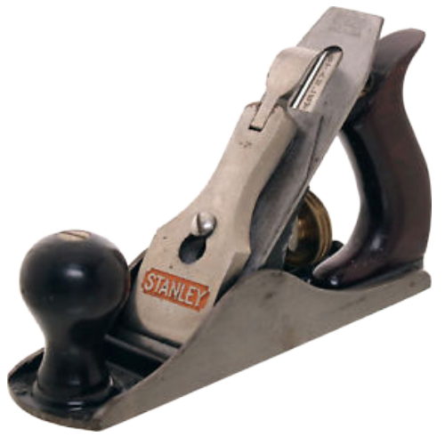
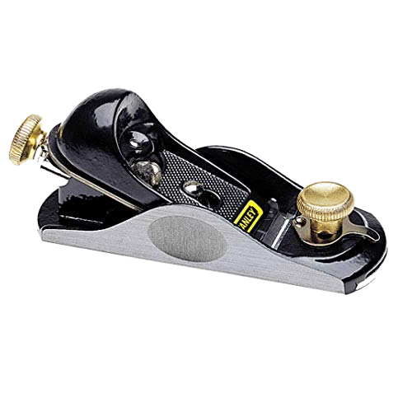
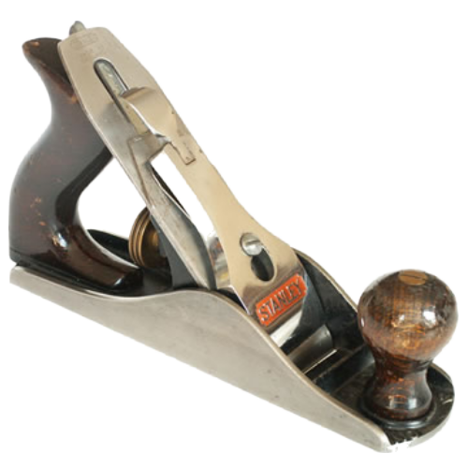
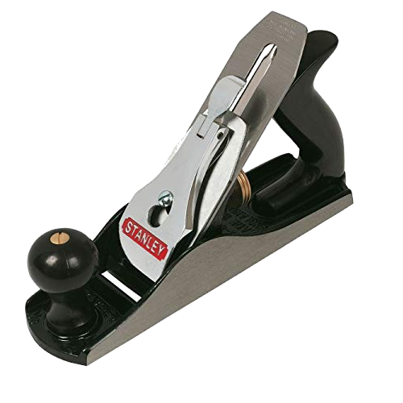
Bench & Shaping Planes.
Bench Planes 1.
No.4 Smoothing Plane
Block Plane
No.2 Smoothing Plane
No.3 Smoothing Plane

Slide 4
Bench Planes 1.
Block Plane.
Feed Adjuster
Cap Iron
A Block Plane is a small, handheld woodworking tool designed for fine trimming and smoothing tasks. It features a short body and a blade set at a low angle, making it ideal for cutting end grain and chamfering edges. Carpenters and joiners use block planes to refine joints, adjust doors, and tidy up small imperfections in timber surfaces. Its compact size allows for one‑handed control, giving precise results when shaping or finishing wood components.
Mouth
Sole
Adjustable Throat
Body

Slide 5
Bench Planes 1.
No.2 Smoothing Plane.
Iron
A No. 2 Smoothing Plane is a compact, fine‑finishing hand plane designed for producing exceptionally smooth surfaces on timber. Its smaller size makes it easy to control with one hand, allowing the user to remove thin shavings and refine surfaces with precision. This plane is commonly used for final passes on small components, trimming end grain, and smoothing areas where larger planes would feel cumbersome. Because of its tight mouth opening and finely adjustable blade, the No. 2 excels at leaving a clean, polished finish with minimal tear‑out, making it a favourite for detailed joinery and fine woodworking tasks.
Chip Breaker
Lever Cap
Handle
Mouth
Knob
Heel
Feed Adjuster
Plane Length:
Stanley No.2: 178mm
Record No.2: 184mm
Sole
Toe

Slide 6
Bench Planes 1.
No.3 Smoothing Plane.
Iron
A No. 3 Smoothing Plane is a small, finely tuned hand plane used for producing smooth, clean surfaces on timber. Slightly larger than a No. 2 but still compact, it offers excellent control for detailed finishing work, especially on narrower boards or components. Its finely adjustable blade allows the user to take thin, precise shavings, reducing tear‑out and leaving a polished surface ready for sanding or finishing. This plane is commonly used in joinery, cabinetry, and final preparation of timber where accuracy and surface quality matter.
Chip Breaker
Lever Cap
Handle
Heel
Knob
Feed Adjuster
Sole
Plane Length:
Stanley No.3: 210mm
Record No.3: 216mm
Mouth
Toe

Slide 7
Bench Planes 1.
No.4 Smoothing Plane.
Iron
Chip Breaker
A No. 4 Smoothing Plane is a versatile, mid‑sized finishing plane commonly used for bringing timber surfaces to a smooth, even finish. Larger than a No. 3 but still easy to control, it’s the standard choice for general smoothing work on boards, panels, and furniture components. Its finely adjustable blade allows the user to take thin, controlled shavings, reducing tear‑out and preparing the wood for sanding or final finishing. Because of its balance, weight, and reliability, the No. 4 is often considered the essential smoothing plane in most carpentry and joinery toolkits.
Lever Cap
Handle
Mouth
Knob
Heel
Feed Adjuster
Plane Length:
Stanley No.4: 245mm
Record No.4: 250mm
Sole
Toe

Slide 8
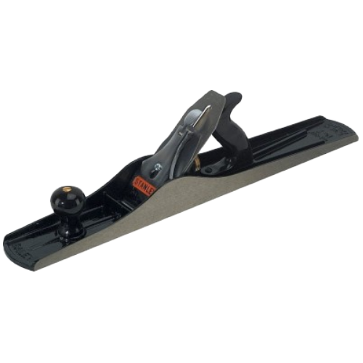
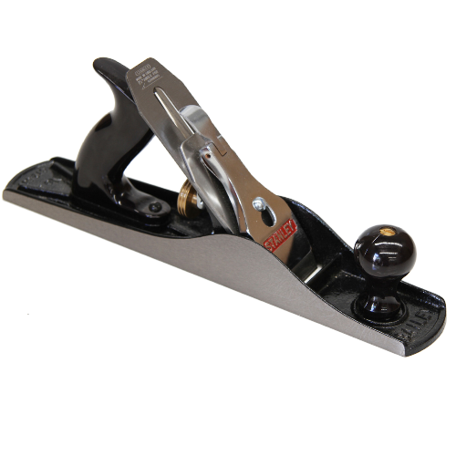
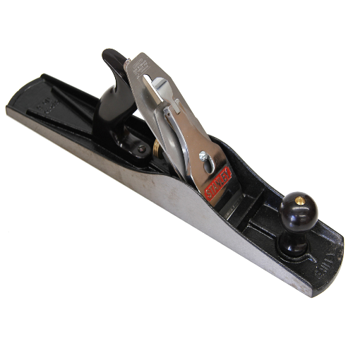
Bench & Shaping Planes.
Bench Planes 2.
No.7 Try Plane
No.5 Jack Plane
No.6 Fore Plane

Slide 9
Bench Planes 2.
No.5 Jack Plane.
Iron
A No. 5 Jack Plane is a medium‑sized, highly versatile bench plane used for general‑purpose woodworking. Often called the “workhorse” of the plane family, it’s long enough to straighten and level boards but still compact enough for smoothing and shaping tasks. Carpenters use the No. 5 for initial stock preparation, removing high spots, refining edges, and preparing timber before final smoothing. Its adjustable blade and comfortable handles make it suitable for a wide range of jobs, from rough shaping to controlled, accurate planing on site or in the workshop.
Chip Breaker
Lever Cap
Handle
Heel
Knob
Feed Adjuster
Sole
Plane Length:
Stanley No.5: 355mm
Record No.5: 355mm
Mouth
Toe

Slide 10
Bench Planes 2.
No.6 Fore Plane.
A No. 6 Fore Plane is a long, heavy bench plane designed for flattening and truing boards during the early stages of stock preparation. Its extended sole helps it ride over high and low spots, gradually bringing a surface into a straight, even plane. Woodworkers often use the No. 6 before a jointer or smoother, as it removes material efficiently while still offering good control. Because of its length and weight, it excels at preparing large panels, straightening edges, and creating flat reference faces in both workshop and site‑based carpentry.
Iron
Chip Breaker
Handle
Lever Cap
Heel
Knob
Feed Adjuster
Sole
Plane Length:
Stanley No.6: 460mm
Record No.6: 458mm
Mouth
Toe

Slide 11
Bench Planes 2.
No.7 Try Plane.
Iron
Chip Breaker
A No. 7 Try Plane is a long, precision bench plane used for truing, flattening, and straightening timber over large surfaces. Its extended sole allows it to bridge high and low spots, creating flat, accurate reference faces and perfectly straight edges. Woodworkers rely on the No. 7 during the final stages of board preparation, especially when jointing edges for panel glue‑ups or producing long, straight surfaces. Because of its weight and length, it delivers stability and consistency, making it an essential tool for achieving true, square, and reliably flat timber in fine woodworking and joinery.
Lever Cap
Handle
Mouth
Heel
Knob
Feed Adjuster
Toe
Plane Length:
Stanley No.7: 560mm
Record No.7: 560mm
Sole

Slide 12
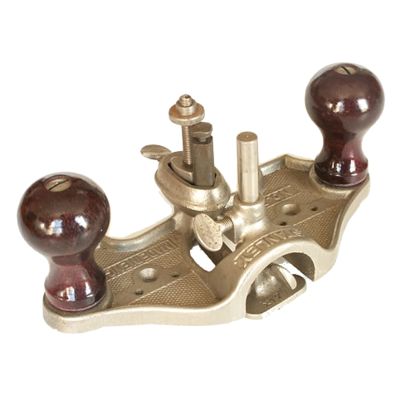
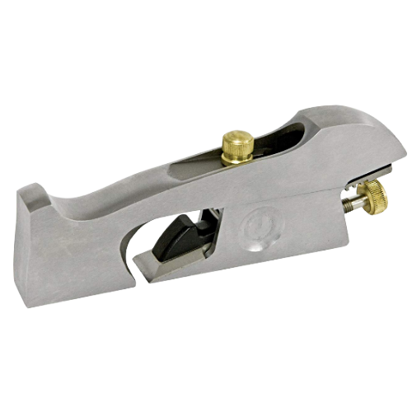
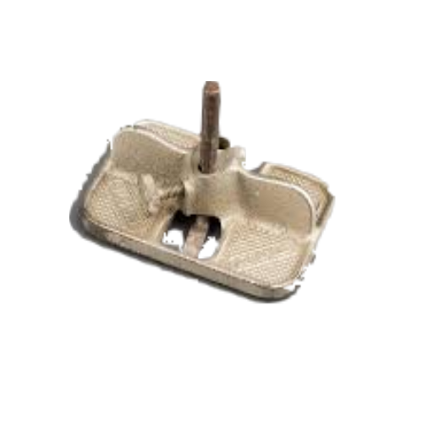
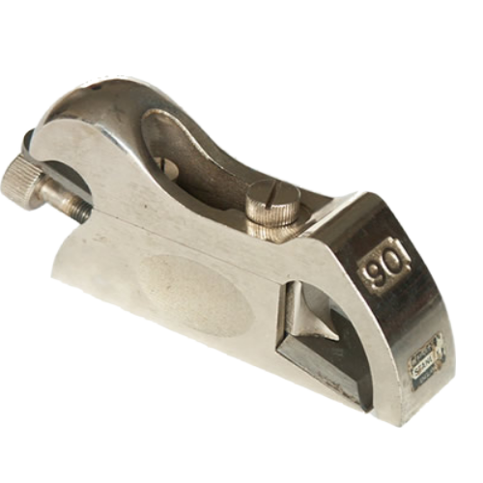
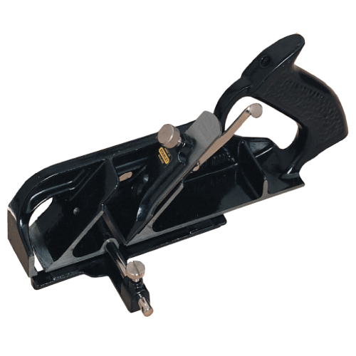
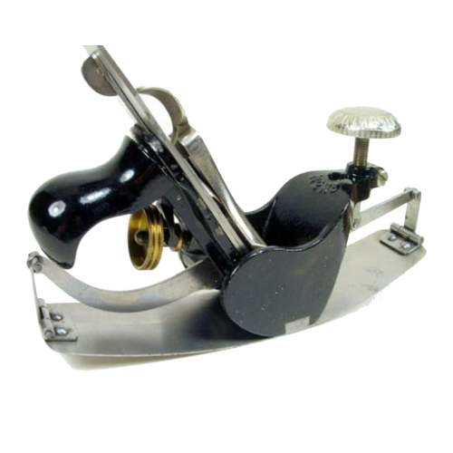
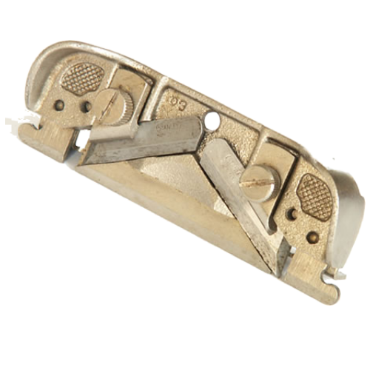
Bench & Shaping Planes.
Shaping Planes 1.
Router Plane
Shoulder Plane
Bullnose Plane
Mini Router Plane
Rebate Plane
Compass Plane
Side Rebate Plane

Slide 13
Shaping Planes 1.
Shoulder Plane.
A Shoulder Plane is a precision hand plane designed specifically for trimming and fitting joints, especially shoulders and cheeks of tenons, where accuracy is essential. Its blade spans the full width of the body, allowing it to cut right up to an inside corner—something standard planes can’t do. Woodworkers use shoulder planes to fine‑tune joinery, clean up rebates, adjust housings, and achieve tight, gap‑free fits. With its low‑angle blade and narrow profile, it excels at controlled, delicate cuts in both end grain and long grain, making it a key tool for high‑quality joinery work.
Blade Lock Screw
Toe
Lever Cap
Depth Adjuster
Heel
Blade
Mouth

Slide 14
Shaping Planes 1.
Bullnose Plane.
A Bullnose Plane is a small, specialised rebate plane designed for working right into corners and tight spaces where other planes cannot reach. Its very short nose allows the blade to sit extremely close to the front of the tool, making it ideal for trimming the ends of housings, cleaning up stopped rebates, refining tenon shoulders, and adjusting joints with precision. Because it excels at close‑quarters work and end‑grain trimming, the bullnose plane is a favourite for fine joinery and detailed fitting tasks where accuracy and control matter.
Blade Lock Screw
Depth Adjuster
Lever Cap
Toe
Heel
Blade
Mouth

Slide 15
Shaping Planes 1.
Router Plane.
Mini
A Router Plane is a precision hand tool used for cleaning, levelling, and controlling the depth of recesses in timber. Its flat sole and vertically mounted blade allow it to remove material evenly across a surface, making it ideal for refining housings, dados, tenon cheeks, and hinge recesses. Unlike chisels, which can dig in or leave uneven bottoms, a router plane ensures a consistent depth, helping joints fit accurately and cleanly. It’s especially valuable in fine joinery and restoration work where precise depth control is essential.
Depth Adjuster
Knob
Knob
Depth Stop
Blade

Slide 16
Shaping Planes 1.
Compass Plane.
A Compass Plane is a specialised hand plane designed for shaping curved surfaces, both concave and convex. It features an adjustable flexible sole that can be tightened or loosened to match the radius of the curve being worked on. This makes it ideal for tasks such as smoothing curved rails, arches, circular table edges, and other non‑flat timber components. Because it maintains consistent contact along a curve, the compass plane allows woodworkers to achieve smooth, accurate, and uniform shapes that would be difficult to produce with standard flat‑soled planes.
Lever Cap
Iron
Chip Breaker
Knob
Handle
Toe
Heel
Mouth
Feed Adjuster

Slide 17
Shaping Planes 1.
Rebate Plane.
Side Rebate Plane.
A Rebate Plane is a specialised hand plane designed for cutting rebates (rabbets)—the stepped, L‑shaped recesses often used in frame construction, door casings, and cabinet work. Its blade is set flush with the full width of the body, allowing it to cut right up to an edge without leaving a shoulder. This makes it ideal for widening, deepening, or cleaning up rebates with accuracy. Many rebate planes also include depth stops and side fences, giving the user precise control over the size and position of the cut, making them essential for traditional joinery and detailed timber fitting.
Iron
Lever Cap
Handle
Toe
Heel
Mouth
Fence

Slide 18
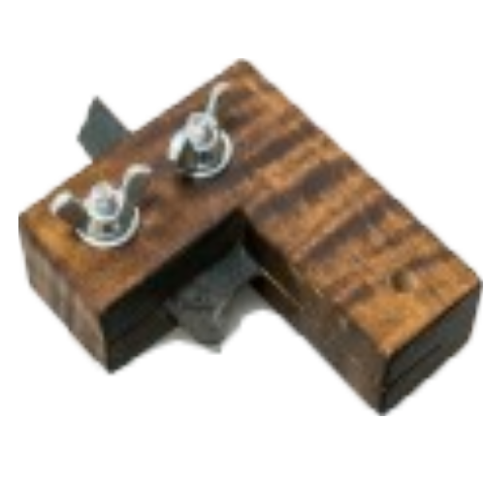
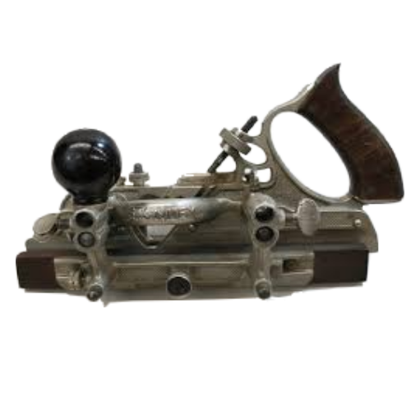
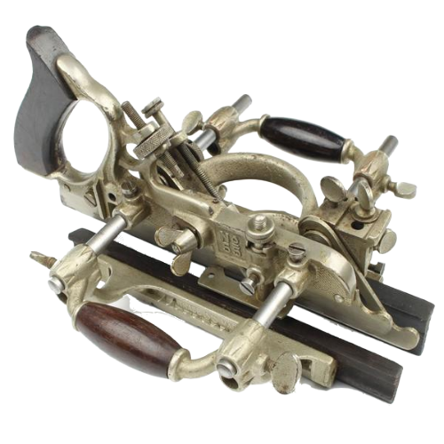
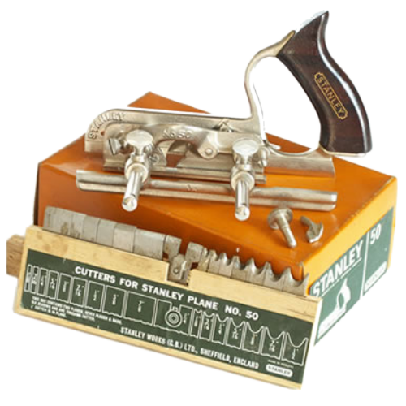
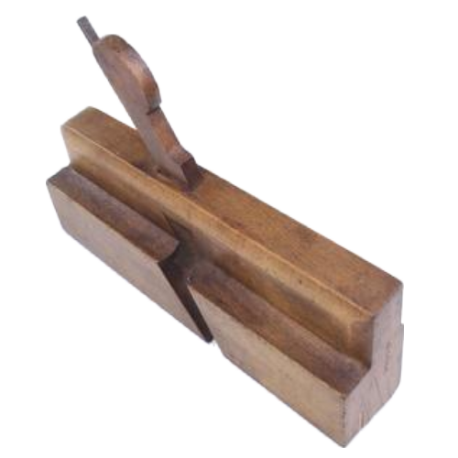
Bench & Shaping Planes.
Shaping Planes 2.
Combination Plane
Scratchstock
Multi Plane
Moulding Plane
Plough Plane

Slide 19
Shaping Planes 2.
Multi Plane.
A Multi‑Plane is a highly adaptable hand tool designed to perform the work of many specialised planes in one body. By swapping out its interchangeable cutters, fences, and depth stops, the multi‑plane can cut grooves, rebates, beads, tongues, dados, and decorative mouldings with precision. Its adjustable fence allows for accurate, repeatable cuts, making it especially useful for joinery and traditional moulding work. Because of its versatility, the multi‑plane is often considered a portable, manual alternative to a small router or spindle moulder, ideal for fine woodworking and restoration tasks where control and accuracy matter.
Depth Adjuster
Fence
Handle
Fence

Slide 20
Shaping Planes 2.
Combination Plane.
A Combination Plane is a versatile, multi‑purpose hand plane designed to perform the work of several specialised planes using a single adjustable body. By swapping out its various cutters, fences, and depth stops, it can cut grooves, rebates, beads, tongues, dados, and a wide range of decorative mouldings. Its adjustable fence allows for accurate, repeatable cuts, making it ideal for traditional joinery, cabinetmaking, and restoration work. Because it replaces multiple dedicated planes, the combination plane is valued for its flexibility and precision, especially when working on detailed or custom timber profiles.
Depth Adjuster
Handle
Knob
Fence

Slide 21
Shaping Planes 2.
Plough Plane.
A Plough Plane is a traditional hand plane designed specifically for cutting grooves along the length of a board. It uses interchangeable cutters and an adjustable side fence to control the width and position of the groove, while a depth stop ensures consistent cutting depth. This makes it ideal for creating slots for panels, drawer bottoms, tongue‑and‑groove joints, and other joinery tasks that require long, straight channels. Because it offers excellent accuracy and repeatability, the plough plane remains a valuable tool in both fine woodworking and restoration work where clean, precise grooves are essential.
Handle
Fence
Cutters

Slide 22
Shaping Planes 2.
Scratch stock.
A Scratch Stock is a simple but incredibly effective hand tool used for cutting custom mouldings, beads, grooves, and decorative profiles into timber. Instead of a plane iron, it uses a shaped scraper blade—often made from an old saw plate or scraper—held in a wooden or metal body.
Stock
Blade
Tightening Screws
Cutter

Slide 23

Recap.
We have….
Identified types of hand saws
Identified Types of Backsaws
Identified Types of shaping saws

Slide 24


Any Questions?
If you have any questions why not try and look up the answer online using a search engine and typing in your question, if you can't find your answer then ask your tutor or email them your questions at:
Lecturer@college.ac.uk

Slide 25

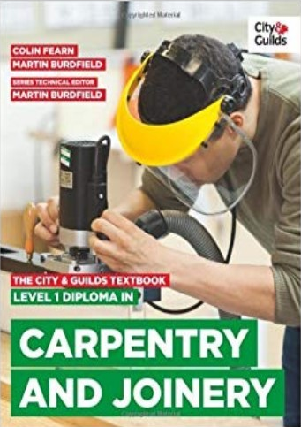




Resources.
The City & Guilds
Textbook.
Level 1 Site Carpentry & Bench
Joinery
ISBN:9780851932675

Slide 26

Thank You.
We would like to take this opportunity to thank you for using this material. If you have any questions or suggestion on this or any other learning material produced by Educon please email:
Educon.rix@gmail.com
Lecturer: James Rix

