Slide 1
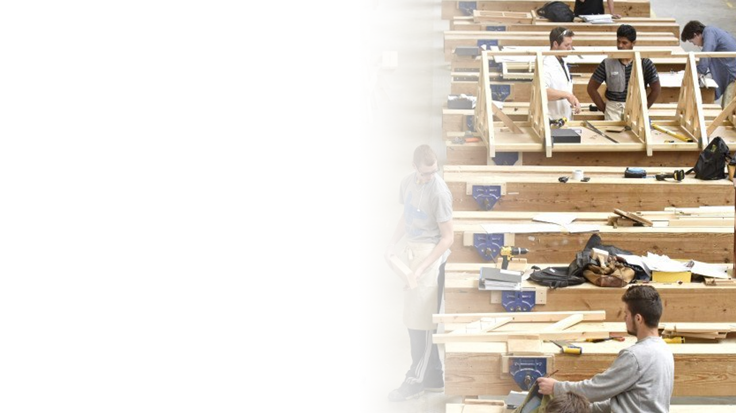



Hand, Back and shaping saws.
Lecturer: James Rix

Slide 2

Aims & Objectives.
Aims:
Know how to maintain carpentry & joinery hand tools
Objectives:
Identify types of hand saws
Identify Types of Backsaws
Identify Types of shaping saws

Slide 3

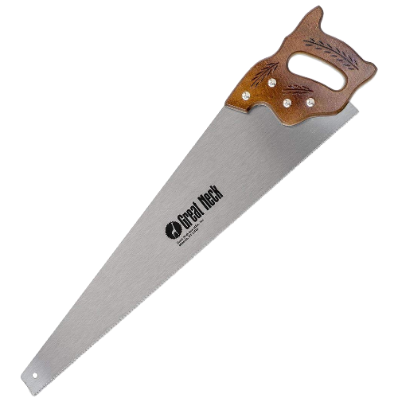
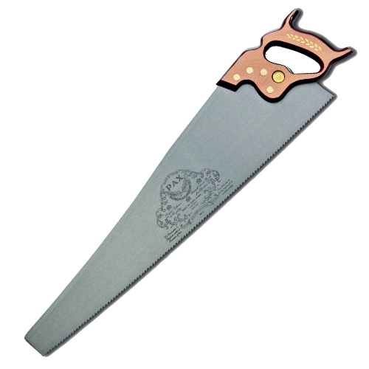
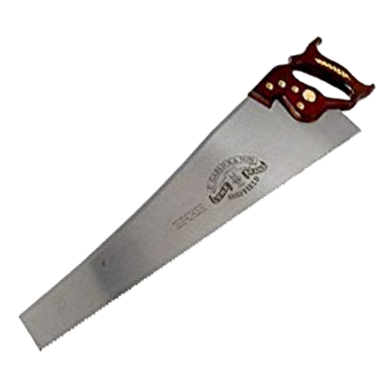
Hand Saws.
Cross Cut Saw
There are 3 different types of Handsaws, these are:
Panel Saw
Cross Cut Saw
Rip Saw
Hand saws are designed for reducing timber to more suitable sizes. The best hand saws are skew-backed meaning they have a gentle S shaped curve to the top side of the blade.
Straight Backed
Panel Saw
Skew-Backed
Rip Saw

Slide 4
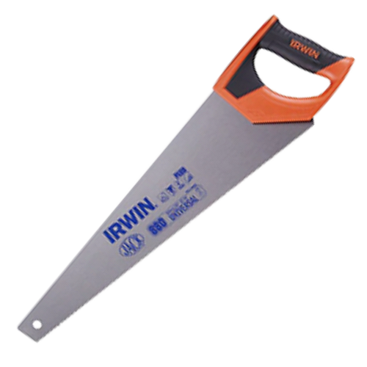
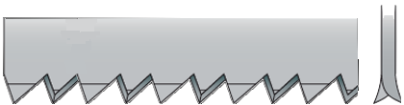

Hand Saws – Panel Saw.
Blade: 500mm - 550mm
TPI: 8-12
Panel saws are general use saws which come in both traditional and disposable formats. Both have between 8-12 tpi with 10 tpi being the most common. The traditional panel saw is resharpenable where as once the disposable one becomes blunt, its time to throw it away and get a new one. This is reflected in the cost.
Handle
Heel
Back
Blade
500mm – 550mm
Cut
Teeth
Disposable
version
1”/25mm
10tpi
Toe
65º

Slide 5
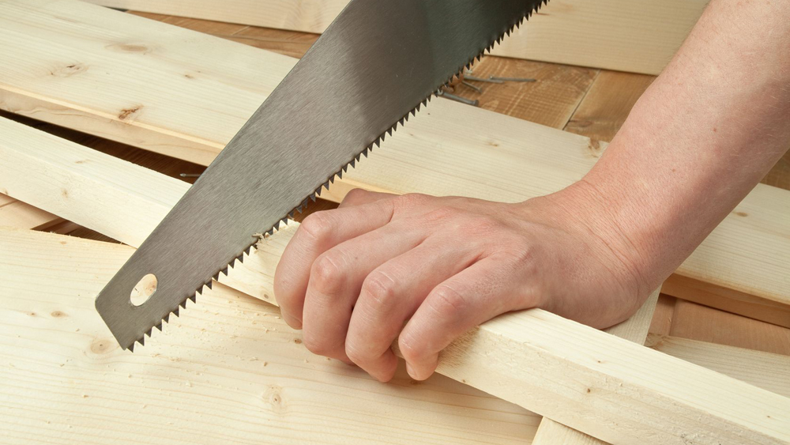
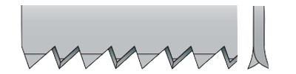

Hand Saws – Cross Cut Saw.
Blade: 600mm - 650mm
TPI: 8-10tpi
The purpose of a cross cut saw is to cut perpendicular to the grain of the wood, for example: cutting boards or stock to length. It has 8-10tpi and the teeth are more pointed having a bevelled edge on both front and rear of the tooth.
Handle
Back
Heel
Cut
600mm – 650mm
Blade
Teeth
1”/25mm
65º
Toe

Slide 6
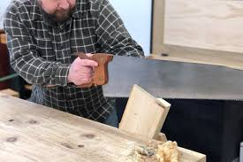
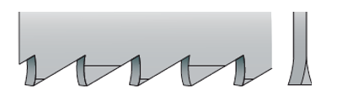

Hand Saws – Rip Saw.
Blade: 650mm - 750mm
TPI: 4.5-6tpi
Rip saws are the bigger of the hand saws,. Teeth are much larger and this is because they have the hardest job which is to cut the wood along the grain. The kerf created by the blade is slightly wider than the blade itself so when sawing its best to keep to the waste side of the line. Rip saws have 4.5 to 6tpi. Teeth are set at 60-90º in relation to the cutting edge.
Handle
Back
Heel
Cut
Blade
650mm – 750mm
1”/25mm
Teeth
90º
Toe

Slide 7
Hand Saws – Details Table.
Saw | Length | Tpi (teeth per inch/teeth per 25mm) | Use
Rip saw | 650mm-750mm | 4.5-6 tpi | Cutting boards along grain to width,
Crosscut Saw | 600mm-650mm | 8-10 tpi | Floor joists and other large sections of timber required to be cut to length
Universal Panel Saw (Disposable) | 500mm-550mm | 8-12 tpi | Floorboards, skirting, architraves, manufactured boards
Panel Saw | 500mm-550mm | 8-12 tpi | Floorboards, skirting, architraves, manufactured boards

Slide 8
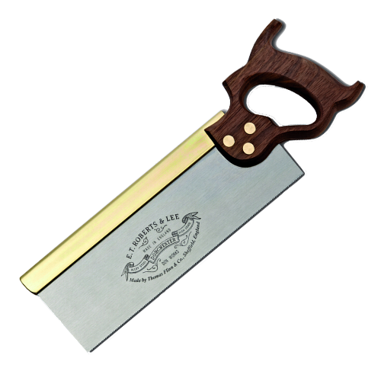
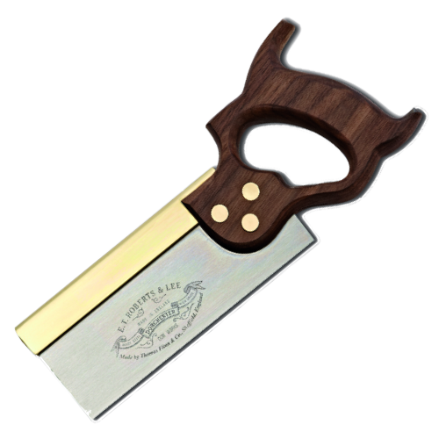
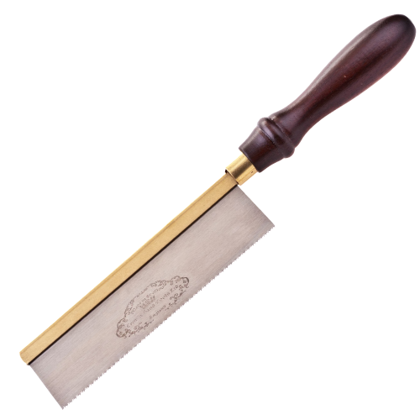
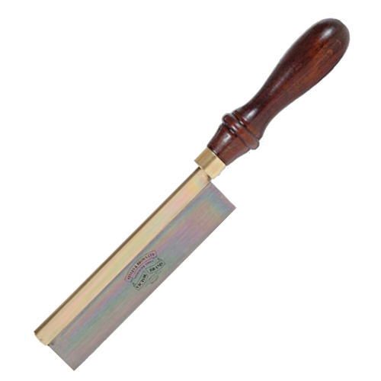
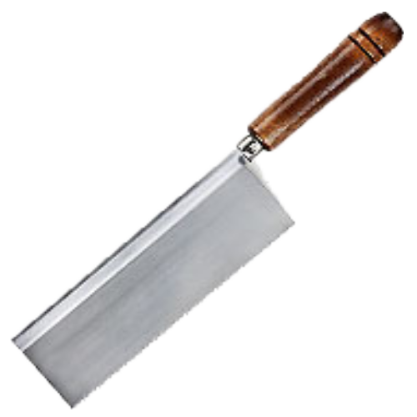
Back Saws.
There are several types of backsaw, the name is given to them because of the heavy brass or steel strip that runs along the back of the blade. This provides stability for the blade. These types of saws are similar to cross cut saws in that they are for cutting stock to length. The types of back saws available are:
Tenon Saw
Dovetail Saw
Gents Saw
Bead Saw
Razor or Blitz Saw
Tenon Saw
Gents Saw
Dovetail Saw
Bead Saw
Razor Saw

Slide 9
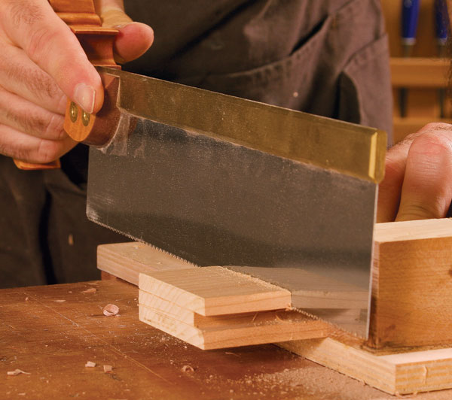
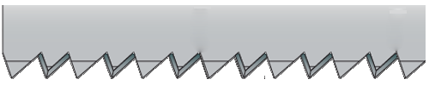
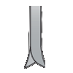
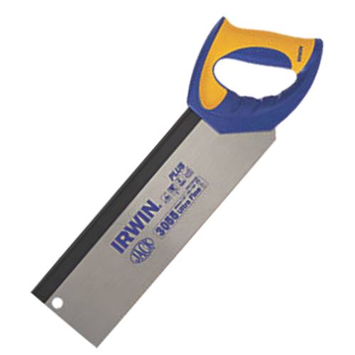

Back Saws – Tenon Saw.
Blade: 200mm - 350mm
TPI: 13-15tpi
Tenon saws are the biggest of the Back saw family. With 13-15tpi they can cut through quite hefty wood. It is also use for more precise work within workshops to cut tenons in softwood. The teeth are set similar to the cross cut saw only smaller with more teeth per inch.
Handle
Brass Back
Heel
Blade
Cut
Teeth
1”/25mm
Toe
Disposable Tenon Saw

Slide 10
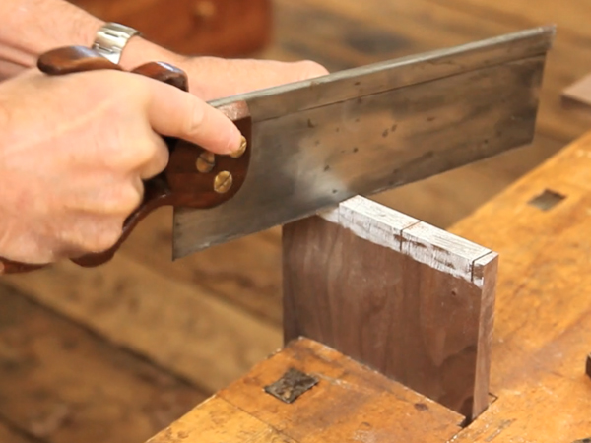

Back Saws – Dovetail Saw.
Blade: 200mm
TPI: 20tpi
Handle
The Dovetail Saw is very similar to the Tenon saw only smaller in size and teeth. Dovetails saws are usually around 200mm in length and have 20 tpi (teeth per inch). Dovetail saw teeth are set like the Rip saw teeth. This is because the Dovetail saw is made for cutting dovetails which require cutting along the grain.
Brass Back
Heel
Cut
Blade
Cut
1”/25mm
Toe
Teeth

Slide 11
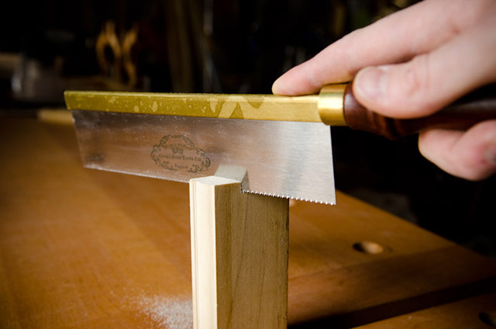
Back Saws – Gents Saw.
Blade: 200mm - 300mm
TPI: 22tpi
This saw is another version of the dovetail saw only smaller with smaller teeth. The teeth are again set like the Rip saw due to the purpose of the saw is to cut along the grain to produce dovetail joints. The saw has 22tpi (Teeth Per Inch) and a blade length of which is supported by the turned handle.
Handle
Brass Back
Heel
Cut
Blade
Cut
1”/25mm
Teeth
Toe

Slide 12
Back Saws – Bead Saw.
Blade: 200mm
TPI: 26tpi
The bead saw is a fine saw with 26tpi (Teeth Per Inch). Used mainly for fine joint work or model-making tasks. The teeth are set like a cross cut saw only much smaller.
Handle
Brass Back
Heel
Blade
Toe
Teeth

Slide 13
Back Saws – Razor/Blitz Saw.
Blade: 150mm
TPI: 32tpi
The razor saw or Blitz saw as it is also known is used for very fine model making tasks. It has 32tpi and the teeth are so small it cannot be sharpened. There are variations of the saw that come with replaceable blades to combat this very problem.
Handle
Steel Back
Heel
Blade
Toe
Teeth

Slide 14
Back Saws – Details Table.
Saw | Tpi (teeth per inch/teeth per 25mm) | Use
Tenon Saw | 13-15tpi | Crosscutting stock, cutting joints
Dovetail Saw | 20tpi | Cutting dovetails
Gents Saw | 22tpi | Cutting dovetails and other fine joints
Bead Saw | 26tpi | Extremely fine work and model making
Razor | 32tpi | Model Making

Slide 15
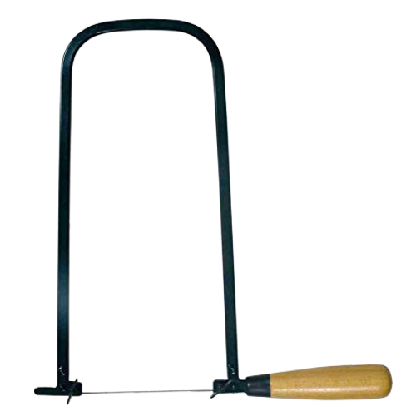
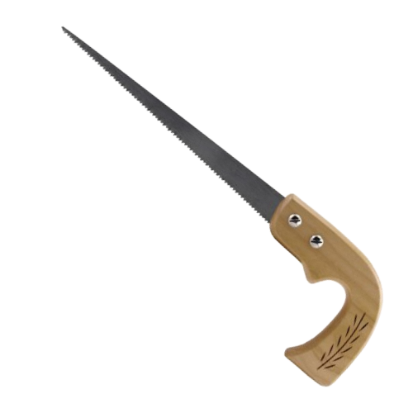
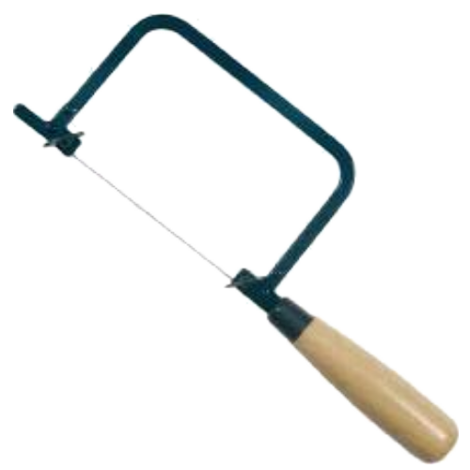
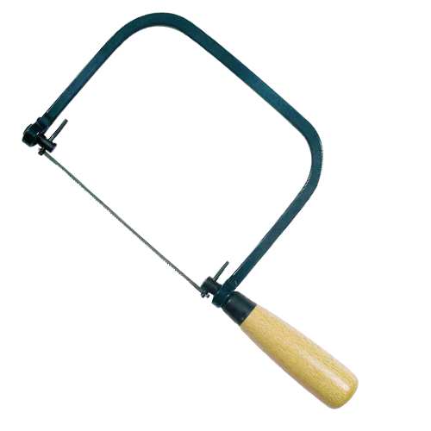
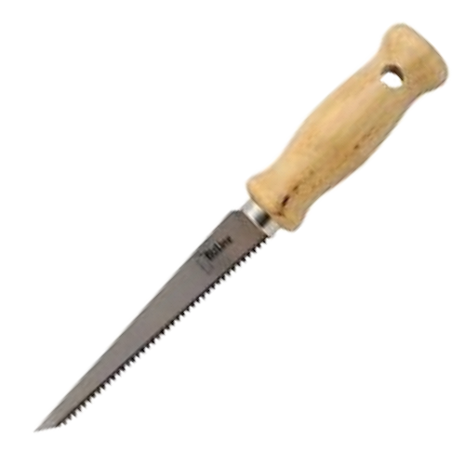
Shaping Saws.
These saws are specifically designed to cut curved shapes or holes in wood. There are several types of shaping saws, these include:
Fret Saw
Coping Saw
Piercing Saw
Compass Saw
Padsaw

Slide 16
Shaping Saws – Piercing Saw.
Blade: 150mm
TPI: 32tpi
The fretsaw is a bow saw used for intricate cutting work which often incorporates tight curves. Although the coping saw is often used for similar work, the fretsaw is capable of much tighter radii and more delicate work. ... Unlike the coping saw, the blade has a fixed orientation in relation to the frame.
Blade
Arms
Frame
Handle

Slide 17
Shaping Saws – Coping Saw.
Blade: 165mm
TPI: 10-24tpi
The coping saw or 'scroll saw' is also used mainly for curvature work. It has a very fine blade which can be detached and pushed through a hole before being re-attached. The handle may be tightened to increase blade tension. The blade can be set to any angle against the frame for cutting.
Blade
Arms
Frame
Handle

Slide 18
Shaping Saws – Fret Saw.
Blade: 150mm
TPI: 32tpi
A piercing saw, often called a jeweller's saw, is essentially a smaller version of a coping saw. Just like a coping saw, a piercing saw has a U-shaped frame and a removable blade. ... There are blades available which can cut through wood, plastic and metal.
Blade
Frame
Arms
Handle

Slide 19
Shaping Saws – Compass Saw.
Blade: 150mm
TPI: 32tpi
This is similar to the pad saw but with a slightly larger blade and is used mainly for cutting curves on flat boards.
Handle
Blade
Teeth

Slide 20
Shaping Saws – Padsaw.
Blade: 150mm
TPI: 32tpi
Pad saws have no frame, so can be used where coping saws cannot reach.
They tend to have a single handle with interchangeable blades to carry out a range of tasks, especially for cutting key holes and large internal shaped work.
Handle
Blade
Teeth

Slide 21

Recap.
We have….
Identified types of hand saws
Identified Types of Backsaws
Identified Types of shaping saws

Slide 22


Any Questions?
If you have any questions why not try and look up the answer online using a search engine and typing in your question, if you can't find your answer then ask your tutor or email them your questions at:
Lecturer@college.ac.uk

Slide 23






Resources.
The City & Guilds
Textbook.
Level 1 Site Carpentry & Bench
Joinery
ISBN:9780851932675
https://en.wikipedia.org/wiki/Backsaw
https://www.youtube.com/watch?v=1cK-xN2uAUI
https://en.wikipedia.org/wiki/Compass_saw
https://www.youtube.com/watch?v=pigcIXjRel8
https://en.wikipedia.org/wiki/Compass_saw
https://www.youtube.com/watch?v=Ezd0rfgbQK8
https://en.wikipedia.org/wiki/Fretsaw
https://en.wikipedia.org/wiki/Hand_saw
https://www.youtube.com/watch?v=Ezd0rfgbQK8

Slide 24

Thank You.
We would like to take this opportunity to thank you for using this material. If you have any questions or suggestion on this or any other learning material produced by Educon please email:
Educon.rix@gmail.com
Lecturer: James Rix

