Slide 1

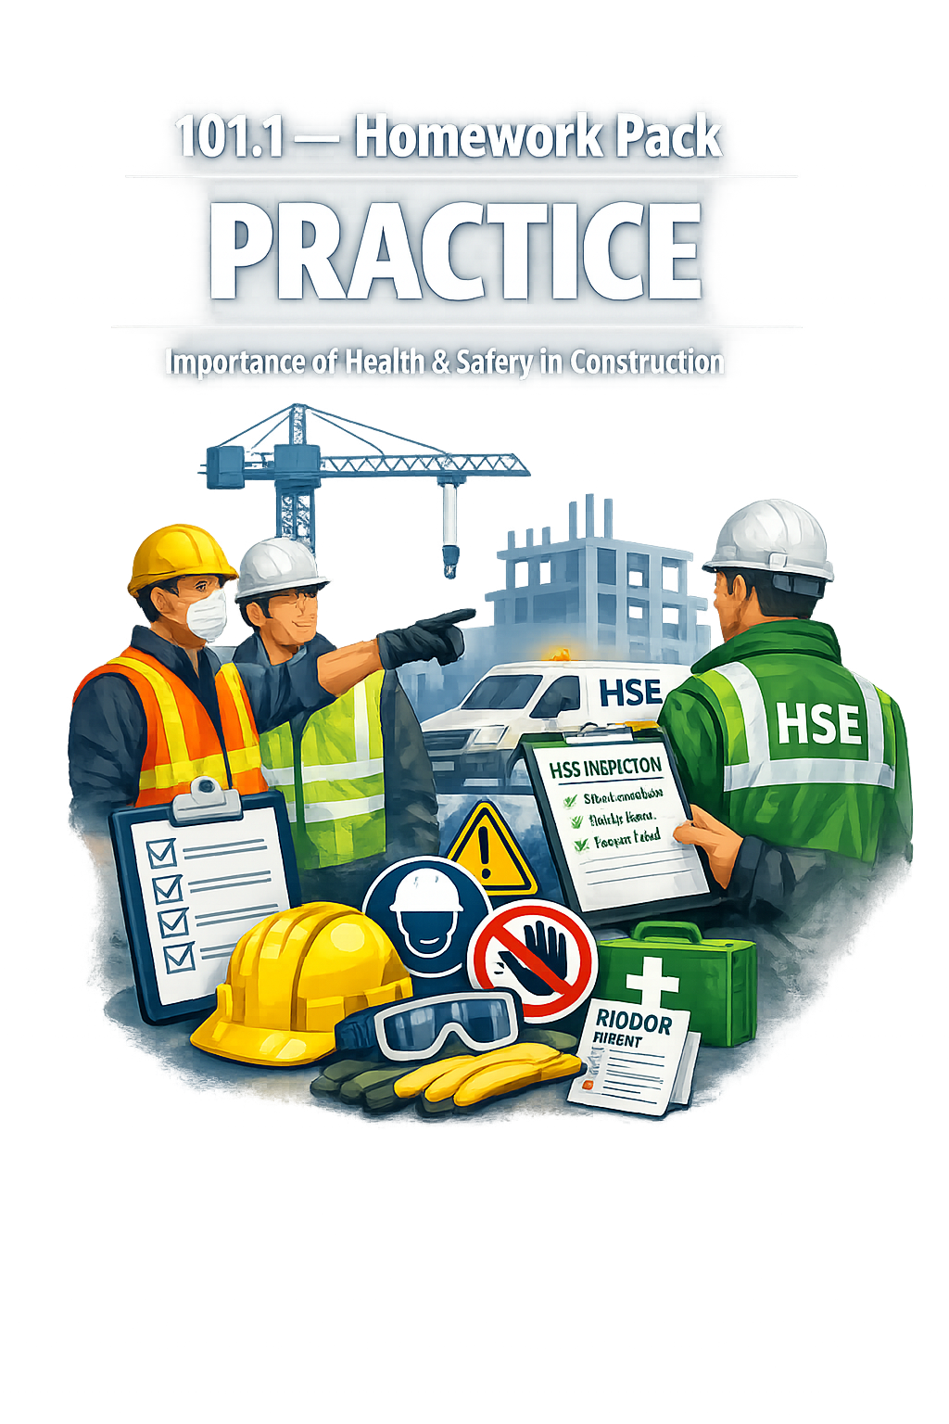


101.1 – Homework Pack
PREPARATION
Importance of Health and Safety in Construction
Lecturer: James Rix

Slide 2
Contents.
Cover
Contents
Purpose
Brief
Resource List
Assessment
Skills
Reading Task
Keywords Task
Reflection Task
Feedback
Thank You

Slide 3
Purpose.
To prepare learners for the next lesson by introducing the ideas of hazards, risks, and risk assessment.
This pack builds on the understanding of health & safety importance and encourages independent reading from trusted sources.

Slide 4
Brief.
Read the extracts provided from your textbook and the HSE website.
Complete the reflection sheet explaining how health & safety principles help prevent accidents.
Fill in the glossary for the new keywords: hazard, risk, risk assessment.
Answer the comprehension questions in full sentences.
Bring your completed pack to the next session.

Slide 5
Resources.
Basic Construction Skills – Health & Safety (City & Guilds)
HSE website: www.hse.gov.uk/construction (hse.gov.uk in Bing)
Unit 101 coursework
Pen, paper, highlighters
Optional: classroom posters on accident prevention

Slide 6
Assessment.
Tutor review of completed reflection and glossary
Discussion in next session on hazard identification
Feedback recorded on learner progress sheet

Slide 7
Skills.
Reading comprehension
Independent learning
Vocabulary development
Linking prior and future learning
Health & safety awareness
Reflective thinking

Slide 8
Reading.
Student Name:
Student Number:
Date:
Reading Task
Read the short extracts provided from your textbook and the HSE website. Then answer the questions below in full sentences.
Questions:
What is the main job of the HSE?
Why must employers complete risk assessments?
Give one example of how employees can help keep the workplace safe.
How does good health and safety benefit both workers and employers?

Slide 9

Textbook 1.
City and Guilds Textbook
L1 Diploma Carpentry and Joinery
ISBN10: 0851932673
ISBN13: 978-051932675
Unit 101 Requirement | Textbook Section | Page(s)
Importance of H&S | Health & safety legislation | p.2
HSE roles | HSE section | p.8
Main regulations | Principal legislation list | p.3
Employer/employee responsibilities | HASAWA duties | p.3–4 & p.6

Slide 10

Textbook 2.
City and Guilds Textbook
L1 Diploma Carpentry and Joinery
ISBN10: 1398319376
ISBN13: 978-1398319370
AC | Topic | Required Reading | Pages
1.1 | Importance of H&S | Introduction | 268–269
1.2 | Role of HSE | Roles & responsibilities of HSE | 275–276
1.3 | Main regulations | Health & safety legislation + Table 6.1 | 268–271
1.4 | Employer & employee responsibilities | Employer responsibilities; Employee responsibilities | 272–275

Slide 11

Textbook 3.
Cskills Textbook
Site Carpentry Level 2 Diploma
ISBN-10: 1408521261
ISBN-13 978-1408521267
AC | Topic | Required Reading | Pages
1.1 | Importance of H&S | Introduction | 268–269
1.2 | Role of HSE | Roles & responsibilities of HSE | 275–276
1.3 | Main regulations | Health & safety legislation + Table 6.1 | 268–271
1.4 | Employer & employee responsibilities | Employer responsibilities; Employee responsibilities | 272–275

Slide 12

Textbook 4.
Heinemann Textbook
L1 NVQ/SVQ Diploma Carpentry & Joinery
ISBN-10: 0435027026
ISBN-13 978-0435027025
AC | Topic | Required Reading | Textbook Source | Pages
1.1 | Importance of health & safety | Introduction (hazards, accidents, fatalities, long‑term health) | Chp 6 – Health, Safety & Welfare in Construction | 268–269
1.1 | Importance of health & safety | Safe working practices; industry accident statistics; health impacts | Unit 1001 – Safe Working Practices in Construction | Page 1

Slide 13

101.1.
Keywords.
Keyword Reference Sheet.
1. Accident
An unplanned event that results in injury, damage, or loss.
2. Fatality
A death caused by unsafe working conditions or serious incidents on site.
3. Hazard
Anything with the potential to cause harm (materials, equipment, environment, behaviour).
4. Risk
The likelihood and severity of harm occurring from a hazard.
5. Control Measure
An action or system put in place to reduce or eliminate risk.
6. Legislation
Laws that govern workplace safety (e.g. HASAWA 1974, CDM 2015).
7. Responsibility
Legal and moral duties of employers and employees to maintain safety.
8. Insurance
Financial protection affected by accident rates and safety performance.
9. Productivity
Output and efficiency impacted by safe or unsafe working practices.
10. Cost
The financial impact of accidents, including lost output, fines, claims, and downtime.

Slide 14
Keyword Glossary.
Student Name:
Student Number:
Date:
Complete the table using your reading and class notes.
Keyword | Meaning (in your own words) | Example
Accident
Fatality
Risk
Control Measure
Legislation
Responsibility
Insurance
Productivity
Cost

Slide 15
Reflection.
Student Name:
Student Number:
Date:
Think about what you learned in 101.1 and how it links to 101.2.
Write a short paragraph (4–6 sentences) explaining:
Why health and safety is important before starting any job.
How understanding hazards and risks helps you work safely.
What you can do personally to prepare for the next session.

Slide 16
Feedback.
Student Name:
Student Number:
Date:
Checklist.
Reding Task Completed
Keyword Glossary Completed
Reflections Completed
Lecturer Comments.

Slide 17

Thank You.
We would like to say thank you for using this learning material, we hope you found it useful.
If you have any questions regarding this or any other learning material, or have any suggestions about improvements or ideas please email James Rix at:
educon@gmail.com
Lecturer: James Rix

