Slide 1




BS1192.
Lecturer: James Rix

Slide 2

Aims & Objectives.
Aims:
Know BS1192 Standards
Objectives:
Identify Drawing Tools & Equipment
Identify BS1192 Standards
Identify Drawing Projections
Identify Hatches, Symbols & Abbreviations
Identify Scales & Measurements

Slide 3

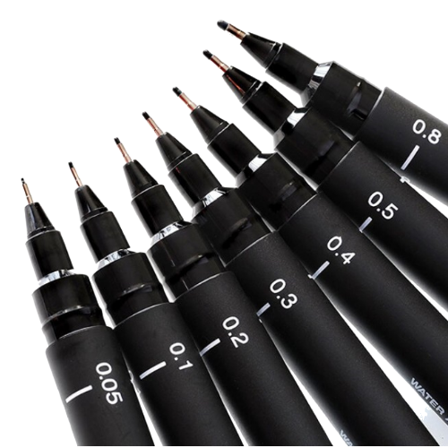
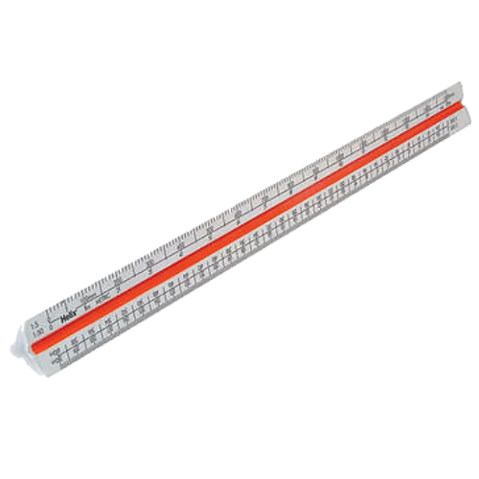

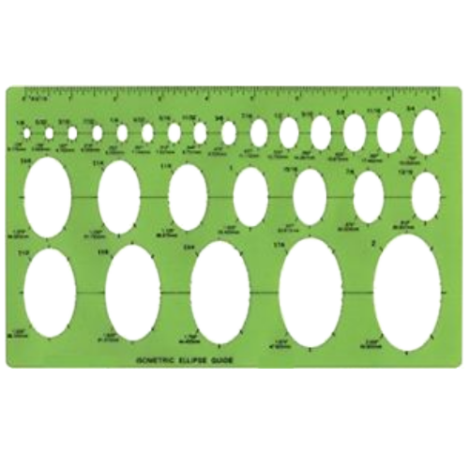
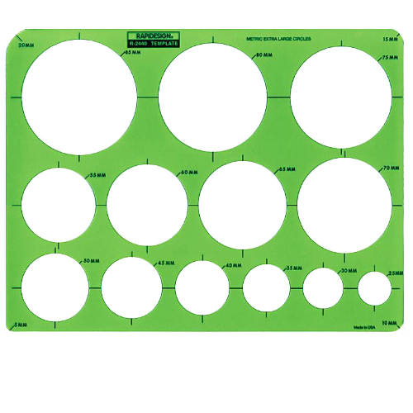
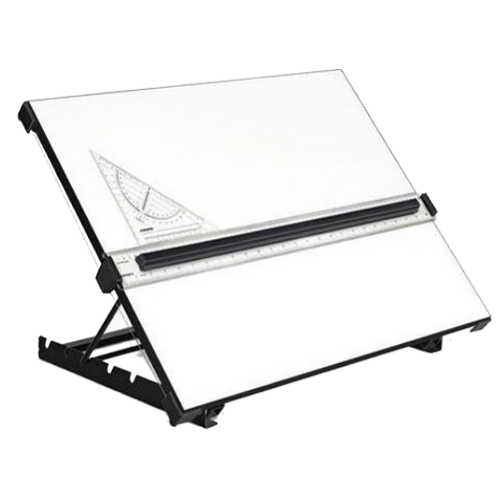
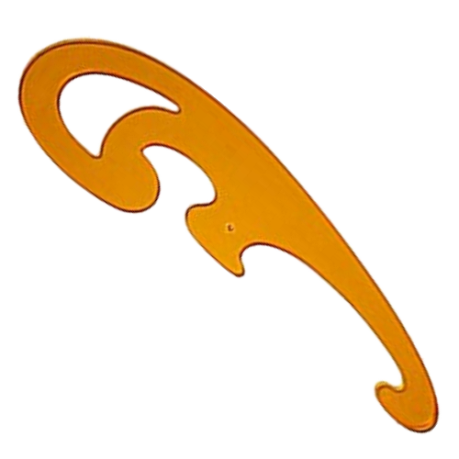
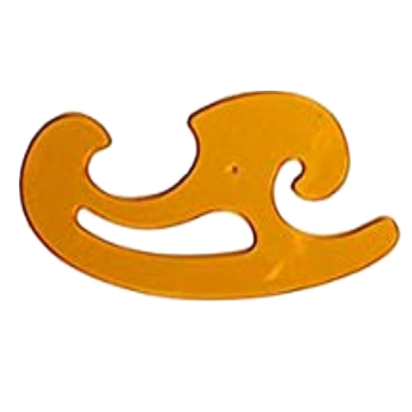
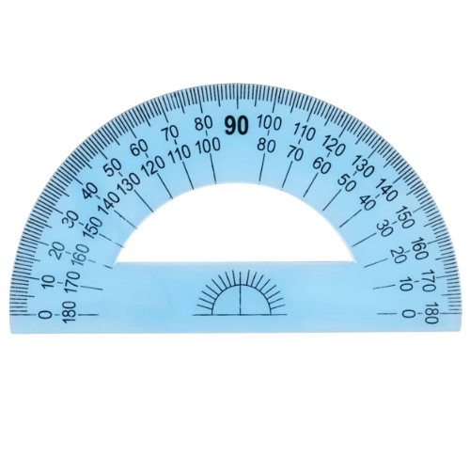
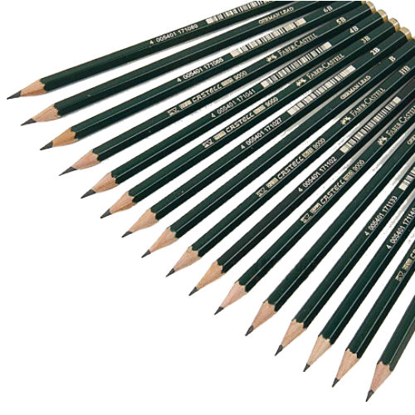
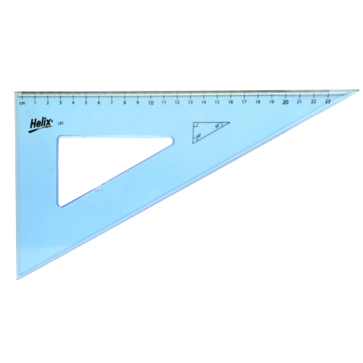
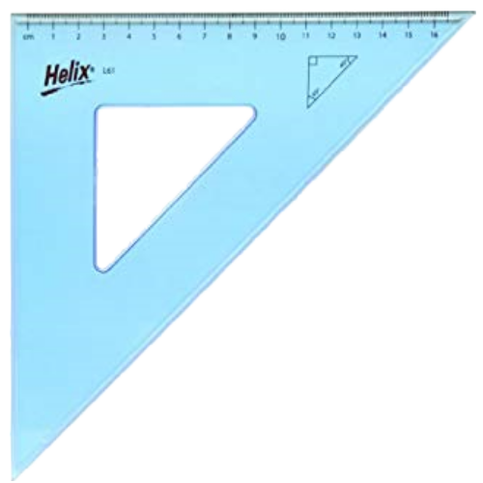
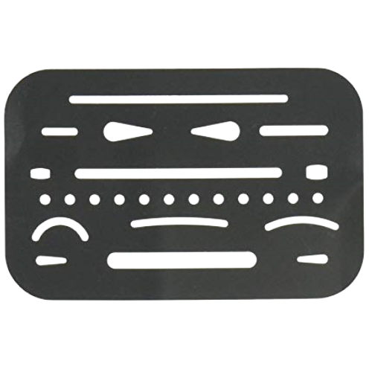
BS1192 Standards.
Drawing Tools & Equipment.
Technical Drawing Pens
Oval and Circle
Templates
Scale Rule
French Curves
Protractor
Graded Pencils
Drawing Board
Set Squares
Eraser Shield
Compass

Slide 4
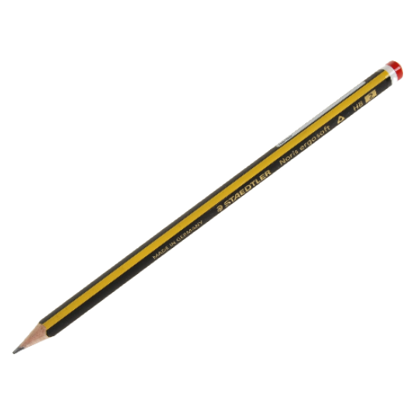

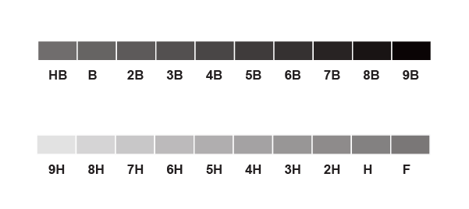
Drawing Tools & Equipment
Pencil.
“an instrument for writing or drawing, consisting of a thin stick of graphite or a similar substance enclosed in a long thin piece of wood or fixed in a cylindrical case”.
In many
different grades

Slide 5
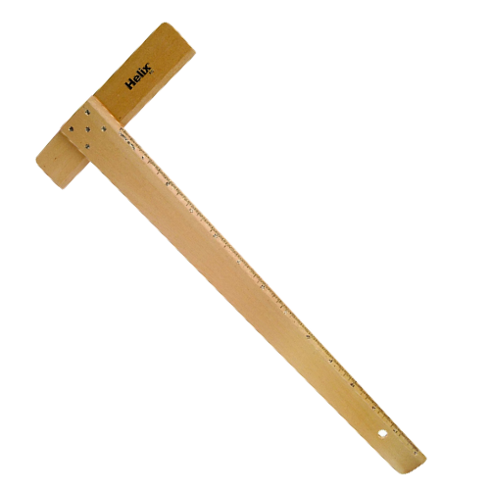
Drawing Tools & Equipment
Drawing Board.
A drawing board is used for producing technical drawings or illustrations such as engineering drawings or architectural drawings. Modern drawing boards come with a vertical moveable rule instead of the traditional T-Square.

Slide 6
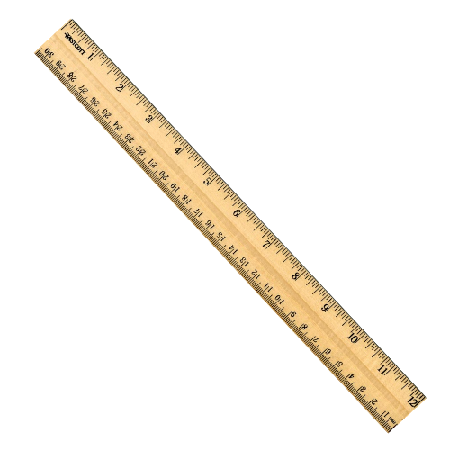
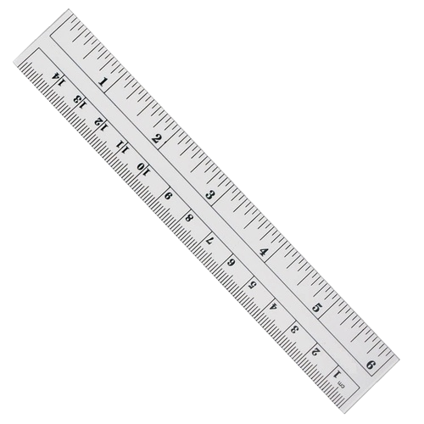
Drawing Tools & Equipment
Ruler.
0
0
Rulers come in various sizes but mainly 15cm (6”) or 30cm (12”) sizes. Used for measuring or drawing straight lines to lengths. They can be shatterproof plastics or more traditionally wooden. They show both imperial and metric measurements.
1
Inches
Centimeters
2
1
1 inch = 25.4mm

Slide 7
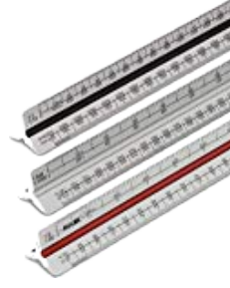
Drawing Tools & Equipment
Scale Rule.
A scale rule is a tool used for measuring lengths and transferring measurements at a fixed ratio of length.
1:1
1:2
1:5
1:10
1:20
1:50
1:75
1:100
1:200
1:500
1:1000
1:1250
1:2500
Using a scale of 1:50
1cm on the drawing = 50cm in real life

Slide 8
Drawing Tools & Equipment
Templates.
There are various types of templates with shapes and lines on them. The two shown are probably the most common templates being circle and oval/eclipse.

Slide 9
Drawing Tools & Equipment
French Curves.
A French curve is a template composed of many curves.

Slide 10
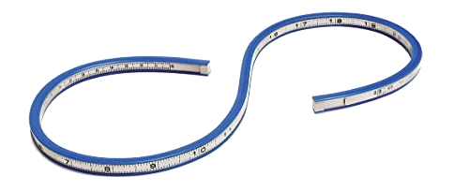
Drawing Tools & Equipment
Flexi Curve.
A flexible curve is a handy tool when wanting to get a specific curve. Used in laying out and drawing curves on paper, fabric, card and woods.

Slide 11
Drawing Tools & Equipment
Set Squares.
Set squares are used for drawing the vertical, 45-degree or 60-degree lines.
o
o
30 /60 Set Square
o
o
45 /90 Set Square

Slide 12
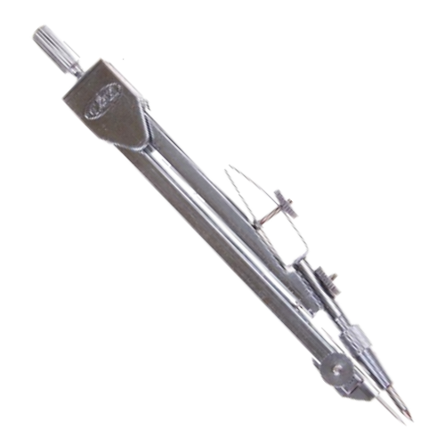
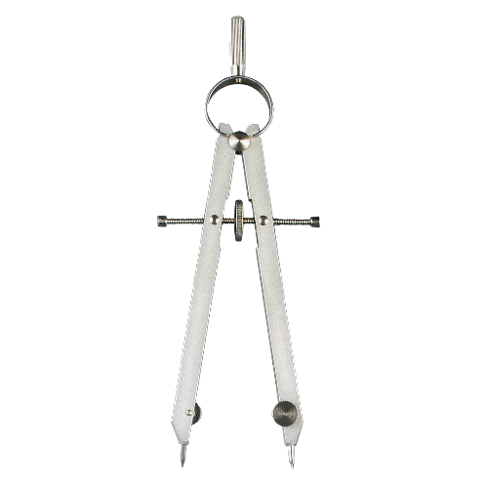
Drawing Tools & Equipment
Compass.
A compass is used for drawing circles and arcs. The Drop compass is set by opening the arms to the required measurement whereas the Spring-bow compass has a wheel in the middle of the two arms that when turned either increases the distance or decreases the distance.
Drop Compass
Spring-bow
Compass

Slide 13
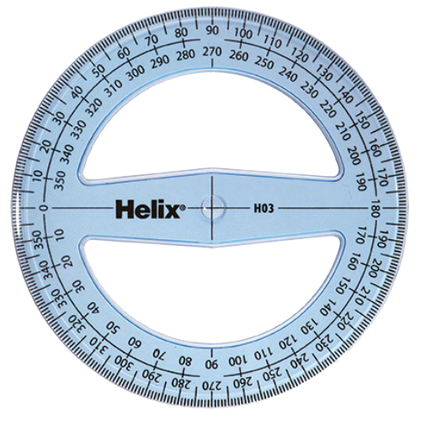
Drawing Tools & Equipment
Protractor.
A protractor is a measuring instrument, typically made of transparent plastic or glass, for measuring angles.

Slide 14
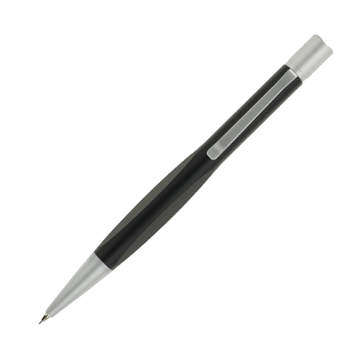
Drawing Tools & Equipment
Ratchet Pencil.
Ratchet-based pencils are a variant of the clutch pencil, in which the lead is held in place by two or three small jaws inside a ring at the tip. The jaws are controlled by a button on the end or the side of the pencil. When the button is pushed, the jaws move forward and separate, allowing the lead to advance.

Slide 15
Drawing Tools & Equipment
Eraser Shield.
An eraser shield is a thin sheet of stainless steel or plastic with slots and holes of different shapes. They are designed to allow erasers to be used through them to erase lines and text without removing lines close by which do not need to be (or should not be) erased

Slide 16
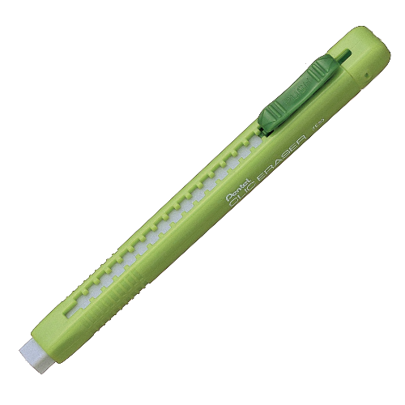
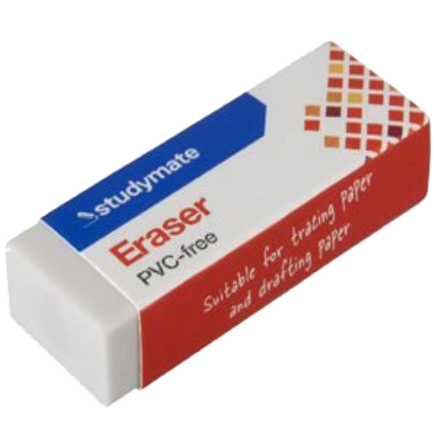
Drawing Tools & Equipment
Eraser.
An eraser, (also called a rubber, from the material first used) is an article of stationery that is used for removing marks from paper

Slide 17
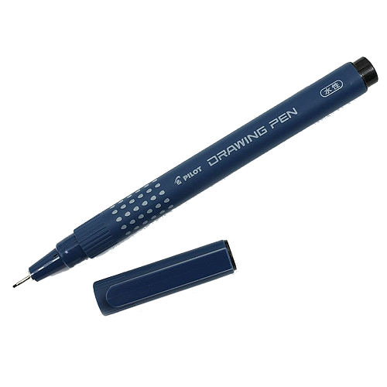
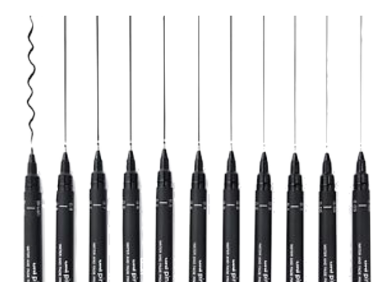
Drawing Tools & Equipment
BS1192.
A specialised instrument designed for technical drawing. Comes in many thicknesses 0.13, 0.18, 0.25, 0.35, 0.5, 0.7, 1.0, 1.4, and 2.0 mm which are defined in ISO 128 (international Standards)

Slide 18

BS1192 Standards.
BS1192.
BS1192 is a British Standard that provides a framework for the collaborative production of information in the construction industry, primarily through Building Information Modelling (BIM).
It sets out best practices for managing and sharing information, ensuring consistency and clarity across all project stages. The standard includes guidelines for naming conventions, data structures, and workflows, which help in reducing errors, improving efficiency, and facilitating better communication among project stakeholders.
By adhering to BS 1192, construction teams can ensure that all information is accurate, up-to-date, and easily accessible, ultimately leading to more successful project outcomes.

Slide 19
BS1192 Standards.
Drawing Tools.
Technical Drawing Pens
Oval and Circle
Templates
Scale Rule
French Curves
Protractor
Graded Pencils
Drawing Board
Set Squares
Eraser Shield
Compass

Slide 20
BS1192 Standards.
Paper Sizes.
1180mm
A0 – 1180 x 840
A1 – 840 x 590
A2 – 590 x 420
A3 – 420 x 295
A4 – 295 x 210
840mm
840mm
590mm
590mm
420mm
295mm
420mm
295mm
210mm
A4
A3
A2
A1
A0

Slide 21
BS1192 Standards.
Lines.
Thick – Main Outlines
Medium – General details and outlines
Thin – Construction and dimension lines
Breakline – Breaks in the continuity of a drawing
Thick Chain – Pipelines, drains and services
Thin Chain – Centre Lines
Section Line– Showing the position of a section cut, the pointers show the direction of the view.
Broken Line – Shows hidden details
Dimension Line – Indicates the distance between two points

Slide 22
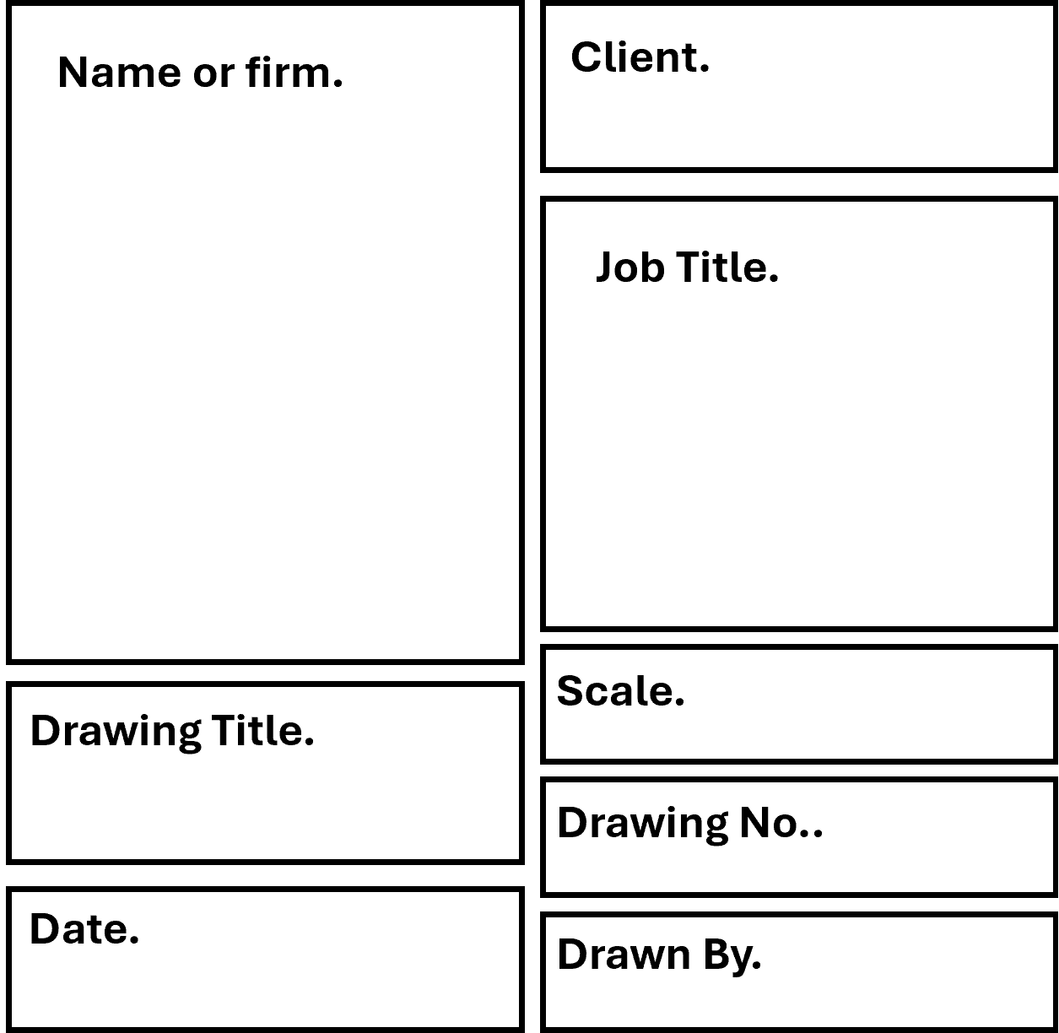
BS1192 Standards.
Setting Out a Drawing.
10mm
This is a general layout of an A3 piece of paper ready for drawing.
20mm
10mm
10mm

Slide 23
BS1192 Standards.
Title.
The British Standard 1192 sets the following recommendations:
Every drawing must have a title panel, which is normally located in the bottom right-hand corner of each drawing sheet. The information contained in the panel is relevant to that drawing only and contains such information as:
• Drawing title.
• Name and address of issuing firm or practice.
• Description of the drawing.
• Scale.
• Date the drawing was completed.
• Draughtsman’s name.
• Company Name.
• Drawing number.
• Client’s details.
• Projection type.
• Revisions.
Name or firm.
Client.
Job Title.
Drawing Title.
Scale.
Drawing No..
Date.
Drawn By.

Slide 24
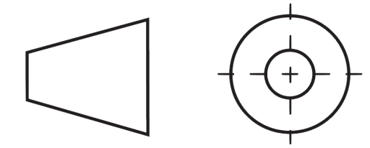
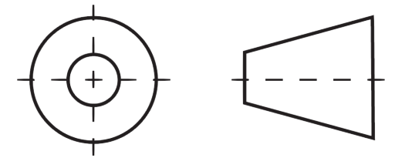
Drawing Projections.
Orthographic Projection.
Orthographic projection is the method of showing all the views of an object
in separate drawings and in a systematic manner on the same drawing
sheet. This method is used for construction drawings, and shows the plan
view, elevations and sections of a building or components of a building.
There are two main methods of orthographic projection:
First Angle Projection. (Used in construction)
The recognised symbol for this is as follows:
Third Angle Projection (Used for engineering drawings).
The recognised symbol for this is as follows:

Slide 25
Drawing Projections.
Orthographic Projection.
125mm
200mm
125mm
80mm
80mm
200mm

Slide 26
Drawing Projections.
Isometric Projection.
Isometric projection.
In this form of pictorial projection, all vertical lines remain vertical but
all the horizontal lines are drawn at an angle of 30° to the horizontal.
30º
30º
125mm
80mm
200mm

Slide 27
Drawing Projections.
Axonometric Projection.
Axonometric projection.
In this form of pictorial
projection, all the vertical lines remain vertical but all the horizontal lines are
drawn at angle of 45° to
the horizontal.
125mm
45º
45º
80mm
200mm

Slide 28
Drawing Projections.
Cavalier Projection.
45º
Cavalier Projection.
All vertical lines are drawn vertical, and all horizontal lines in the front elevation are drawn horizontal, to give a true front view or elevation. All horizontal lines in the side view or elevation are drawn full length at 45° to the horizontal.
80mm
80mm
125mm
200mm

Slide 29
Drawing Projections.
Cabinet Projection.
45º
Cabinet.
All vertical lines are drawn vertical, and all horizontal lines in the front elevation are drawn horizontal to give a true front view or elevation. All horizontal lines in the side view or elevation are drawn to half their full length at 45° to the horizontal.
Half Width at the 45º
80mm
62.5mm
200mm

Slide 30
Scales.
Scales used in Drawings.
Plan or Drawing | Scales Used
Block Plans | 1:1000, 1:1250, 1:2500
Site Plans | 1:500, 1:200
Floor Plans | 1:100
Elevational Drawings | 1:200
Sectional Drawings | 1:50
Detail Drawings | 1:1, 1:2, 1:5, 1:10

Slide 31
Scales.
Use of Scales.
The choice of scale will depend on two things:
1. The size of the object to be drawn.
2. The amount of detail that needs to be shown.
Scale rule
Scale measurements are not usually taken off drawings as the drawing could
enlarge or reduce during photocopying. If scaled dimensions and written
dimensions disagree, then the written dimension should always be used.
The scale shows how much smaller the plan or object is, compared to its
original size.
• On a scale of 1:50, 10 mm represents 500 mm.
• On a scale of 1:100, 10 mm represents 1000 mm (1.0 m).
• On a scale of 1:200, 30 mm represents 6000 mm (6.0 m)

Slide 32
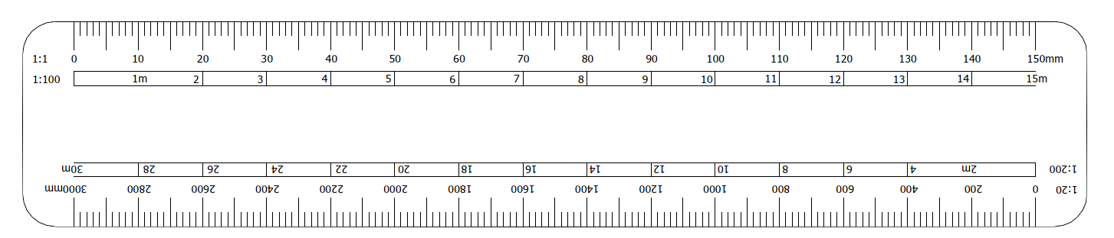
Scales.
Scale Rule.
This is an example of a scale rule. The scales it shows are:
1:1
1:100
1:20
1:200
=
74mm or 7.4m

Slide 33
Measuring.
Metric.
Metre
1 metre = 100cm = 1000mm
1 centimetre = 10mm
cm
Centimetre
To change metres into centimetres you divide the number of metres by 100.
To change metres into millimetres you divide the number of metres by 1000.
To change centimetres into millimetres you divide the number of centimetres by 10
mm
Millimetre
0
1
2
3
4
5
6
7
8
9

Slide 34
Measuring.
Imperial.
Inches
12 inches = 1 foot
inch
Feet
There are increments of half, quarter, 8ths, 16ths and 32ths
Feet
0
1
2
3

Slide 35
Measuring.
Conversion.
0
1
2
3
4
5
6
7
8
9
1inch = 25.4mm
0
1
2
3

Slide 36

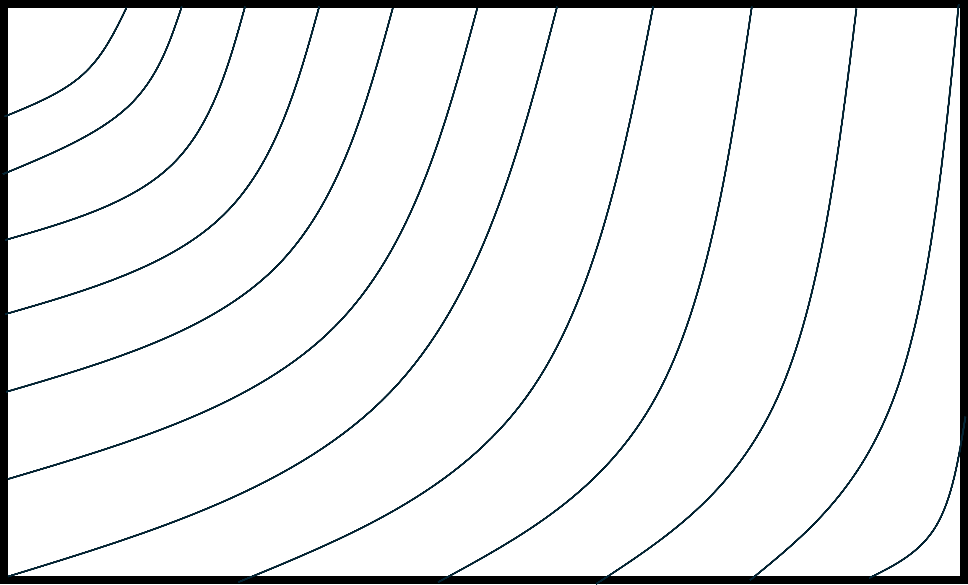
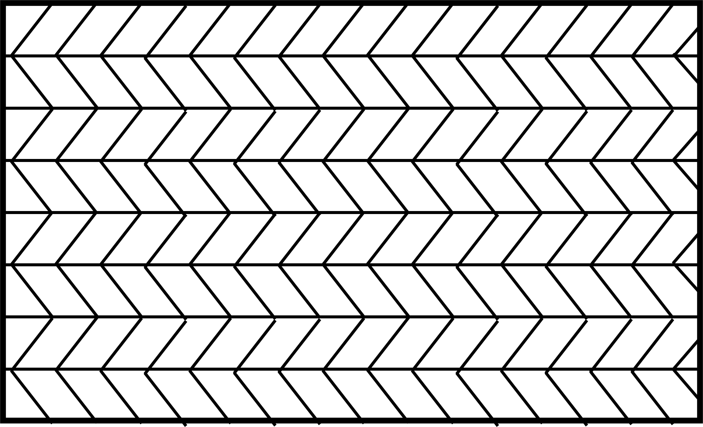
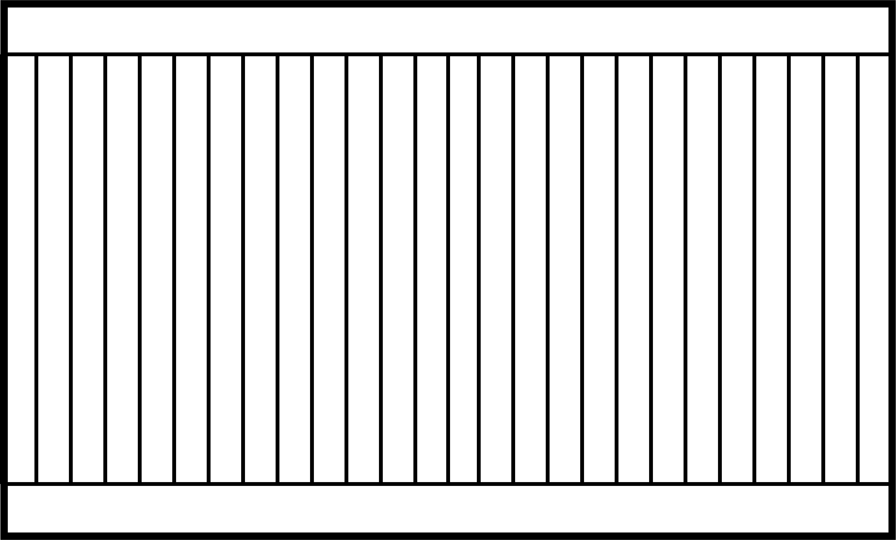
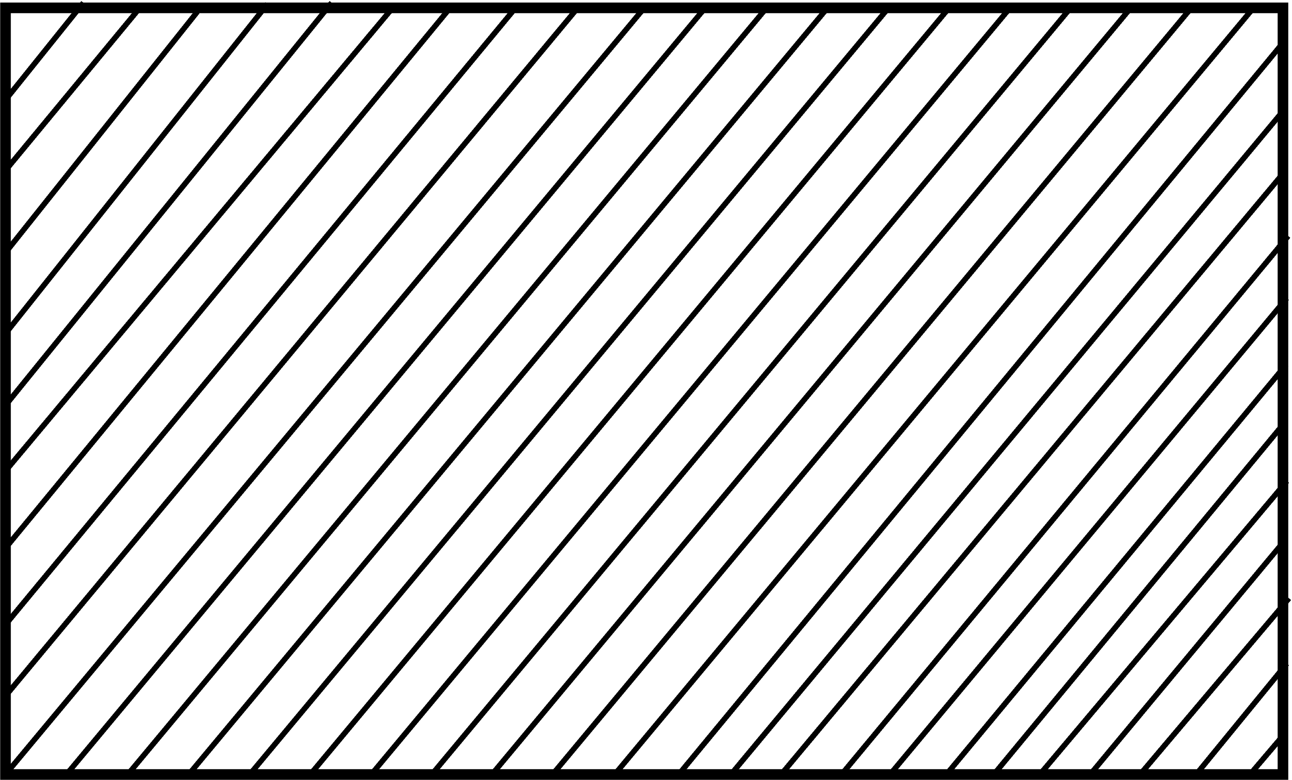
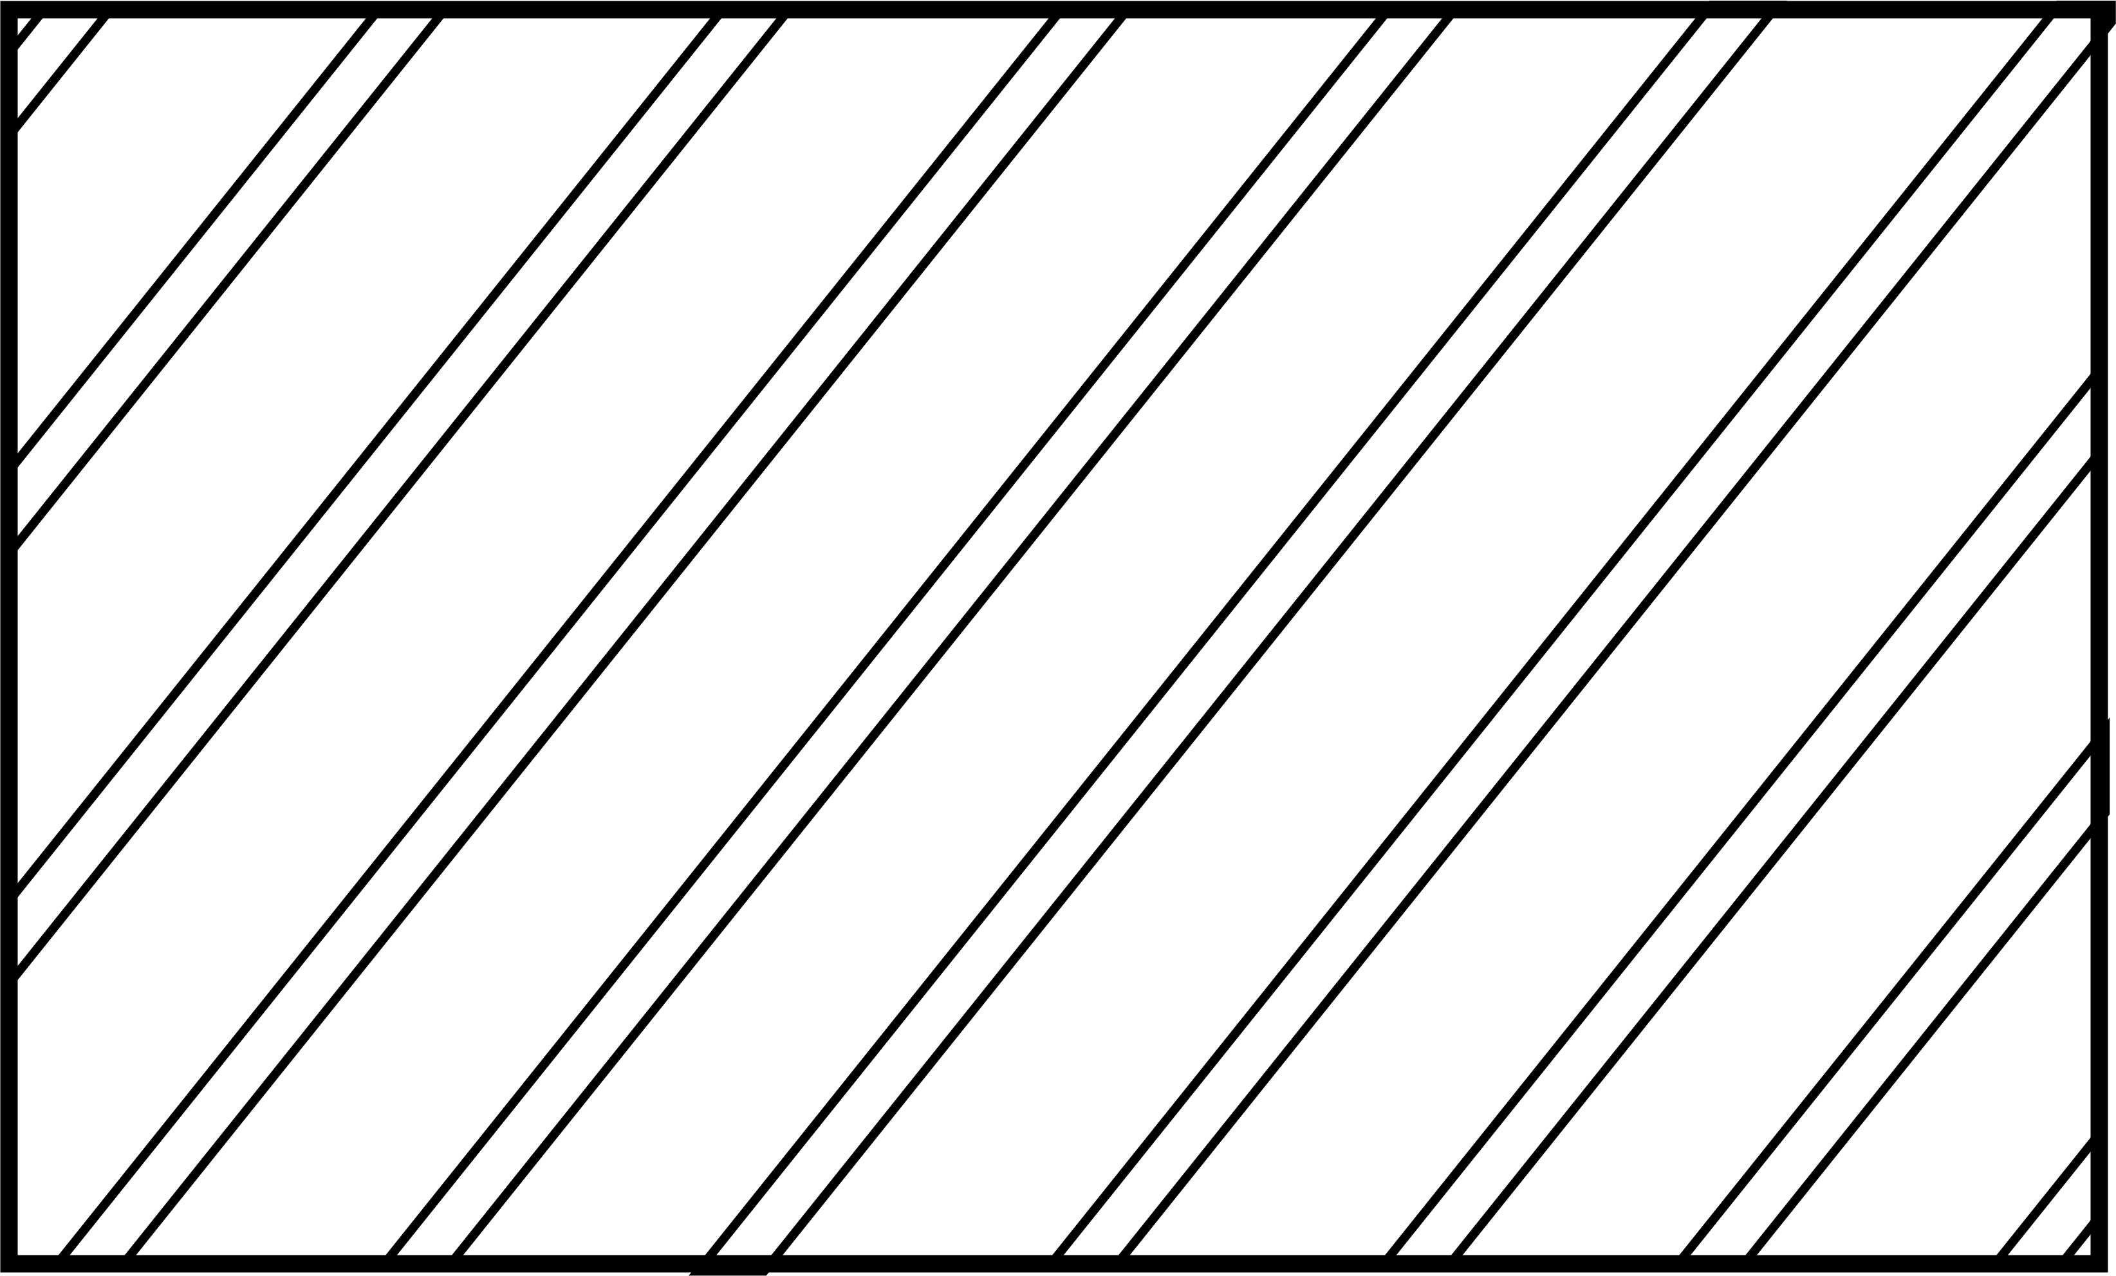
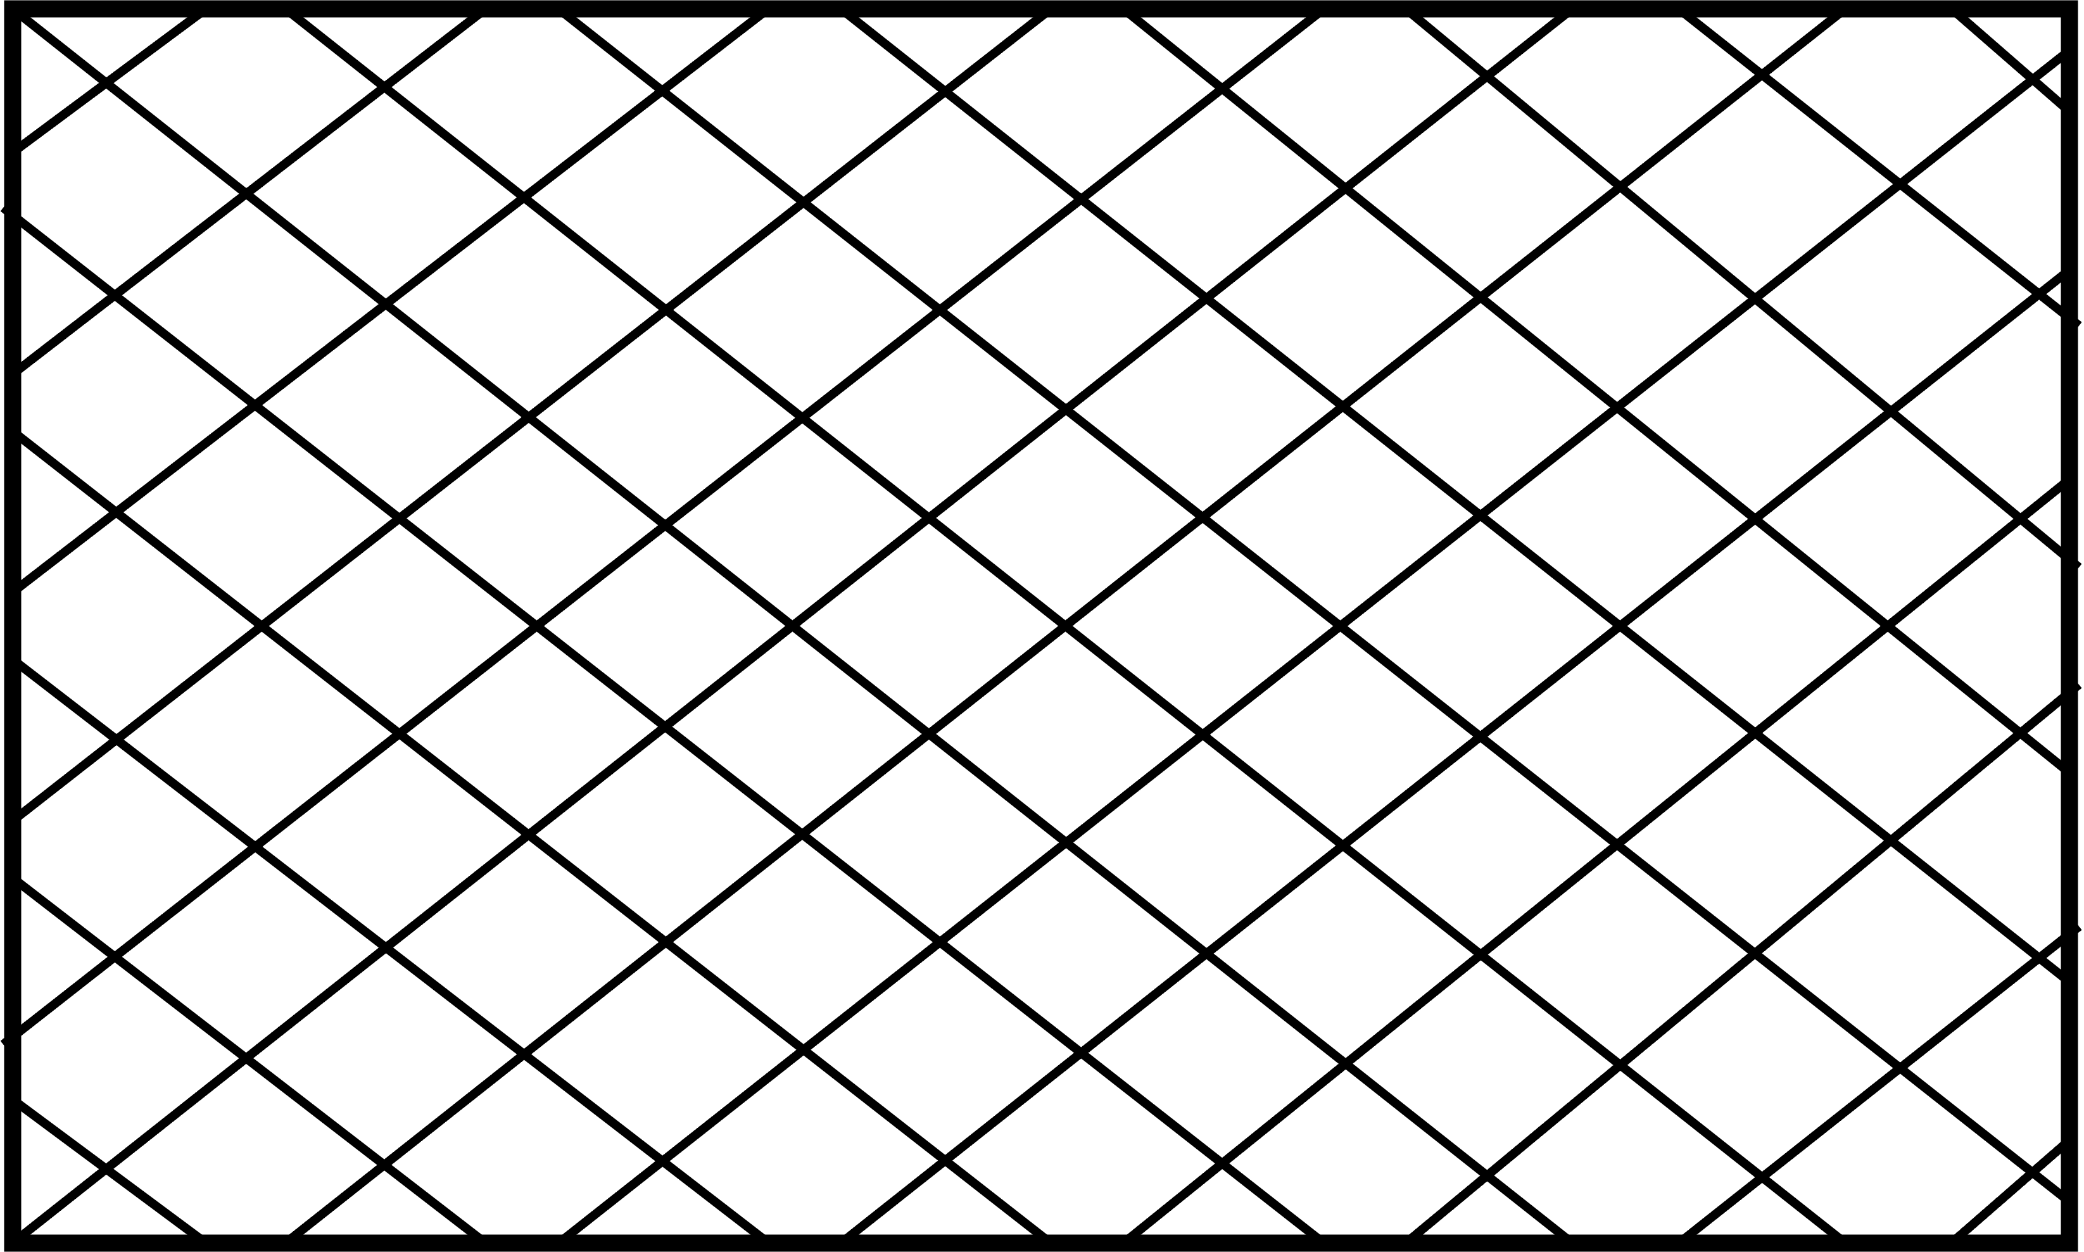
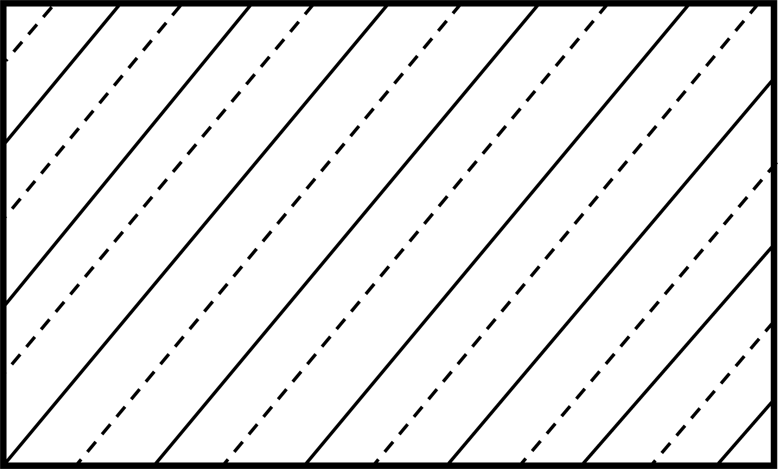

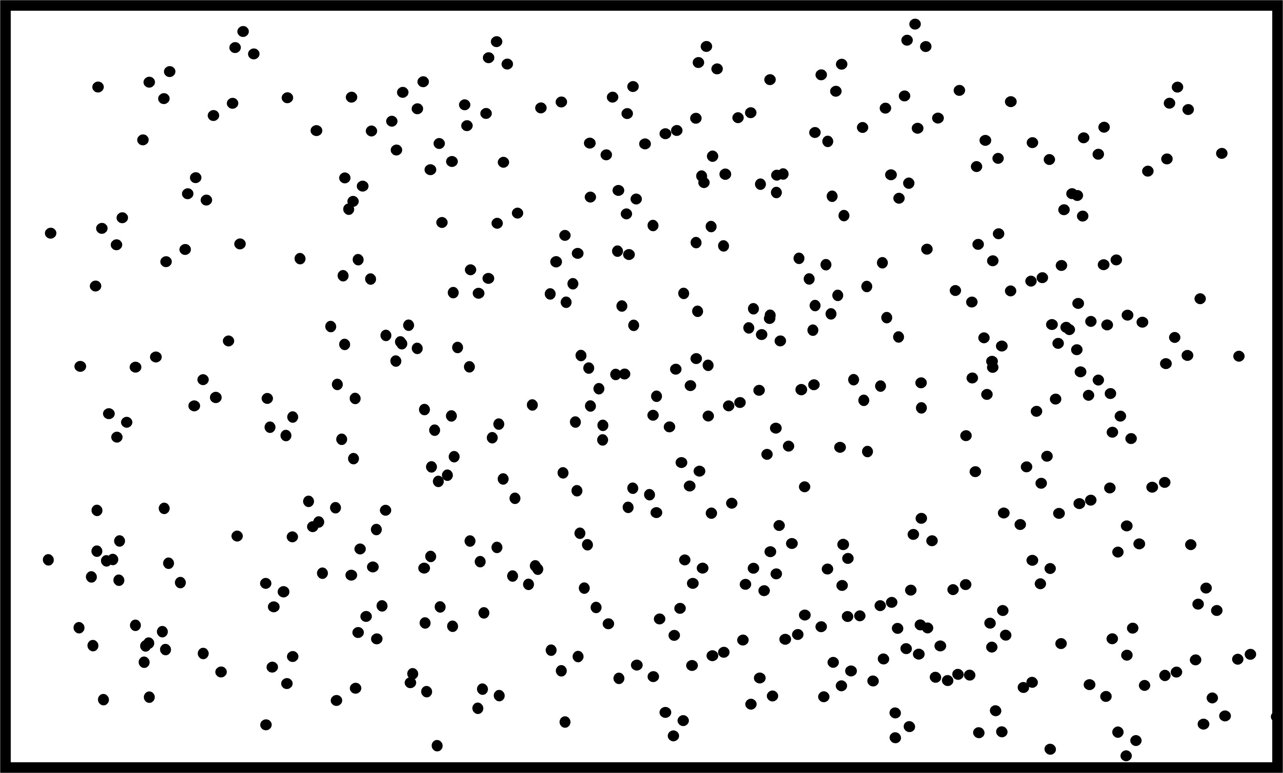
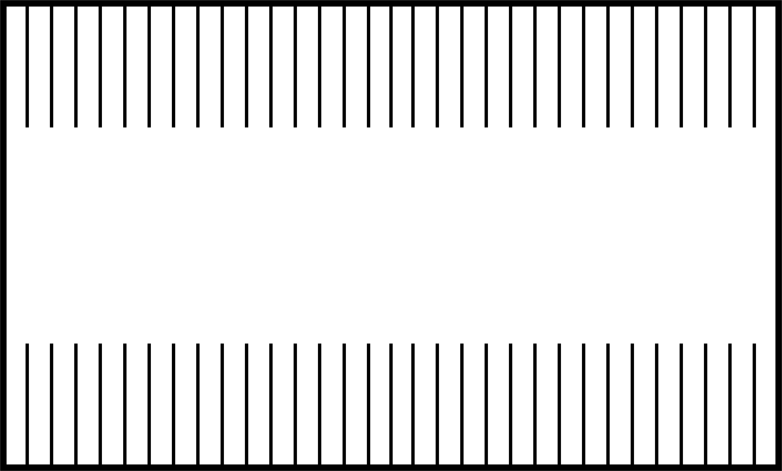
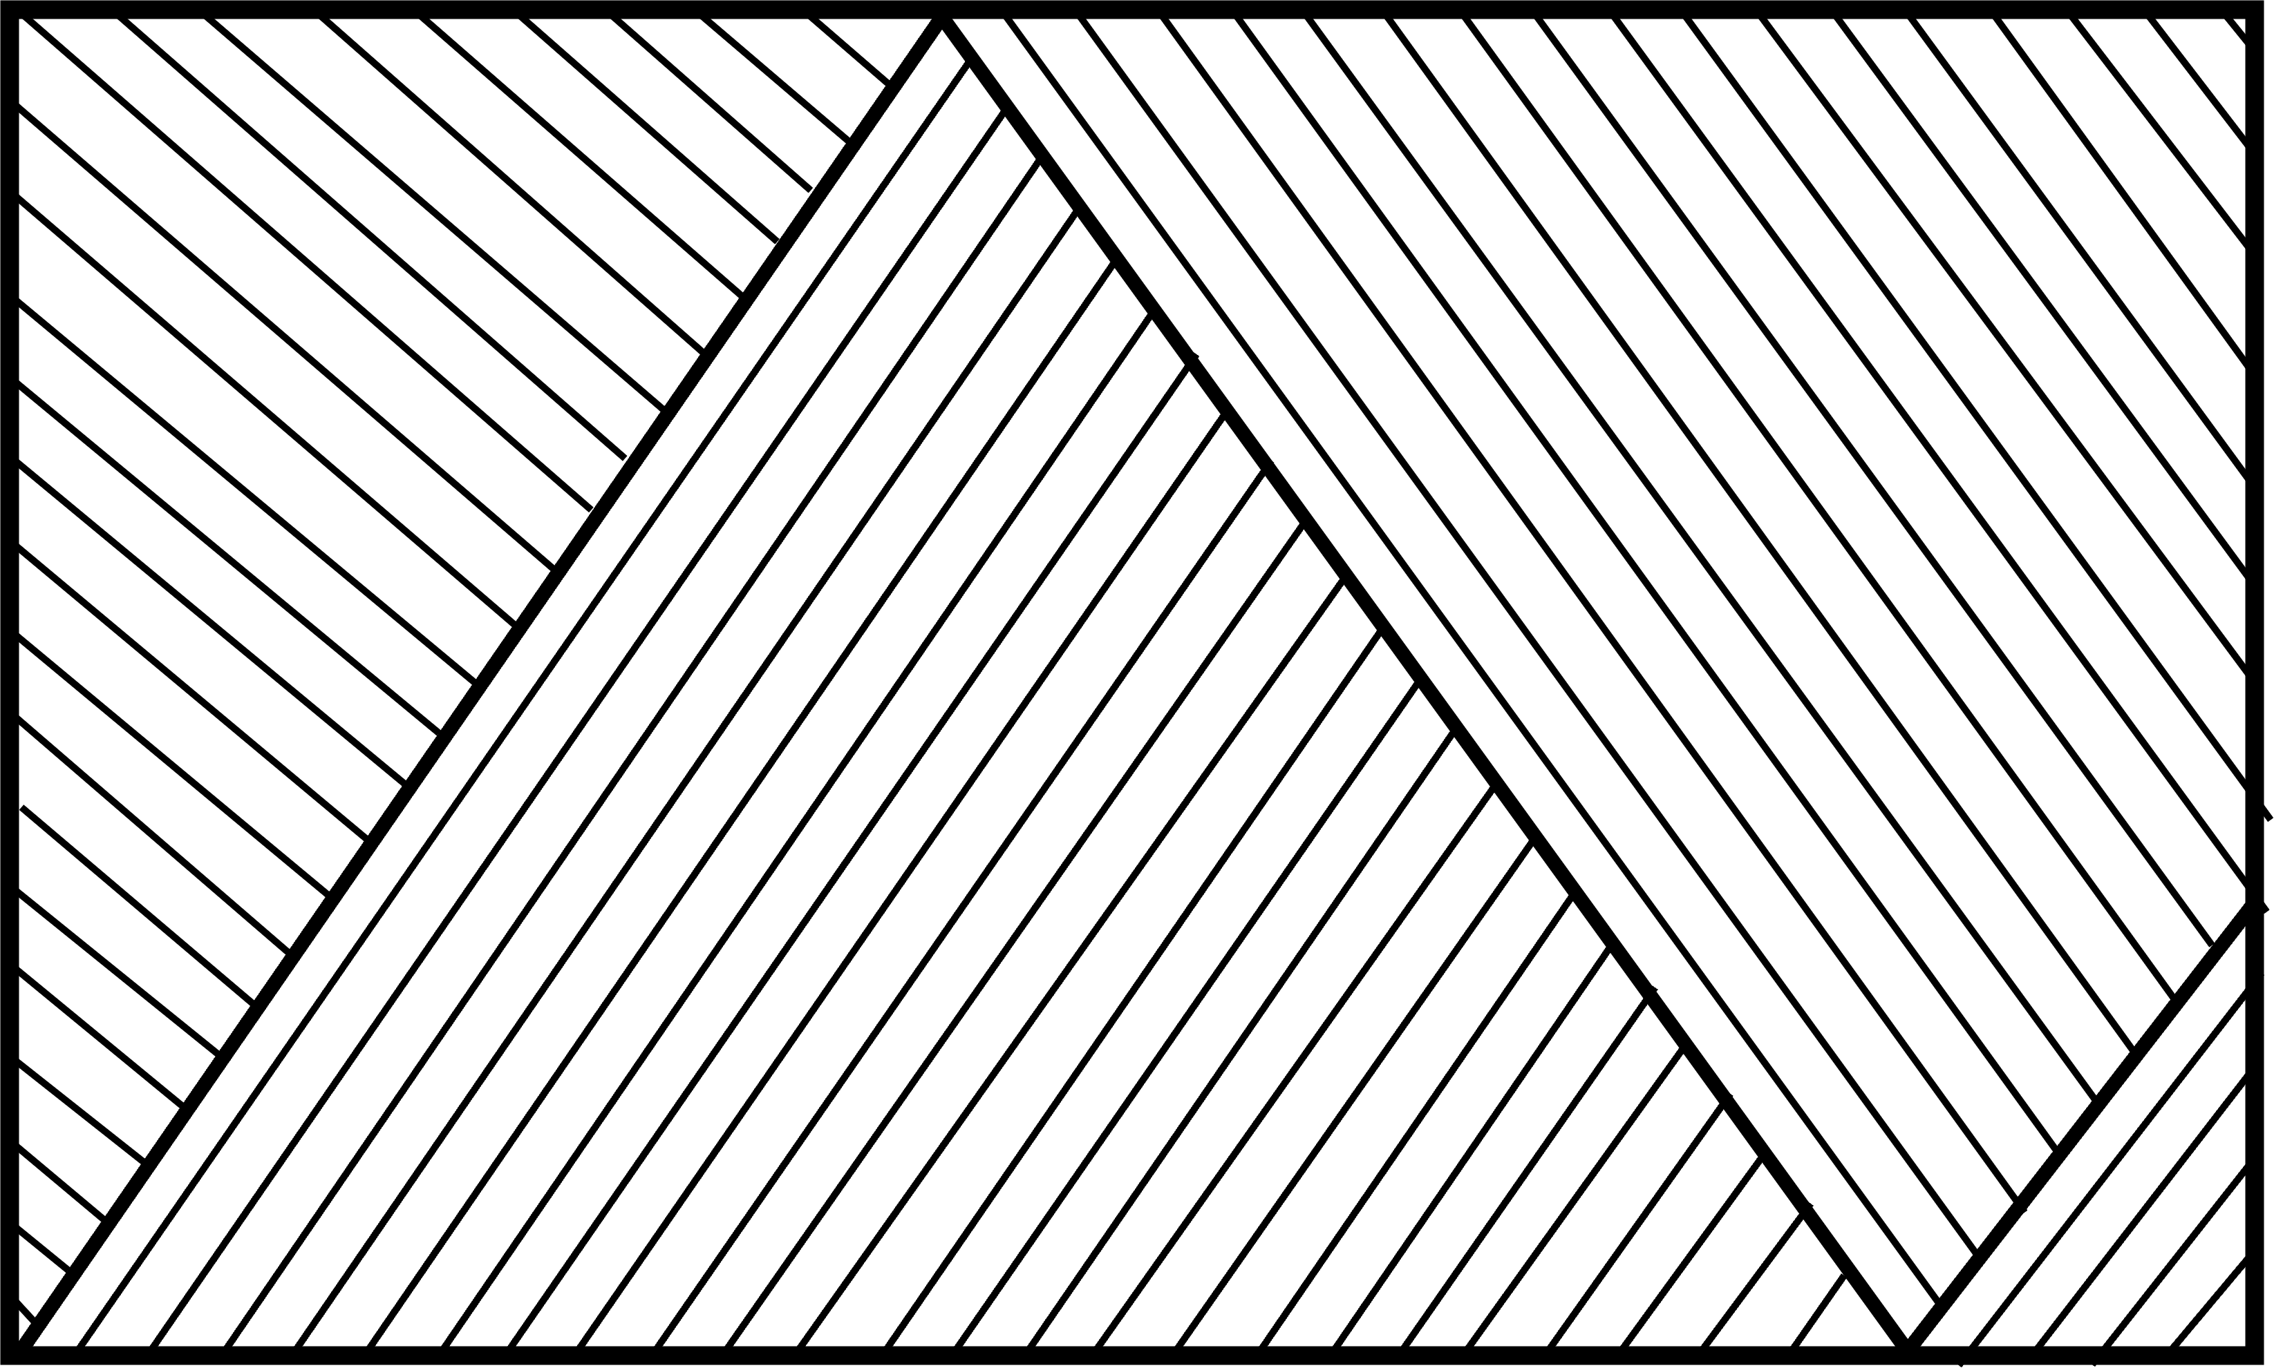
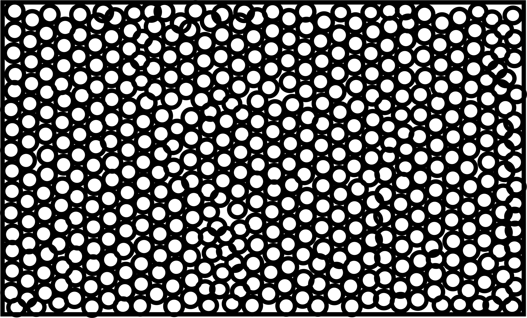
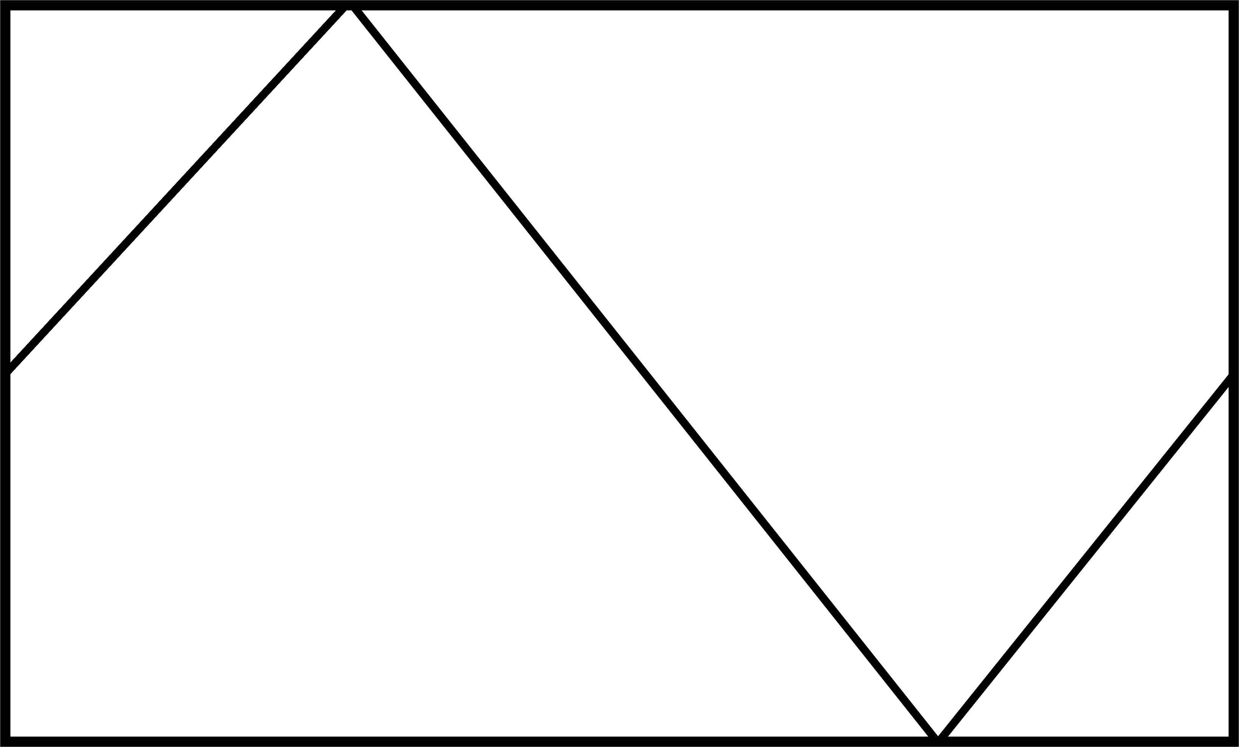
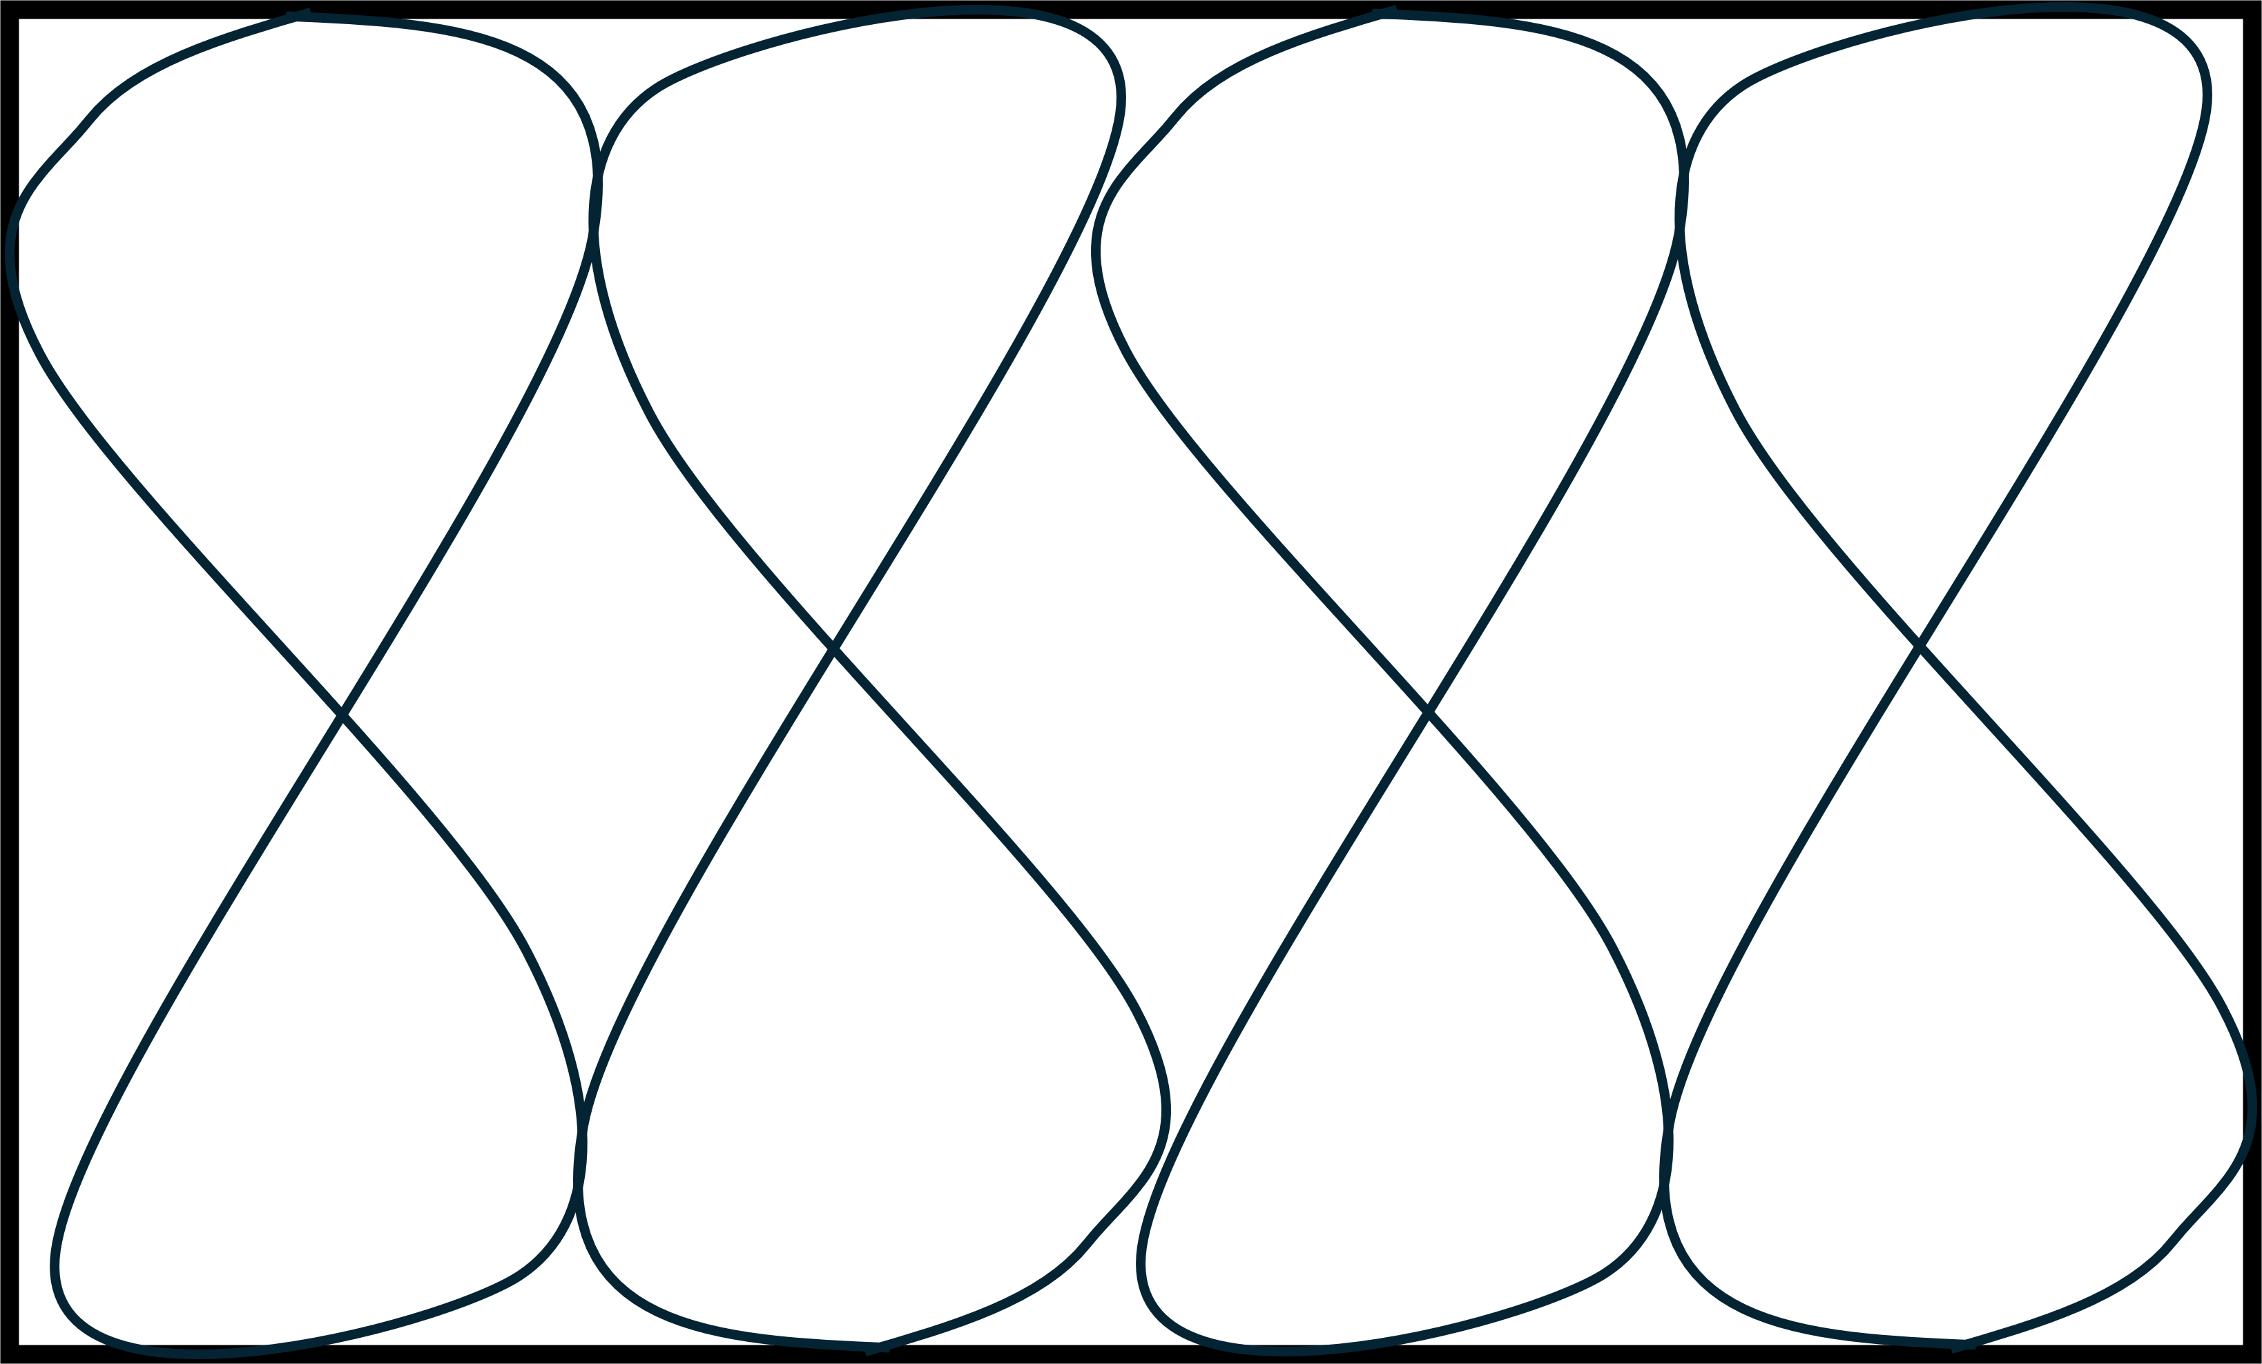
Hatchings.
Sawn Timber
Planed Timber
Plywood
Blockboard
Metal
Brickwork
Blockwork
Stonework
Concrete
Plaster
Topsoil
Subsoil
Granular Fill
Hardcore
Insulation

Slide 37
Lines.
Cement Screed
Damp Proof Coarse
Window

Slide 38
Symbols.
Symbols are used in construction drawings for several important reasons:
Clarity and Precision:
Symbols provide a clear and precise way to represent various elements of a construction project. This helps avoid misunderstandings and ensures that everyone involved in the project has a common understanding of the design.
Efficiency:
Using symbols allows for a lot of information to be conveyed in a compact and efficient manner. This is especially useful in complex projects where space on drawings is limited.
Standardization:
Symbols are standardized across the industry, which means that anyone familiar with construction drawings can understand them, regardless of the specific project or location. This standardization helps in maintaining consistency and quality across different projects
Communication:
Symbols facilitate effective communication among architects, engineers, contractors, and other stakeholders. They provide a universal language that can be understood by professionals from different disciplines.
Detail Representation:
Symbols can represent detailed information about materials, dimensions, and other specifications without cluttering the drawing. For example, different hatch patterns can indicate various materials like concrete, wood, or steel.
Safety and Compliance:
Accurate use of symbols ensures that safety standards and building codes are adhered to. This is crucial for the safety of both the construction workers and the eventual occupants of the building.

Slide 39

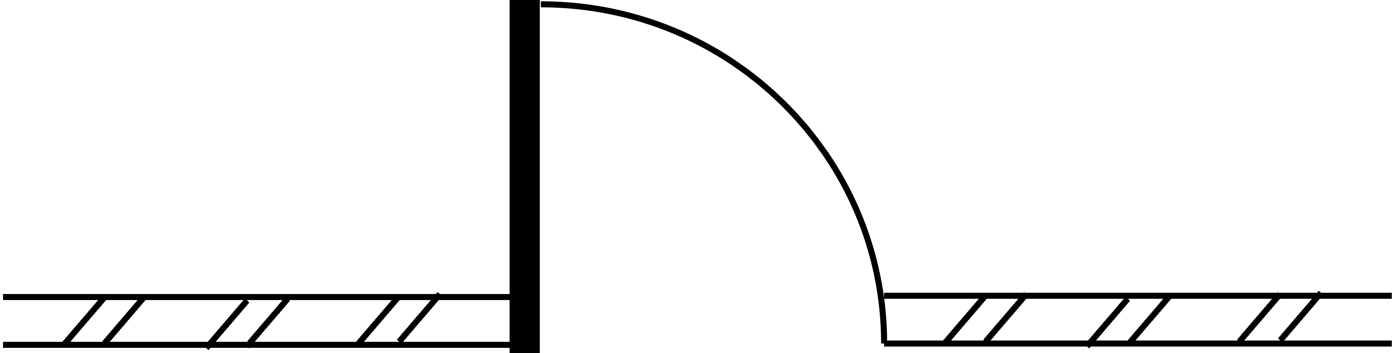

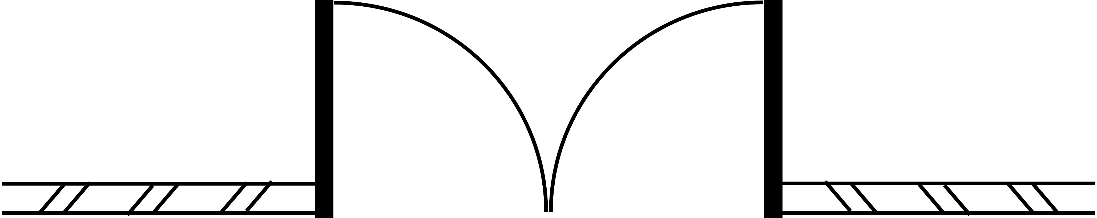
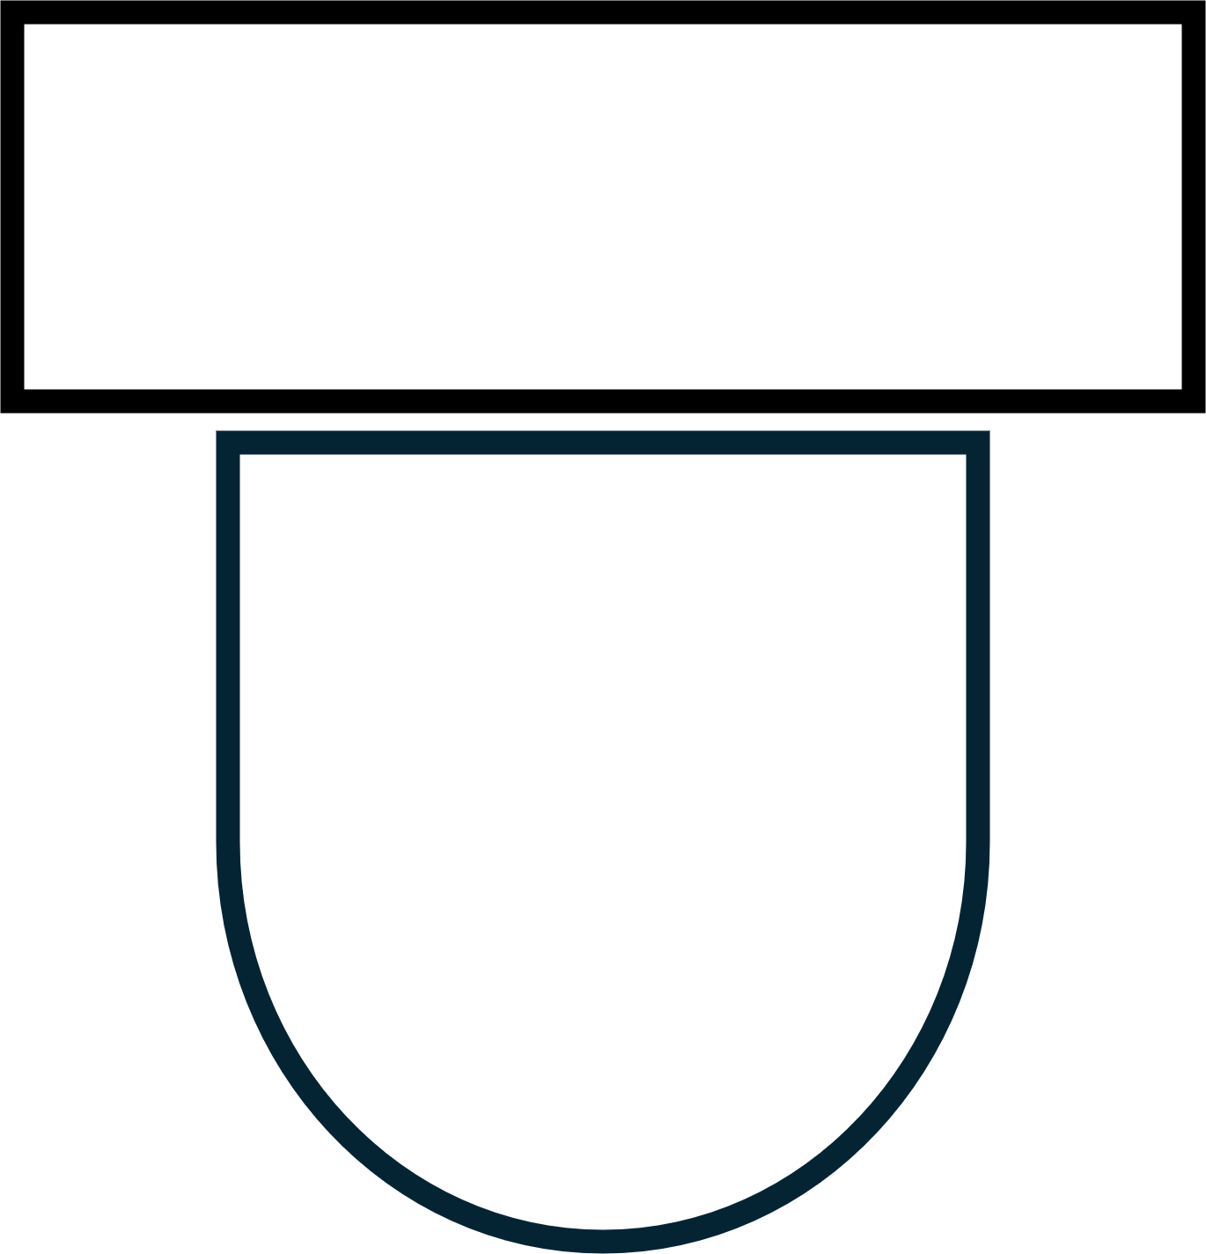
Symbols.
Bath
Single Door
Sink
Double Door
Toilet

Slide 40

Symbols.
North Point
Staircase
1
2
3
4
5
6
7
8
N
Bottom Hung Window
Top Hung Window
Side Hung Window

Slide 41
Abbreviations.
Abbreviations in construction drawings are shortened forms of words or phrases used to convey complex information quickly and efficiently. They are essential for making drawings more concise and easier to read, especially given the limited space available on blueprints.
By using abbreviations, architects and engineers can communicate detailed instructions about materials, measurements, and construction techniques without cluttering the drawings.
This practice helps streamline communication, reduce the risk of misinterpretation, and ensure that all stakeholders have a clear understanding of the project requirements. Common examples include “A/C” for air conditioning, “HVAC” for heating, ventilation, and air conditioning, and “CAD” for computer-aided design.

Slide 42
Abbreviations.
Word | Abbreviation
Damp Proof Course | dpc
Discharge Pipe | DP
Foundation | fdn
Hardcore | hc
Hardboard | hdbd
Hardwood | hwd
Inspection Chamber | IC
Insulation | insul
Tongue & Grooved | t&g
Joist | jst
Plasterboard | pbd
Reinforced Concrete | RC
Rainwater Pipe | RWP
Word | Abbreviation
Aggregate | agg
Air Brick | Ab
Aluminium | Al
Bitumen | Bit
Boarding | Bdg
BS Beam | BSB
Building | Bldg
Cast Iron | Ci
Cement | Ct
Column | Col
Concrete | Conc
Copper | Cu

Slide 43

Recap.
We have….
Identified Drawing Tools & Equipment
Identified BS1192 Standards
Identified Drawing Projections
Identified Hatches, Symbols & Abbreviations
Identified Scales & Measurements

Slide 44


Any Questions?
If you have any questions why not try and look up the answer online using a search engine and typing in your question, if you can't find your answer then ask your tutor or email them your questions at:
Lecturer@college.ac.uk

Slide 45

Thank You.
We would like to take this opportunity to thank you for using this material. If you have any questions or suggestion on this or any other learning material produced by Educon please email:
Educon.rix@gmail.com
Lecturer: James Rix

