Slide 1




Measuring & Marking Tools.
Lecturer: James Rix

Slide 2


Aims & Objectives.
Aims:
Identify types of measuring and marking tools.
Objectives:
Identify Measuring & Marking Tools 1
Identify Measuring & Marking Tools 2
Identify Measuring & Marking Tools 3
Identify Measuring & Marking Tools 4
Identify Measuring & Marking Tools 5
Identify Measuring & Marking Tools 6

Slide 3

Measuring & Marking Tools
1.

Slide 4

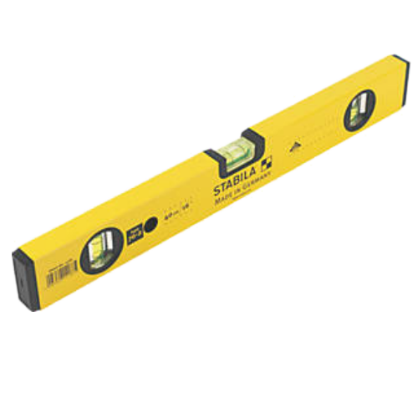
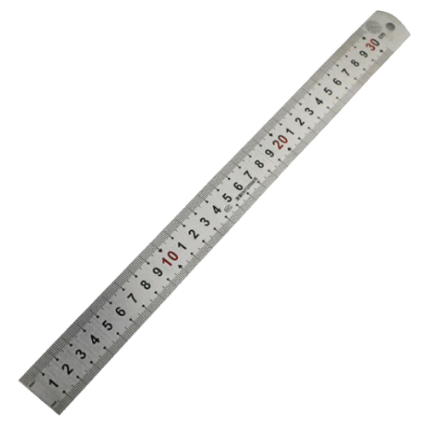
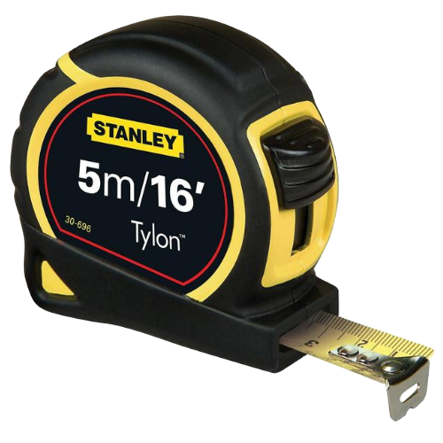
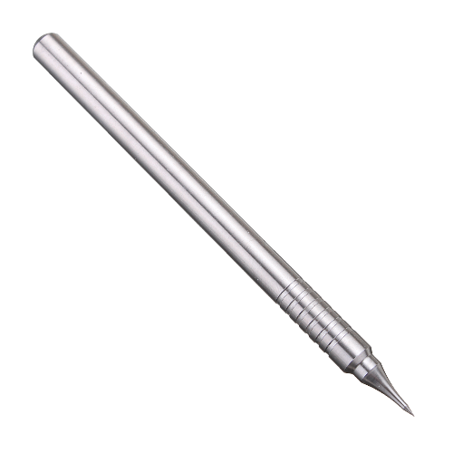
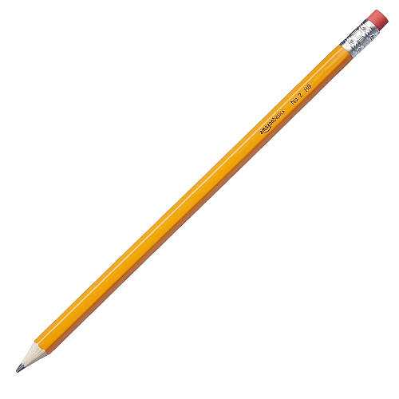
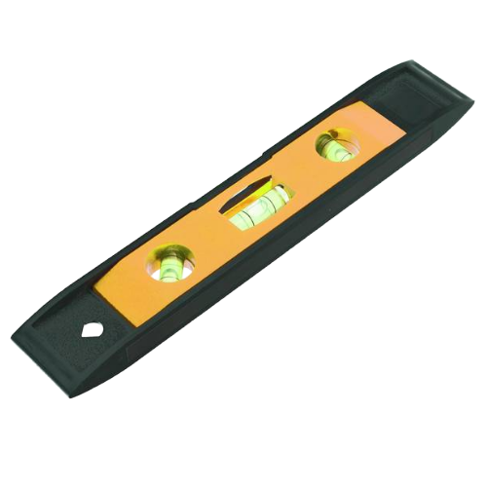
Measuring & Marking Tools 1.
Spirit Level
Tape Measure
Steel Rule
Pencil
Boat Level
Scribe

Slide 5
Measuring & Marking Tools 1:
Pencil.
Rubber
A pencil is a drawing and writing instrument that comes in many grades (see bottom of slide). The lead is a graphite powder mixed with a clay binder that creates a mark from physical abrasion.
Pencils are mainly used for drawing and sketching and in this case for marking wood for cutting or shaping. As well as different shades pencils come in colours too.
Lead
Ferule
Wood Casing
9H
8H
7H
6H
5H
4H
3H
2H
H
F
HB
B
2B
3B
4B
5B
6B
7B
8B
9B

Slide 6
Measuring & Marking Tools 1:
Scribe.
Head
A scribe is used for marking wood accurately. Sometimes preferred over a pencil or instead of a pencil. Scribes produce fine markings that reduce the need for aftercare or removal. A basic scribe is a steel spike with a tip sharpened to a fine point.
Body

Slide 7
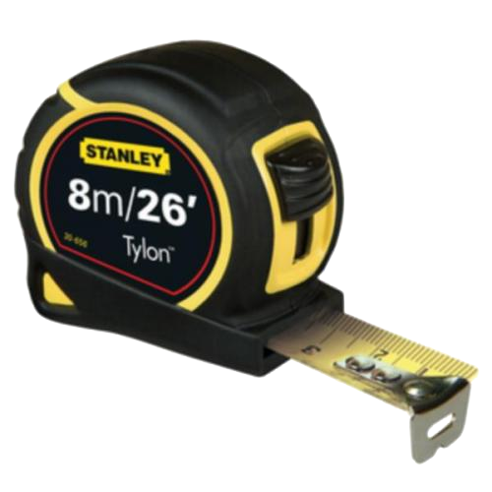
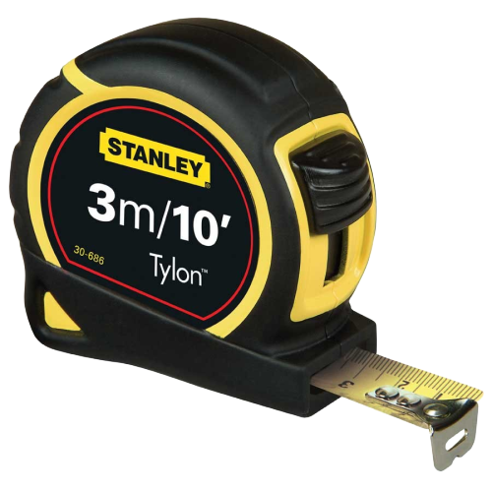
Measuring & Marking Tools 1:
Tape Measure.
Belt Loop
A tape measure is a tool used for measuring. It has linear measurement markings and can be found in both metric and imperial versions. Most tape measures have both metric and imperial measurement markings.
Tape measures can typically be bought in 3m, 5m and 8m lengths.
Tape measures consist of a metal strip that retracts into the body/case of the tape measure.
Body/Case
Thumb Lock
Blade
Spring & Stop
Hook
8m
5m
Imperial
3m
1
1
2
3
Metric

Slide 8
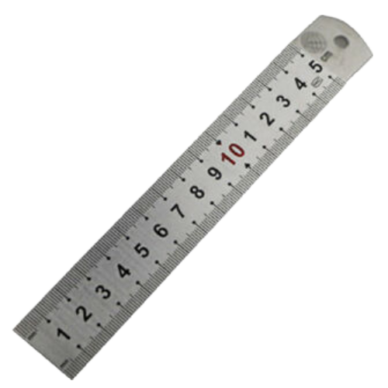
Measuring & Marking Tools 1:
Steel Rule.
Steel rules are an essential part of the toolkit. A metal blade with measurements marked along the edges. Usually has both imperial and metric measurements. Steel rules come in various lengths; the more popular lengths are 150mm/6” and 305mm/12”. Steel rules are more accurate than folding rules as they are rigid and made in one piece.
Rule Blade
300mm/12”
150mm/6”
Imperial
1
1
2
3
Metric

Slide 9
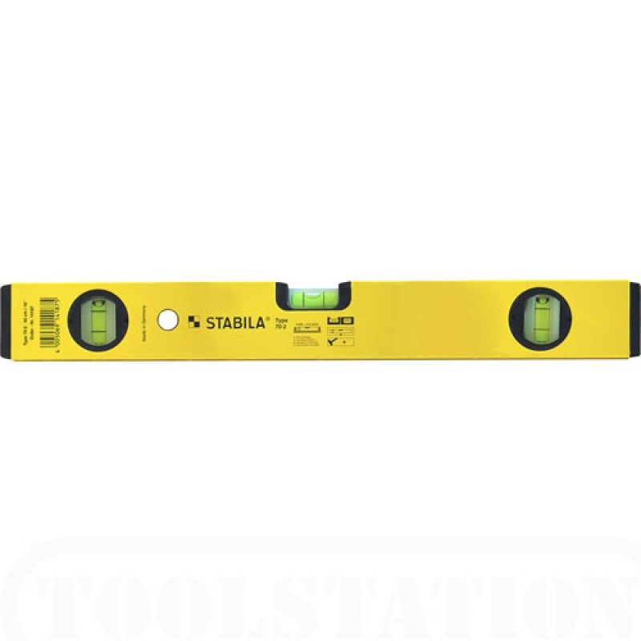
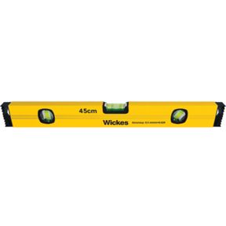
Measuring & Marking Tools 1:
Spirit Level.
Box Beam Construction
Level Vials
A spirit level is a tool used to check work for level (horizontal) or plumb (Vertical). Some levels also have a 3rd vial for 45º angles. The vials are a yellowish-green colour with additives for UV protection. The best spirit level is accurate to within 0.5mm. Spirit levels are also known as bubble levels or simply level.
Check for level here
Level
90º
180º
45º
Check for plumb here
Plumb

Slide 10
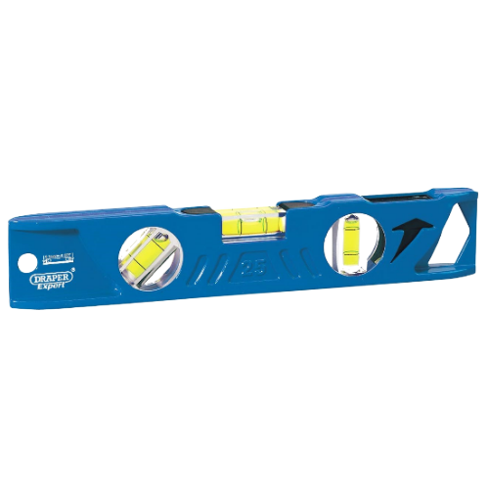
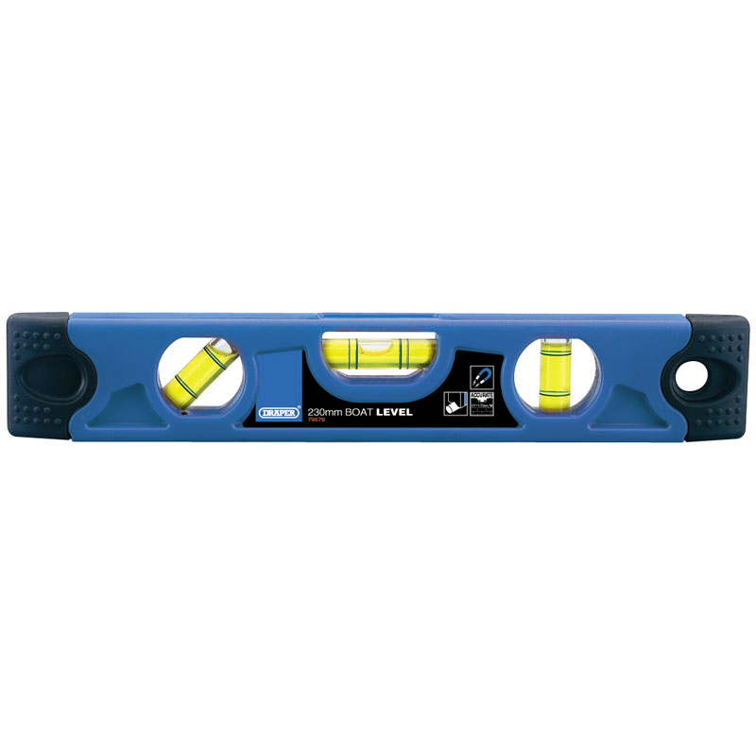
Measuring & Marking Tools 1:
Boat Level.
Level Vials
A spirit level is a tool used to check work for level (horizontal) or plumb (Vertical). Some levels also have a 3rd vial for 45º angles. The vials are a yellowish-green colour with additives for UV protection. The best spirit level is accurate to within 0.5mm. Spirit levels are also known as bubble levels or simply a level.
45º
180º
90º
Check for level here
Level
Check for plumb here
Plumb

Slide 11
Measuring & Marking Tools
2.

Slide 12
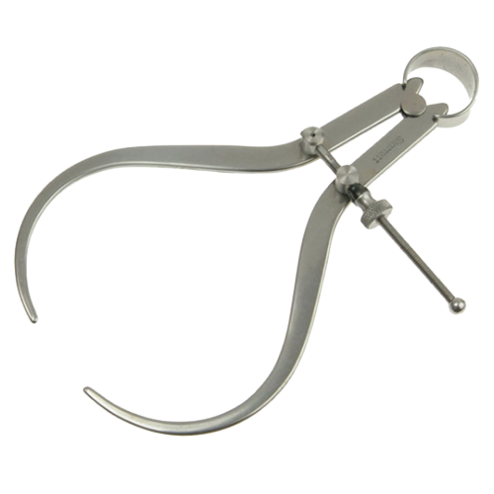
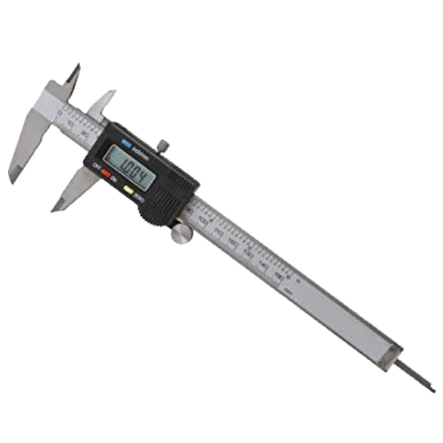
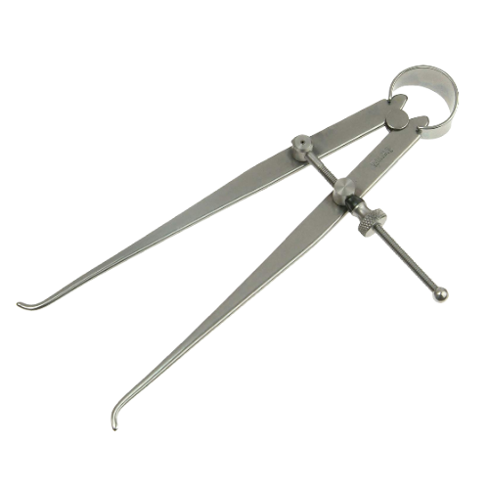
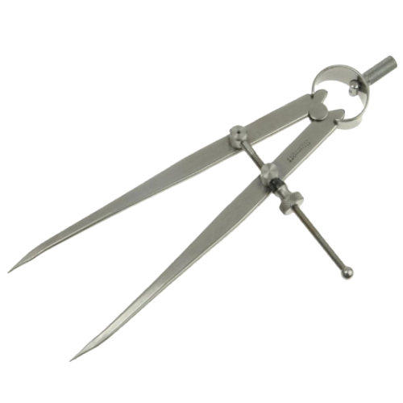
Measuring & Marking Tools 2.
Outside Calipers
Digital Calipers
Inside Calipers
Dividers

Slide 13
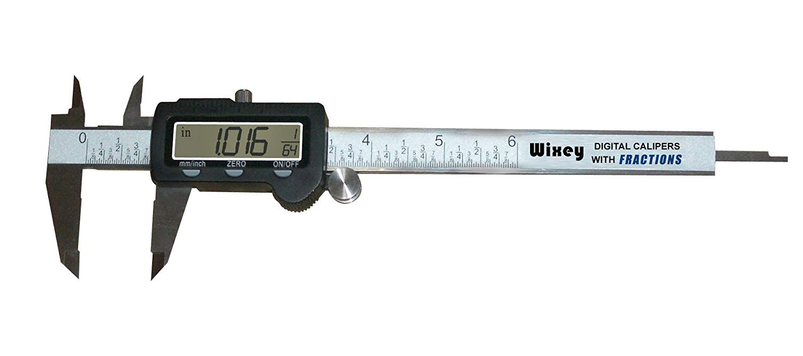
Measuring & Marking Tools 2:
Digital Calipers.
Digital calipers are the next generation of Vernier calipers. With a digital readout and ability to switch between metric and imperial measurements. Used for measuring distances either internally or externally. Digital calipers are extremely accurate. Powered by a small battery.
Main scale
Upper jaws for inside measurement
Lower jaws for outside measurement
Depth Rod
LCD Display

Slide 14
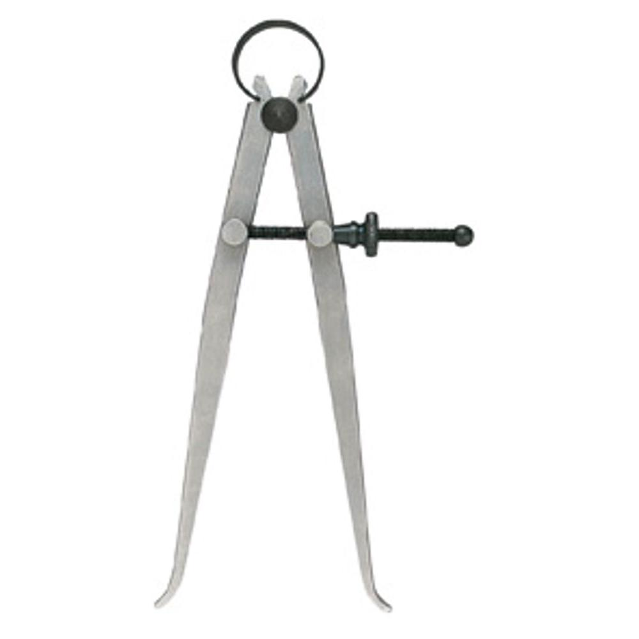
Measuring & Marking Tools 2:
Inside Calipers.
An instrument used to measure the inside distance of a gap. For example, when turning a bowl, inside calipers would be used to determine the internal size of the object.
Internal measurement
Centering Collar
Spring
Legs
Spring Loaded Tension Knob

Slide 15
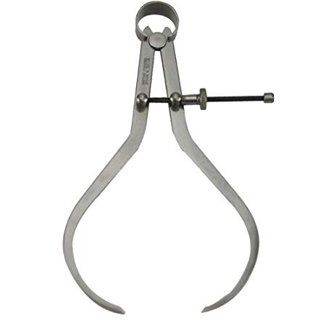
Measuring & Marking Tools 2:
Outside Calipers.
An instrument used to measure the outside distance of a gap. For example, when turning a spindle, outside calipers would be used to determine the external size of the object.
Centering Collar
Spring
External measurement
Legs
Spring Loaded Tension Knob

Slide 16
Measuring & Marking Tools 2:
Dividers.
Often referred to as a compass the dividers main use is for marking out arcs and circles and for dividing up a measurement into equal increments. The divider has 2 points, one on each arm. One is for pivoting on and the other is for the marking. The distance between each leg is adjusted at the centering collar using the spring-loaded tension knob and once set can repeat the same measurement over and over.
Centering Collar
Equal parts
Spring
Legs
Spring Loaded Tension Knob

Slide 17
Measuring & Marking Tools
3.

Slide 18
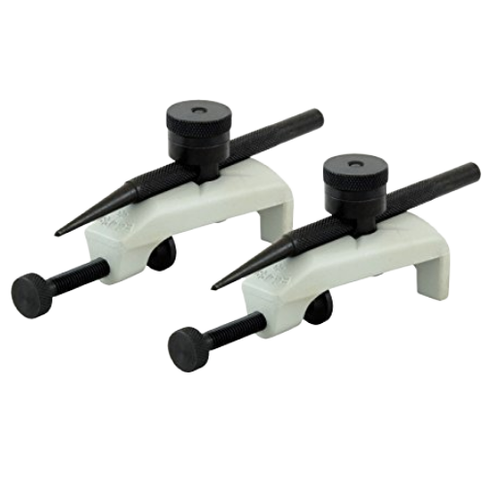
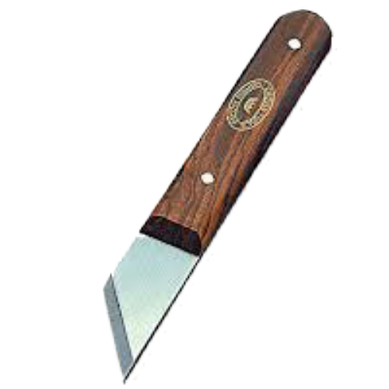
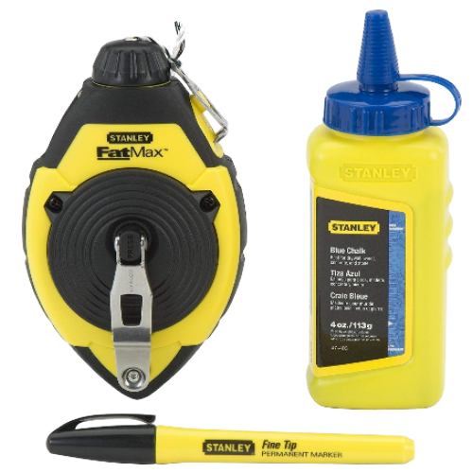
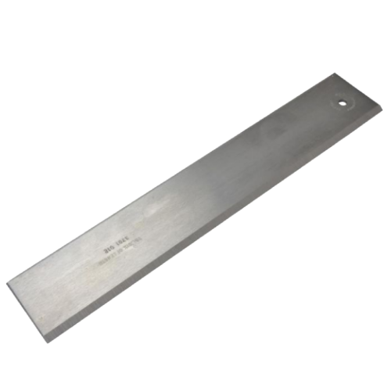
Measuring & Marking Tools 3.
Trammel heads
Marking Knife
Straight Edge
Chalk Line and Reel

Slide 19
Measuring & Marking Tools 3:
Chalk Line & Reel.
Hook and line
A chalk line is a tool used to mark out straight lines. It is used mainly on a flat surface over distances that can't be achieved by rulers or straightedges. The line is charged with chalk while in the reel, the line is then stretched between the two points and twanged against the surface producing a straight line. When marking a plumb line the reel itself can be used as a weight to stretch the line.
Door
Crank
Box
Reel
Chalk
Chalk pen

Slide 20
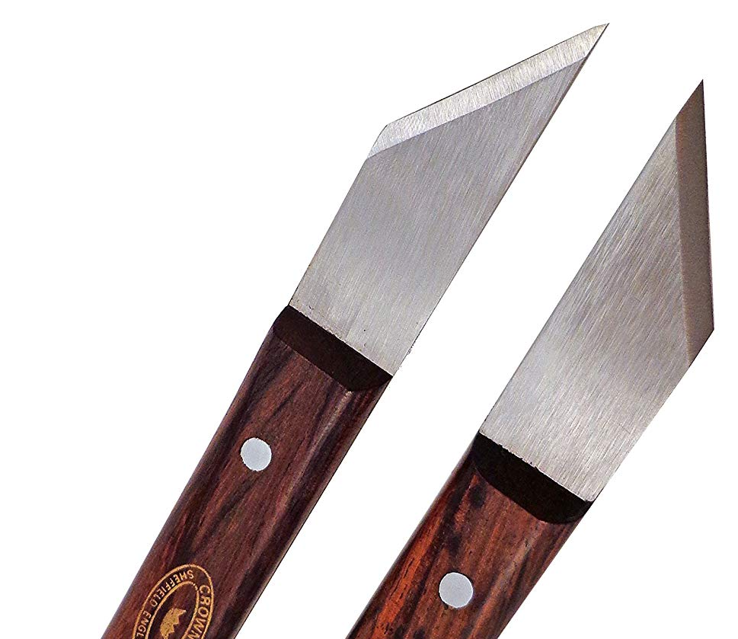
Measuring & Marking Tools 3:
Marking Knife.
Pins
A marking knife is a tool used for scribing markings onto wood. Used in place of a pencil or scribe. Marking knives are comprised of a steel blade encases in a handle with a single bevel blade. The blade is sharpened on the left side for left-handed people and the right side for right-handed people.
Hardwood handle
Single bevel blade
Right-handed
High carbon steel
Left-handed

Slide 21
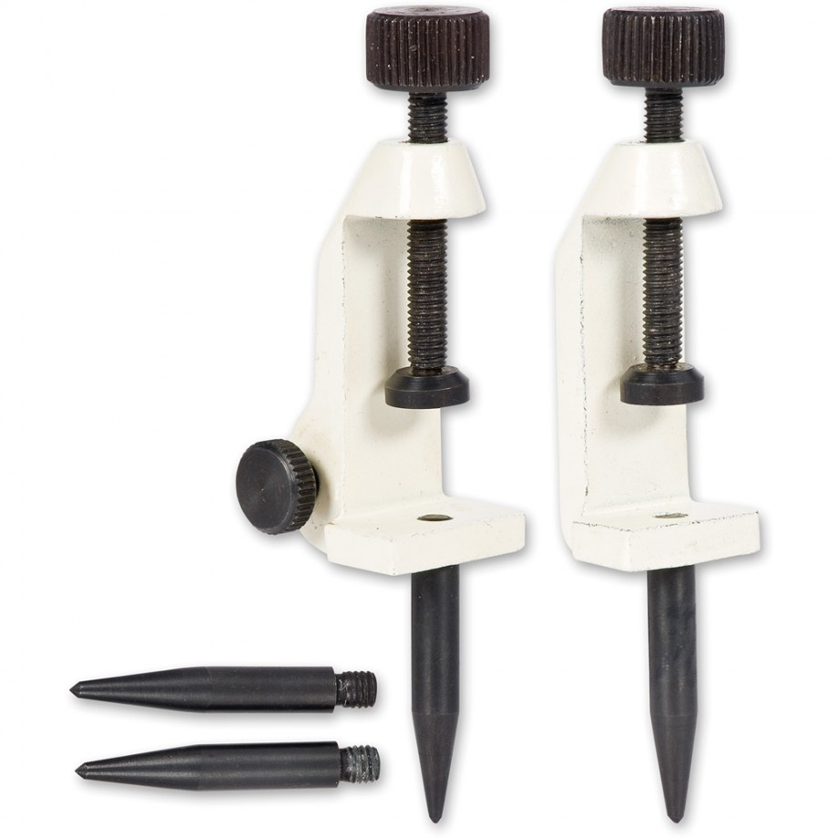
Measuring & Marking Tools 3:
Trammel Heads.
Trammel heads are a tool primarily used for marking arcs and circles. They are also known as Trammel Points or trammels. They are clamped to a straight and true beam of either wood or metal and are only restricted by the length of said beam. The trammel pins or points can be replaced with a pencil creating a bigger scale compass.
Clamps
Thumbscrews
Pins

Slide 22

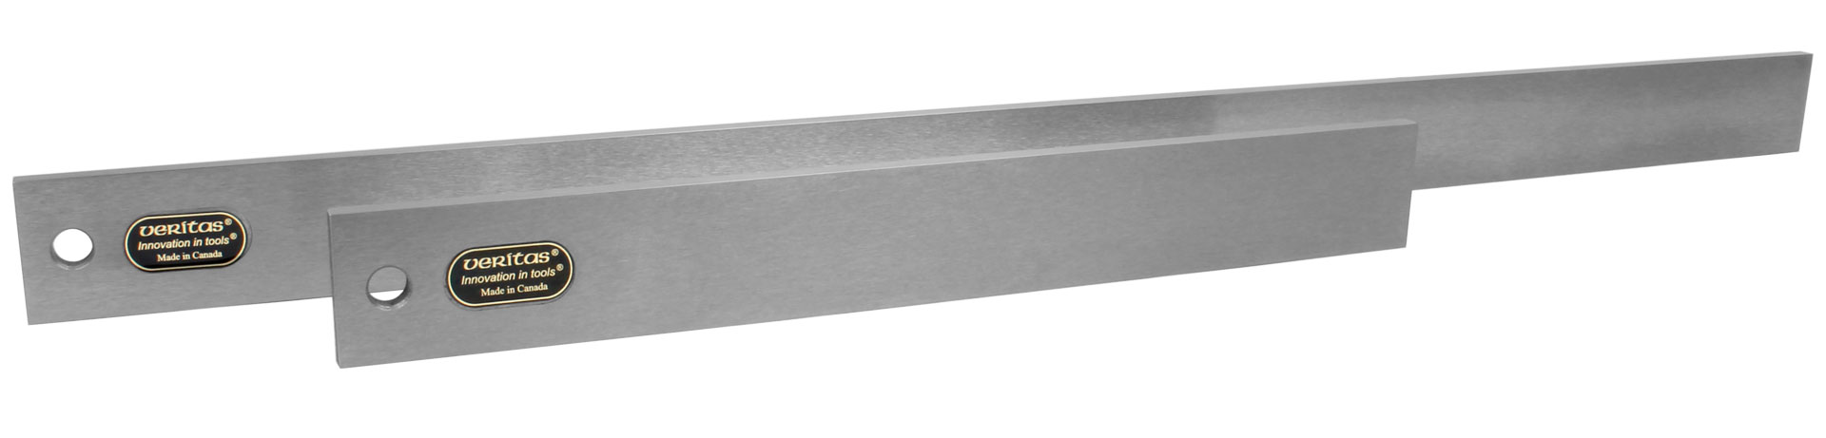
Measuring & Marking Tools 3:
Straight Edge.
A straight edge also spelt straightedge is used for marking straight lines or checking for straightness. Straight edges are used in many different trades including those outside of construction. They comprise of steel or aluminum lengths of square and true bars. A pair of straight edges can be used as winding sticks to check for twists.
Steel or aluminum blade
Using 2 straight edges for winding stick
Various Lengths

Slide 23
Measuring & Marking Tools
4.

Slide 24
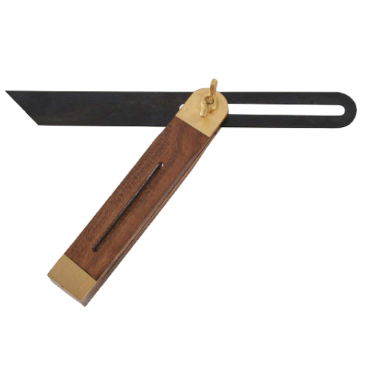
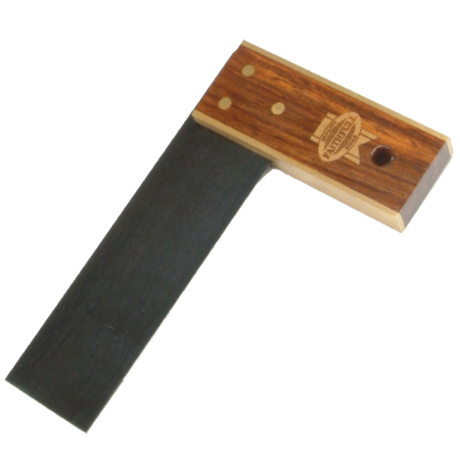
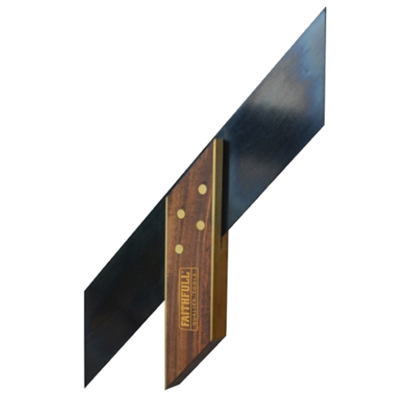
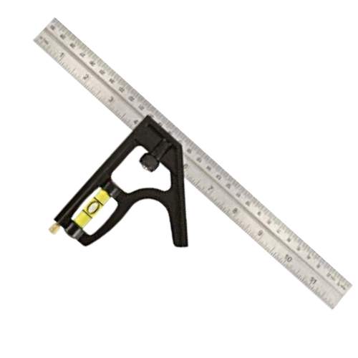
Measuring & Marking Tools 4.
Try Square
Sliding Bevel
Mitre Square
Combination Square

Slide 25
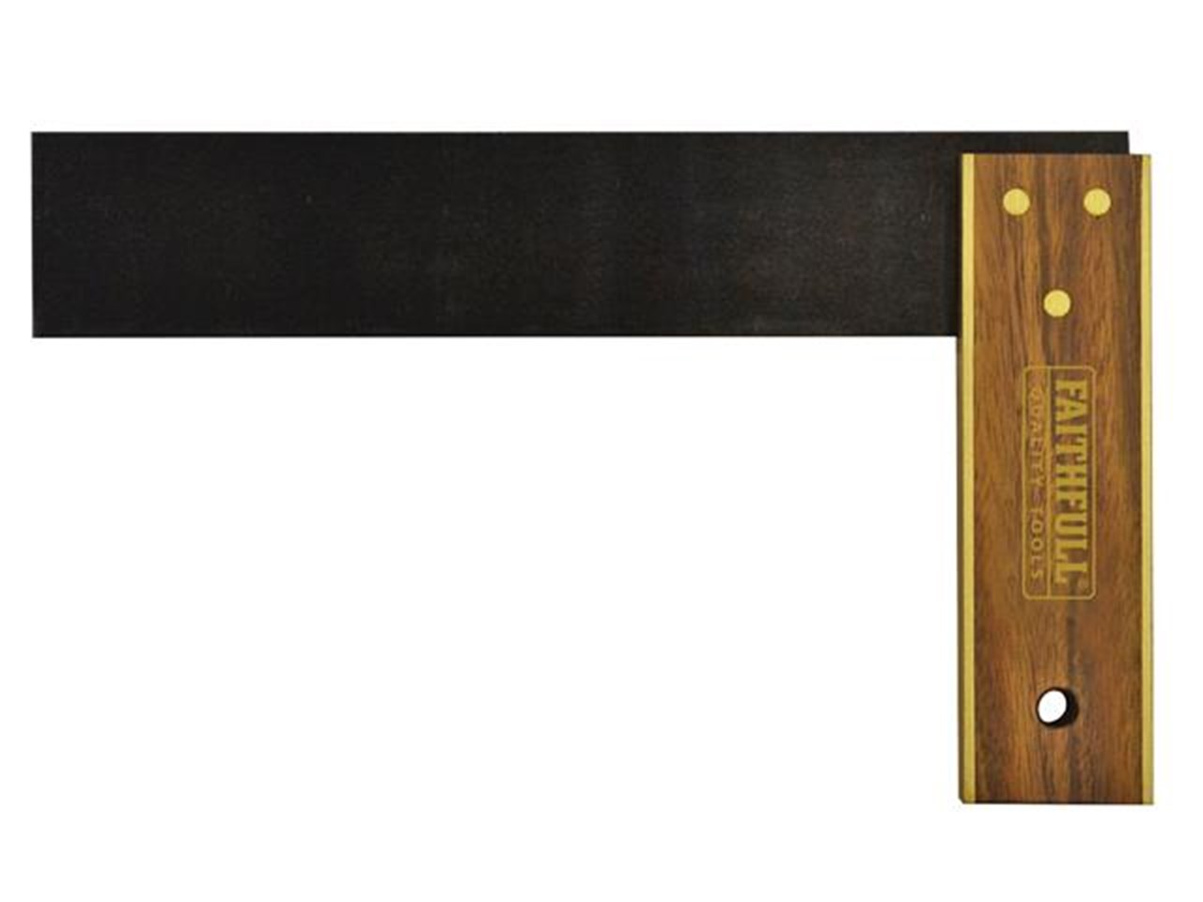
Measuring & Marking Tools 4:
Try Square.
Rivets
Stock
A try square is used for marking and checking square. In marking it allows a 90º angle to be produced off a straight edge. In checking it allows you to check stock for squareness on all sides and ends. The try square is composed of two main parts - the stock and the blade.
Blade
Wear Plate
90º

Slide 26
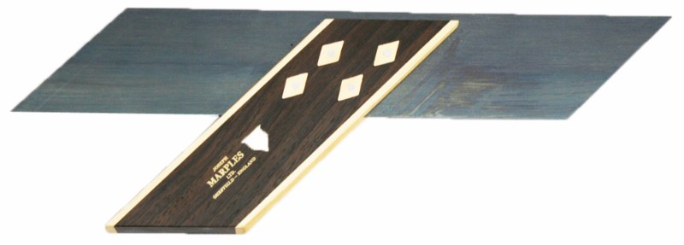
Measuring & Marking Tools 4:
Mitre Square.
Rivets
A mitre square is used for marking and checking mitres/45º. In marking it allows a 45º angle to be produced off a straight edge. In checking it allows you to check stock for mitres. The mitre square is composed of two main parts - the stock and the blade.
Blade
Wear Plate
Stock
45º

Slide 27
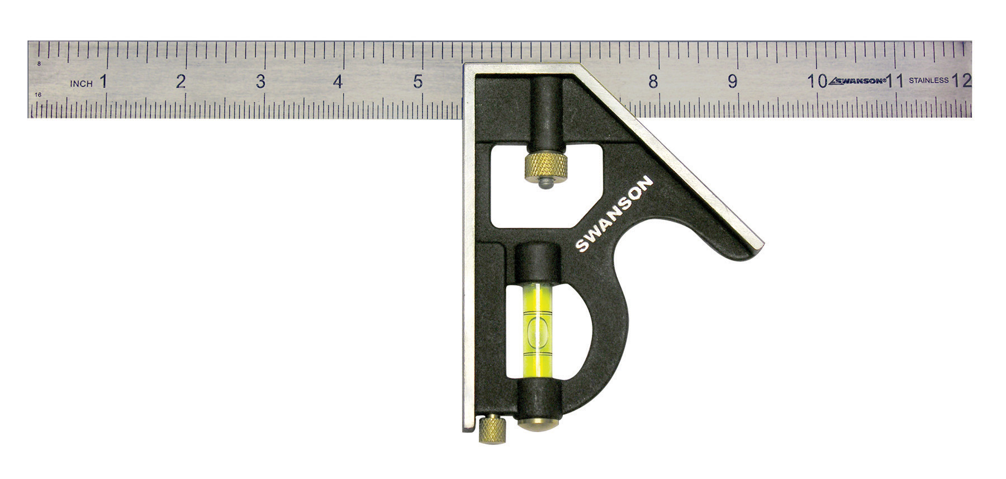
Measuring & Marking Tools 4:
Combination Square.
Blade
A combination square is a tool used for marking out 90º and 45º lines in woodworking, stonemasonry and metalworking. It also has a level and scribe functions. Combination squares can have interchangeable heads to give it more functions hence the name combination square, it has a combination of uses.
Square
Level
Mitre
Scribe
Stock
90º
45º

Slide 28
Measuring & Marking Tools 4:
Sliding Bevel.
Blade
A sliding bevel is an adjustable marking tool used in carpentry and joinery for transferring and setting angles. It consists of a stock and a movable blade that can be locked in place with a screw or lever. Because the blade pivots freely, the sliding bevel is ideal for copying existing angles, marking dovetails or mitres, and checking accuracy during layout work. It’s a versatile tool that helps ensure consistent, repeatable angles across a project.
Stock
Tightening Screw

Slide 29
Measuring & Marking Tools
5.

Slide 30
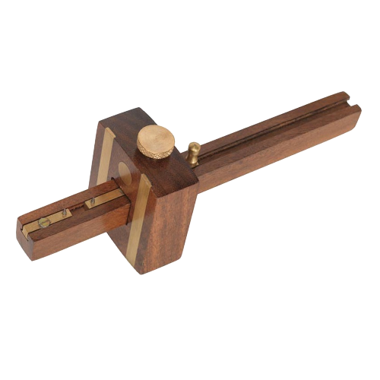
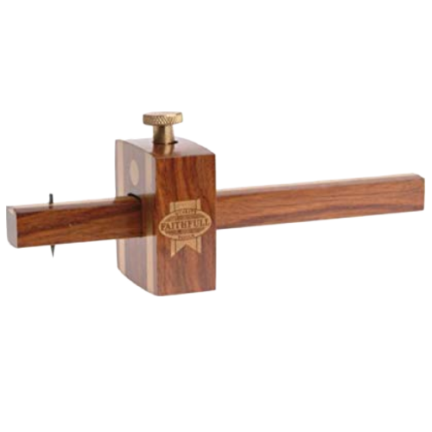
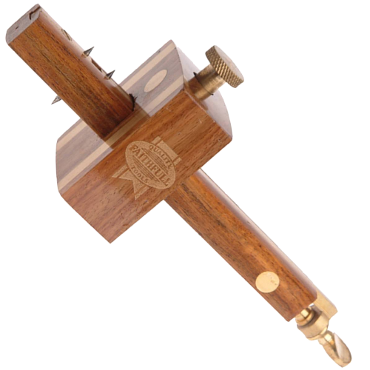
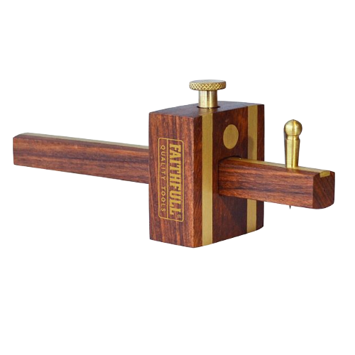
Measuring & Marking Tools 5.
Mortice Gauge
Marking Gauge
Combination Gauge
Cutting Gauge

Slide 31
Measuring & Marking Tools 4:
Marking Gauge.
A marking gauge is a precision tool used in carpentry and joinery to scribe parallel lines along a piece of timber. It consists of a stem, a fence (or stock), and a sharp pin or cutter that marks the surface. By adjusting the fence, the marking gauge ensures consistent measurements from the edge, making it ideal for tasks like marking out joints, rebates, or tenons with accuracy and repeatability.
Tightening Screw
Fixed Pin
Beam
Stock/Fence

Slide 32
Measuring & Marking Tools 4:
Mortice Gauge.
Beam
A mortice gauge is a marking tool used in carpentry and joinery to scribe two parallel lines at a set distance, usually for marking out mortices and tenons. It looks similar to a marking gauge but has two adjustable pins instead of one, allowing precise marking of both sides of a joint. The fence slides along the stem and locks in place, ensuring consistent spacing and accuracy when laying out work.
Stock/Fence
Moveable Pin
Tightening Screw
Fixed Pin

Slide 33
Measuring & Marking Tools 4:
Combination Gauge.
Mortice Gauge Side.
A combination gauge is a versatile marking tool used in carpentry and joinery that combines the functions of both a marking gauge and a mortice gauge. It has a single pin on one side for marking parallel lines and a pair of adjustable pins on the other for marking mortices. With its sliding stock and dual‑purpose design, the combination gauge allows quick switching between tasks, making it especially useful for efficient, accurate layout work.
Fixed Pin
Moveable Pin
Tightening Screw
Fixed Pin
Beam
Marking Gauge Side.
Stock/Fence
Second Pin Adjustment

Slide 34
Measuring & Marking Tools 4:
Cutting Gauge.
Tightening Screw
A cutting gauge is a marking tool used in carpentry and joinery to score clean, accurate lines across the grain. Instead of a pin, it uses a small blade that slices the fibres, helping prevent tear‑out and giving a sharper, more precise mark. It’s especially useful when marking shoulders, rebates, or any layout where a crisp, clean line is essential for accuracy.
Beam
Stock/Fence
Blade

Slide 35
Measuring & Marking Tools
6.

Slide 36
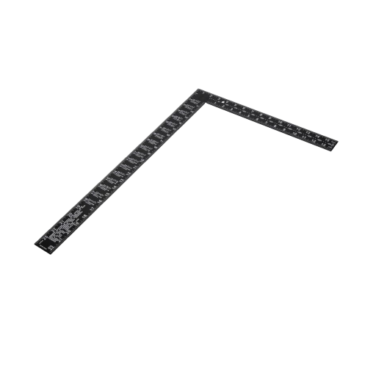
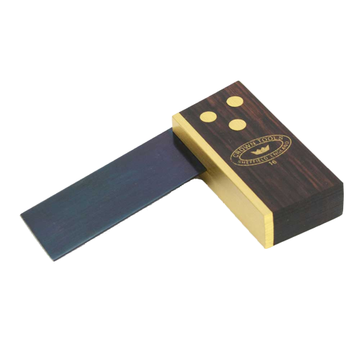
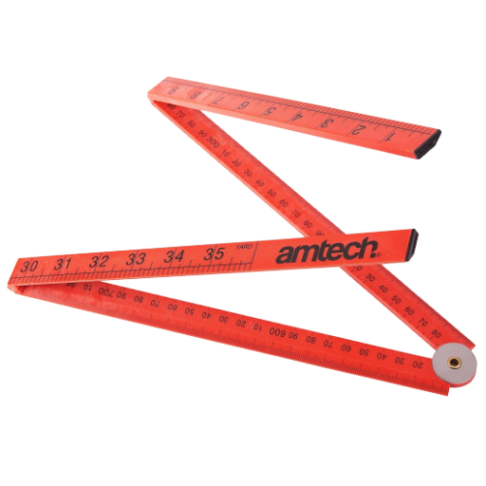
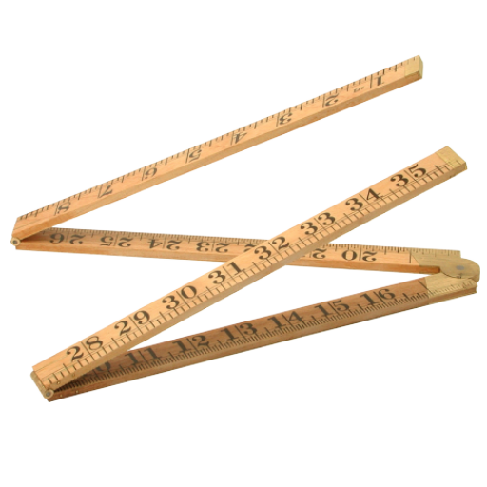
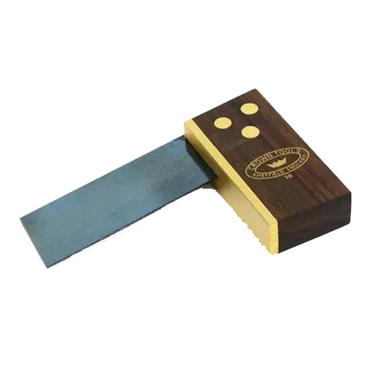
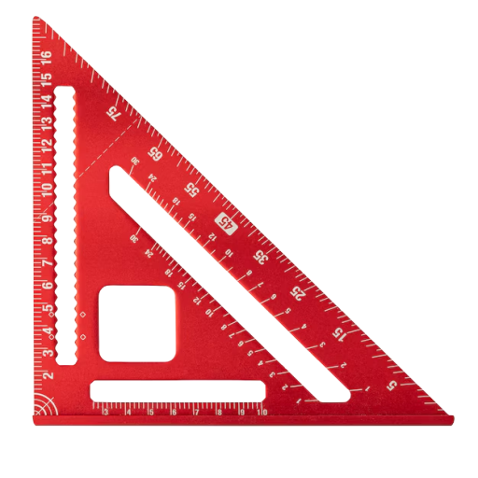
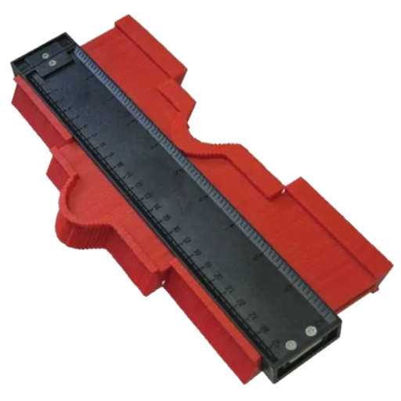
Measuring & Marking Tools 6.
Builders Square
Folding Rule
Dovetail Square 1:6
Profile Gauge
Speed Square
Dovetail Square 1:8

Slide 37
Measuring & Marking Tools 6:
Folding Rule.
A folding rule is a traditional measuring tool used in carpentry and joinery for taking accurate linear measurements. Made from wood or plastic, it consists of several hinged sections that fold together for easy storage and unfold to form a straight ruler. Unlike a tape measure, it stays rigid when extended, making it ideal for marking straight lines and measuring internal spaces with precision.

Slide 38
Measuring & Marking Tools 6:
Dovetail Square 1:6.
A 1:6 dovetail square is a specialist marking tool used in fine carpentry and joinery to set out dovetail joints with consistent accuracy. The 1:6 ratio gives a gentle slope ideal for softwoods, helping create strong, clean‑fitting dovetails. Its fixed angle allows the user to mark both the tail and pin sides quickly and repeatably, ensuring each joint is uniform and precise.
Stock
6
5
4
3
2
1
0
Blade
0
1

Slide 39
Measuring & Marking Tools 6:
Dovetail Square 1:8.
A 1:8 dovetail square is a fixed‑angle marking tool used to lay out dovetail joints with a steeper, more refined slope suited to hardwoods. The 1:8 ratio creates a stronger mechanical lock in dense timber, helping the joint resist pulling forces. Its precise, unchanging angle allows carpenters and joiners to mark tails and pins quickly and consistently, ensuring clean, accurate dovetail layouts every time.
8
Stock
7
6
5
4
3
2
Blade
1
0
0
1

Slide 40
Measuring & Marking Tools 6:
Builders Square.
A builder’s square is a large, L‑shaped measuring tool used in carpentry and joinery to check and mark accurate 90‑degree angles on timber and sheet materials. Its long, rigid arms make it ideal for squaring door frames, stud walls, and larger construction layouts where precision over distance matters. Durable and easy to read, the builder’s square helps ensure structures stay true, straight, and properly aligned.
Tongue
Body

Slide 41
Measuring & Marking Tools 6:
Profile Gauge.
A profile gauge, also known as a contour gauge, is a handy marking tool used in carpentry and joinery to copy the exact shape of an irregular surface. It consists of a row of sliding pins that move independently, allowing the gauge to press against mouldings, pipes, trims, or other uneven profiles and capture their outline. This shape can then be transferred directly onto timber for accurate cutting and fitting, making the profile gauge ideal for scribing work and precision finishing.

Slide 42
Measuring & Marking Tools 6:
Speed Square.
A speed square is a triangular measuring tool used in carpentry and joinery for marking and checking angles quickly. Made from metal or plastic, it combines the
functions of a try square,
protractor, and saw guide. Its 90° and 45° edges make it ideal for marking perpendicular or mitre cuts, while the degree scale allows for precise angle layout. It’s a compact, versatile tool that helps ensure accuracy and efficiency in everyday marking tasks.
45º
Hip/Valley
Angles
Line Guide
Commons
Pivot Point
45º
Right Angle
T Edge

Slide 43

Recap.
In this session we…
Identified Measuring & Marking Tools 1
Identified Measuring & Marking Tools 2
Identified Measuring & Marking Tools 3
Identified Measuring & Marking Tools 4
Identified Measuring & Marking Tools 5
Identified Measuring & Marking Tools 6

Slide 44

Any Questions?
If you have any questions why not try and look up the answer online using a search engine and typing in your question, if you cant find your answer then ask your tutor or email them your questions at:
Lecturer@college.ac.uk

Slide 45

Thank You.
We would like to take this opportunity to thank you for using this material. If you have any questions or suggestion on this or any other learning material produced by Educon please email:
Educon.rix@gmail.com
Lecturer: James Rix

