Slide 1



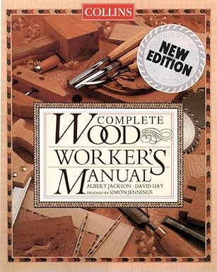
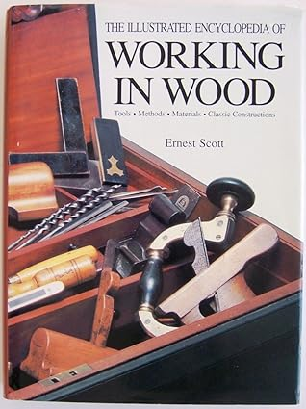







101.1 – Resource Sheet
Resource Sheet.
Collins Complete Woodworkers Manual.
ISBN-10: 9780004140056
ISBN-13: 978-0004140056
The Illustrated Encyclopedia of Working in Wood.
ISBN-10: 051712078X
ISBN-13: 978-0517120781
Working in Wood, An Introduction
ISBN-10: 1857325648
ISBN-13: 978-1857325645
https://www.hse.gov.uk/construction/new-health-safety.html
https://www.youtube.com/watch?v=QbK8p1tKxYI
https://www.youtube.com/watch?v=3vZzvKZtZ2A
https://www.hse.gov.uk/construction/resources/index.html
https://www.youtube.com/watch?v=5zjzvZzvKzA
https://www.combepaffordschool.co.uk/_site/data/files/curriculum/work-related-learning/construction/learning-organisers/2024/DC67115973FDAA2AA324548070B4765C.pdf?utm_source=copilot.com
https://www.hse.gov.uk/construction/resources/law.docx
https://www.hse.gov.uk/construction/resources/toolboxtalks.docx
https://qualifications.pearson.com/content/dam/pdf/BTEC-Specialist-Qualifications/Health-and-Safety-in-a-Construction-Environment/Specification-Issue-2.pdf

