Slide 1


Back cover
Front cover
28
1

Slide 2

Back cover
Front cover
2
27

Slide 3

Back cover
Front cover
26
3

Slide 4

Back cover
Front cover
4
25

Slide 5


Back cover
Front cover
24
5

Slide 6

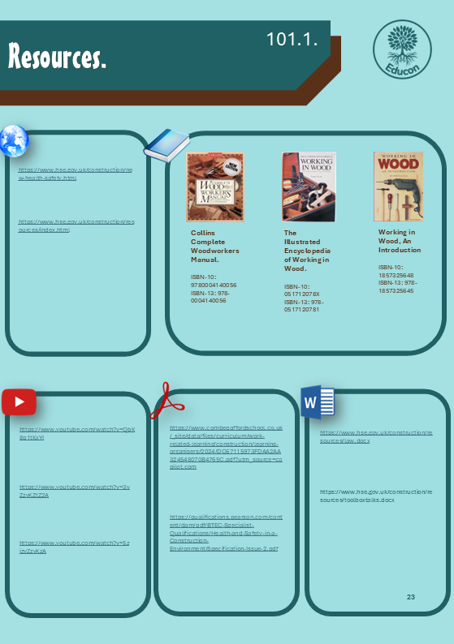
Back cover
Front cover
6
23

Slide 7
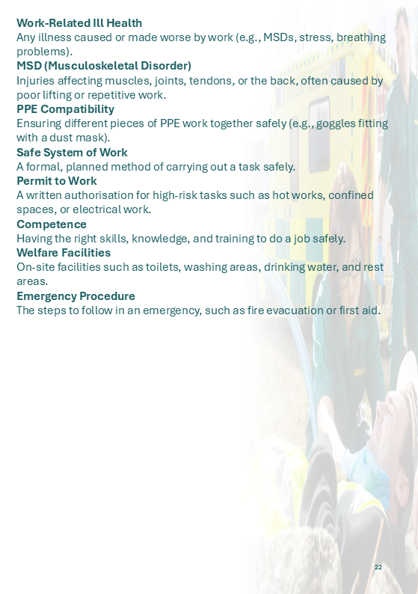

Back cover
Front cover
22
7

Slide 8

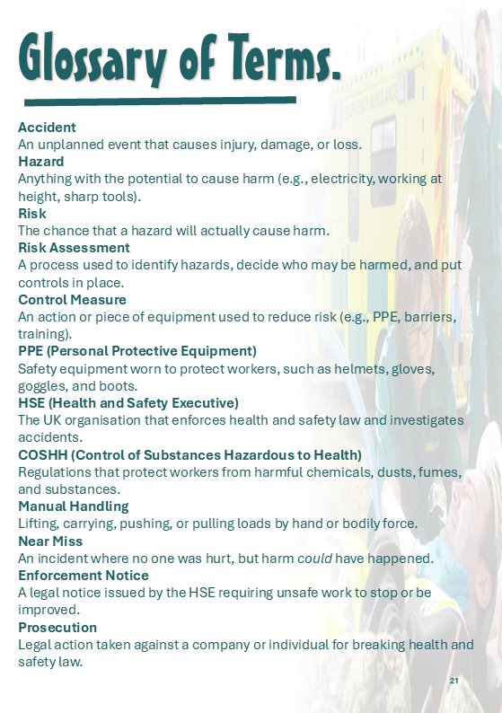
Back cover
Front cover
8
21

Slide 9
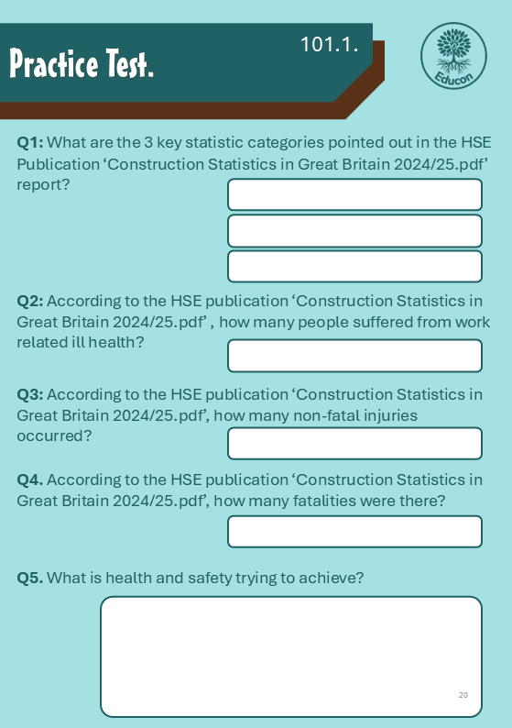

Back cover
Front cover
20
9

Slide 10
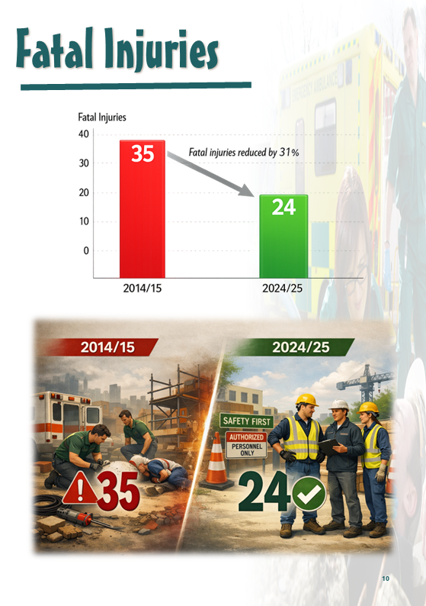

Back cover
Front cover
10
19

Slide 11


Back cover
Front cover
18
11

Slide 12


Back cover
Front cover
12
17

Slide 13


Back cover
Front cover
16
13

Slide 14


Back cover
Front cover
14
15

