Slide 1

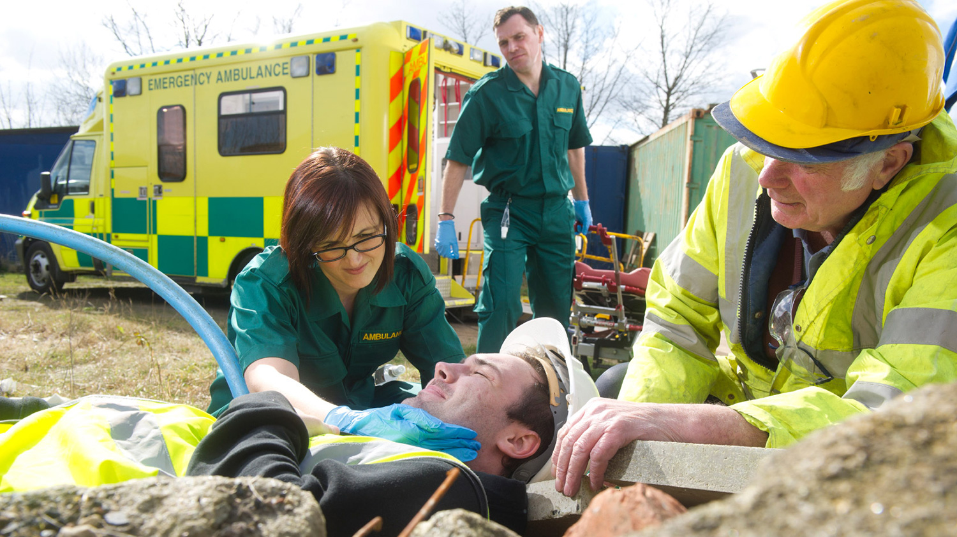







&
101.1:
CARPENTRY
JOINERY.
Importance of Health & Safety in Construction.
This book is designed to support your carpentry and joinery studies across the 6219-06 Construction Skills Qualification.
Information at a glance
Small incremental learning
Access to further resources
Test your knowledge
James Rix

Slide 3
Contents.
Title Page 1
Contents 3
Before you start 4
Learning Outcomes Overview 5
Who are the HSE? 6
What do they do? 7
How they keep construction workers safe 8
HSE Case Study Files 9
Case Study 1. 10
Case Study 2. 12
Case Study 3. 14
Practice Test 16
Glossary of Terms 17
Resources 19
Index 20

Slide 4
Before you get started.
Before You Start.
This book will help you learn about the Health and Safety Executive (HSE) — the organisation that helps keep people safe at work. It uses short text, clear pictures, and simple examples to show what the HSE does in construction.
What This Book Will Help You Do.
Understand who the HSE are.
Learn what the HSE does to protect workers.
See how the HSE checks sites and investigates accidents.
Read real examples of HSE actions.
Know why the HSE is important for everyone on site.

Slide 5
Learning Outcome
Overview.
By the end of this unit, you will be able to:
✔ State the role of the Health and Safety Executive (HSE)
You will learn what the HSE is, what it does, and how it helps keep construction workers safe.
What You Will Learn
Who the HSE are and why they exist.
How the HSE checks construction sites to make sure safety rules are followed.
What actions the HSE can take when something is unsafe.
How the HSE investigates accidents and gathers evidence.
Why the HSE is important for protecting workers and preventing harm.

Slide 6

Who are the HSE?.
The Health and Safety Executive (HSE) is the organisation that helps keep people safe at work in the UK. They make sure that workplaces — including construction sites — follow the law and protect workers from harm.
What the HSE Is
A government organisation
Independent from construction companies
Focused on keeping workers safe
Works across all industries, not just construction

Slide 7
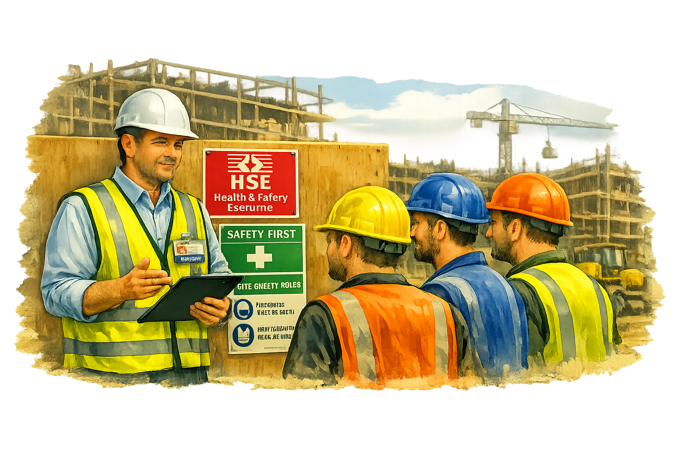
What do they do?.
The HSE has an important job: they help keep people safe at work. They do this by checking workplaces, giving advice, and taking action when something is unsafe.
HSE Actions:
Visits construction sites to check safety.
Talks to workers and employers about how to stay safe.
Looks for hazards that could hurt people.
Checks equipment and PPE to make sure it is safe to use.
Investigates accidents to find out what happened.
Gives safety advice to help stop accidents in the future.
Takes action when rules are broken.

Slide 8
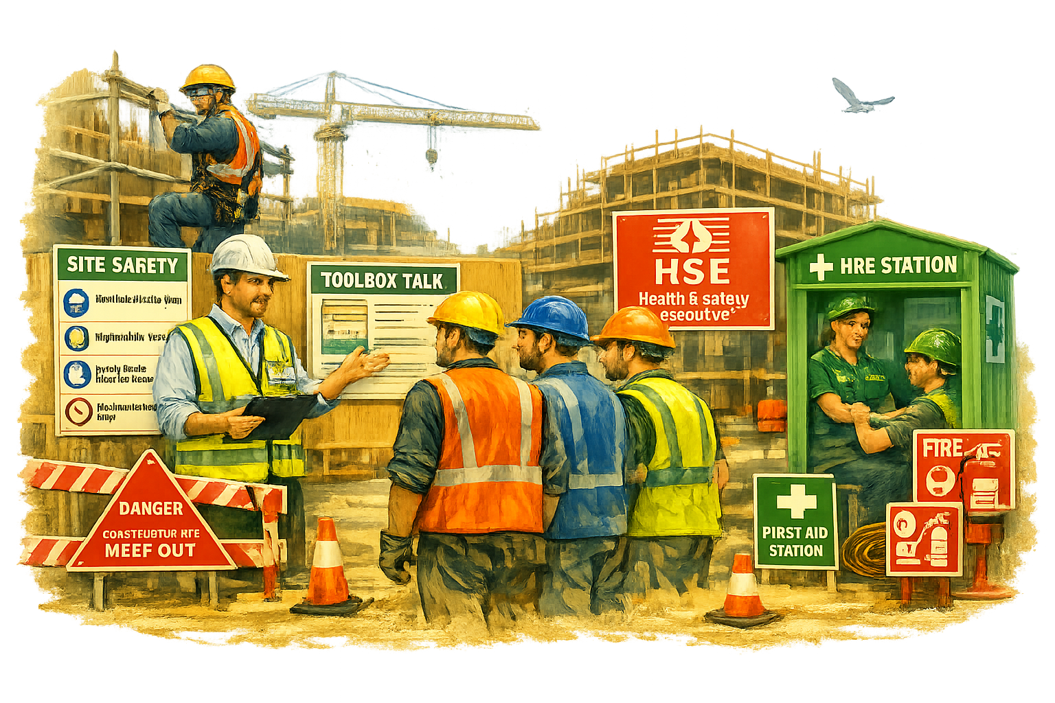
How they keep
construction workers
safe?.
Give advice on how to fix the problem.
Issue an Improvement Notice (the company must make things safer).
Issue a Prohibition Notice (the work must stop immediately).
Prosecute a company or person in court if laws are broken.

Slide 9
HSE Case Study Files.
The next pages show real examples of how the Health and Safety Executive (HSE) works to keep people safe on construction sites. Each case study tells a short story about what happened, what the HSE did, and what was learned.
Why Case Studies Are Important
Case studies help you:
See how the HSE works in real life.
Understand what can go wrong on site.
Learn how accidents can be prevented.
Discover what actions the HSE can take.
Think about how you would stay safe in the same situation.
What You Will Do
For each case study:
Read the short story about what happened.
Look at the picture to see the situation.
Answer the questions to show what you’ve learned.
Think about how the HSE helped and what could be done differently next time.
Remember
The HSE doesn’t just punish people — it helps everyone learn from mistakes and improve safety for the future.

Slide 10
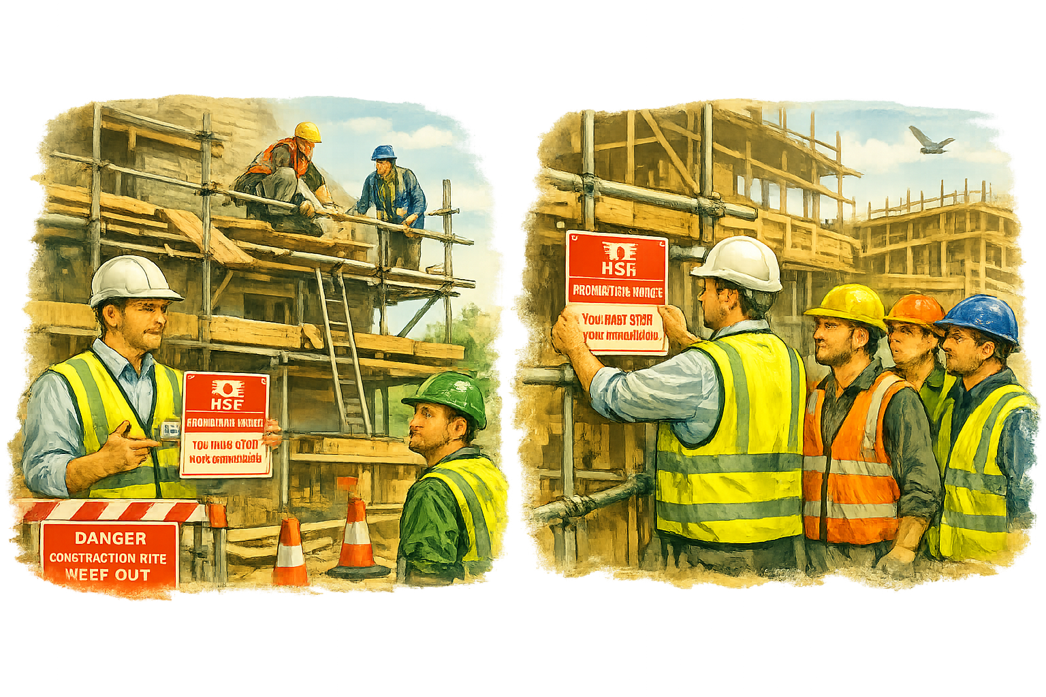
Case Study 1.
Case Study 1 – Unsafe Scaffolding
What Happened.
A small construction team was replacing roof tiles on a two‑storey building. When the HSE inspector arrived, they noticed several serious problems with the scaffolding:
No guardrails to stop workers falling
No toe boards, meaning tools could fall onto people below
Loose planks that could shift under someone’s feet
No safe access ladder, so workers were climbing up the frame
These issues created an immediate risk of a fall from height — one of the biggest causes of
injury in construction.
What the HSE Did
Because the situation was
dangerous, the inspector
issued a Prohibition Notice.

Slide 11
Why the HSE Took Action
The HSE acted because:
Workers were at serious risk of falling
The scaffolding did not meet legal safety standards
There was no safe access to the work area
Loose materials could have injured people below
Stopping the work prevented a potential life‑changing accident.
What We Learn
Falls from height are one of the leading causes of injury in construction.
Scaffolding must always be properly built, inspected, and recorded.
The HSE can stop work immediately when there is a danger to life.
A competent person must check scaffolding every 7 days and after any changes.

Slide 12
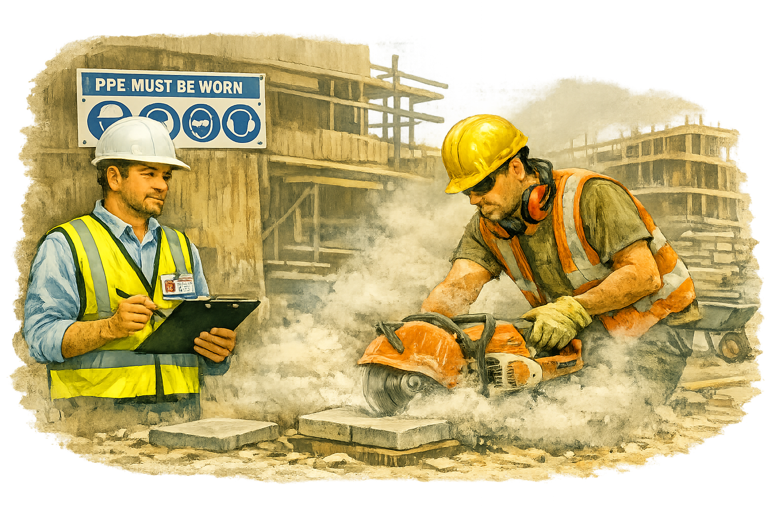
Case Study 2.
Case Study 2 – PPE Failure.
What Happened.
A small team was cutting paving slabs using a petrol‑powered saw. The HSE inspector noticed that one worker was not wearing eye protection or a dust mask, even though the saw was producing thick dust and flying debris.
Another worker had ear defenders around his neck instead of over his ears. The site had PPE available, but it wasn’t being used properly.

Slide 13
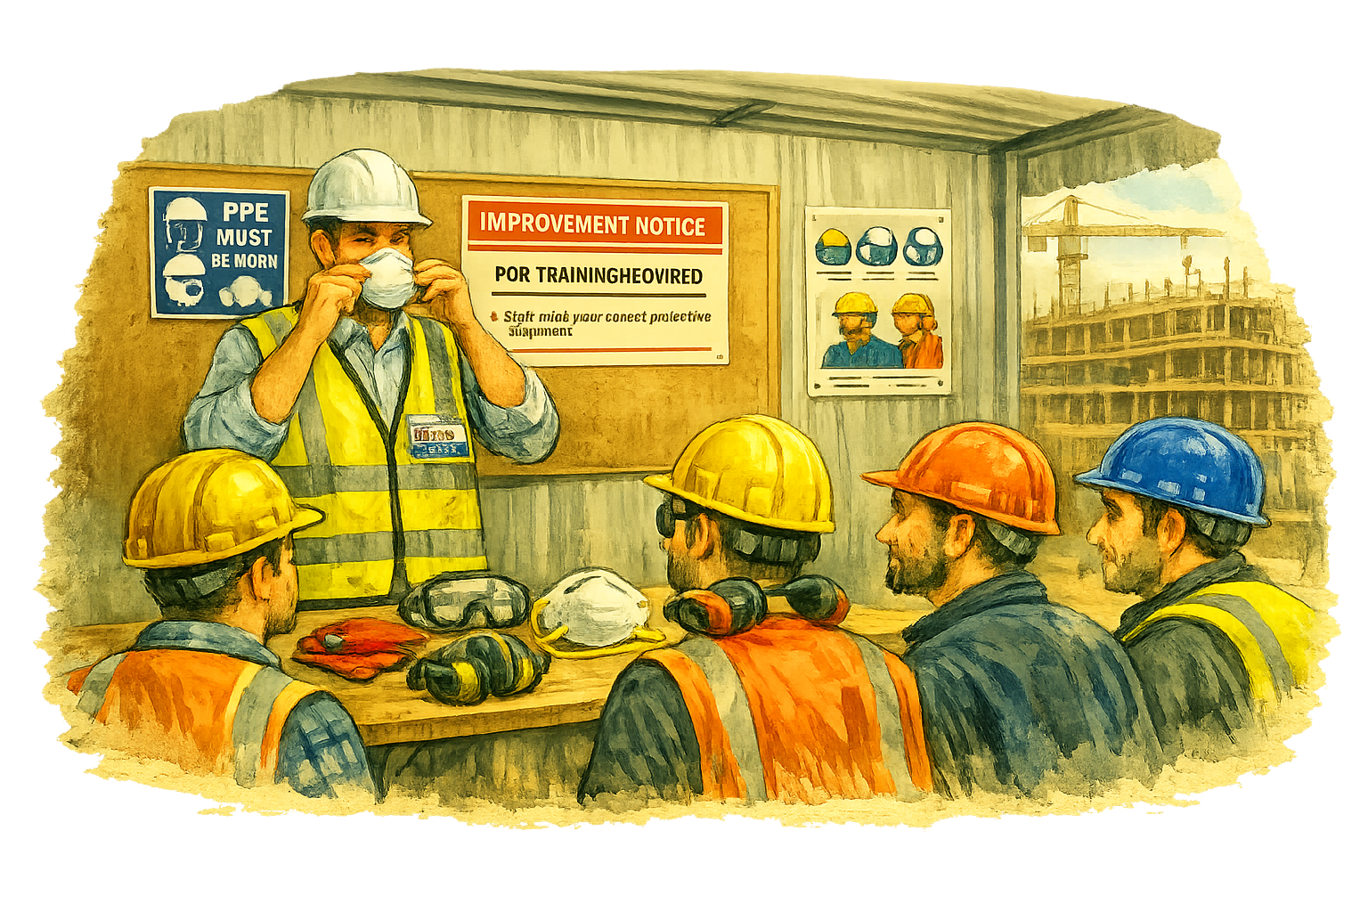
What the HSE Did.
The inspector issued an Improvement Notice requiring the employer to:
Provide a PPE training session for all staff.
Ensure PPE is worn correctly at all times.
Keep a record of PPE checks and replacements.
Work was allowed to continue, but only after the training and checks were completed.
Why the HSE Took Action.
The HSE acted because:
Workers were at risk of eye injury and lung damage.
PPE was available but ignored.
Employers must make sure PPE is used properly and maintained.
The goal was to improve safety behaviour, not stop work completely.
What We Learn.
PPE must be worn correctly every time.
Employers must train and supervise workers in PPE use.
The HSE can issue an Improvement Notice when safety standards need raising.
PPE protects against long‑term health problems like hearing loss and lung disease.

Slide 14
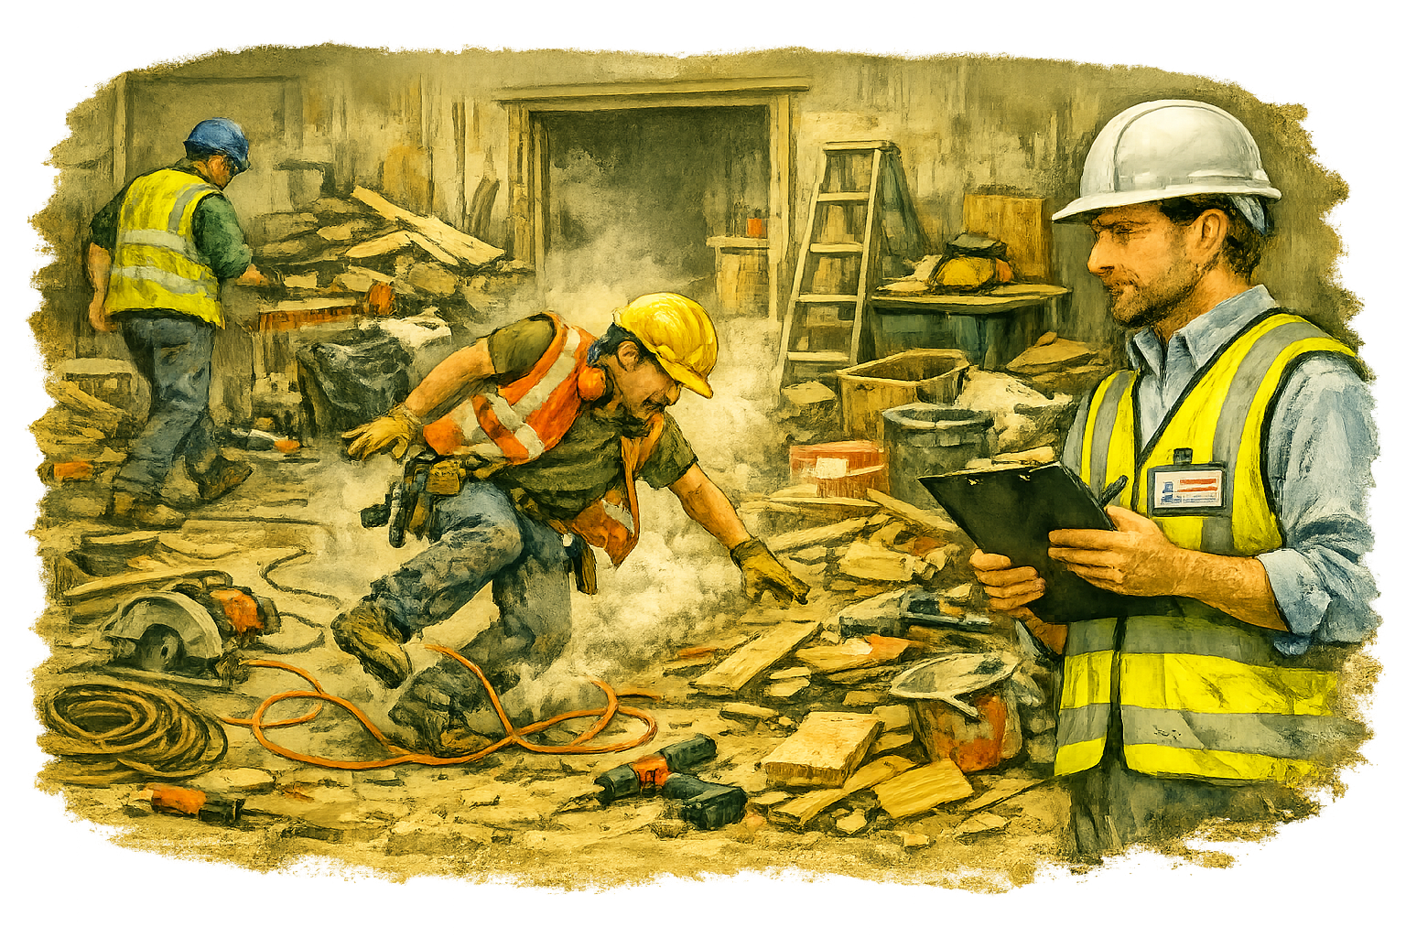
Case Study 3.
Case Study 3 – Poor Housekeeping
What Happened
During a routine inspection, the HSE inspector visited a small refurbishment site.
They found that the work area was cluttered with off‑cuts, cables, and tools scattered across the floor.
A worker had already tripped over a loose extension lead, narrowly avoiding a fall from a low platform.
There were no clear walkways, and waste materials were piling up near the exit.

Slide 15
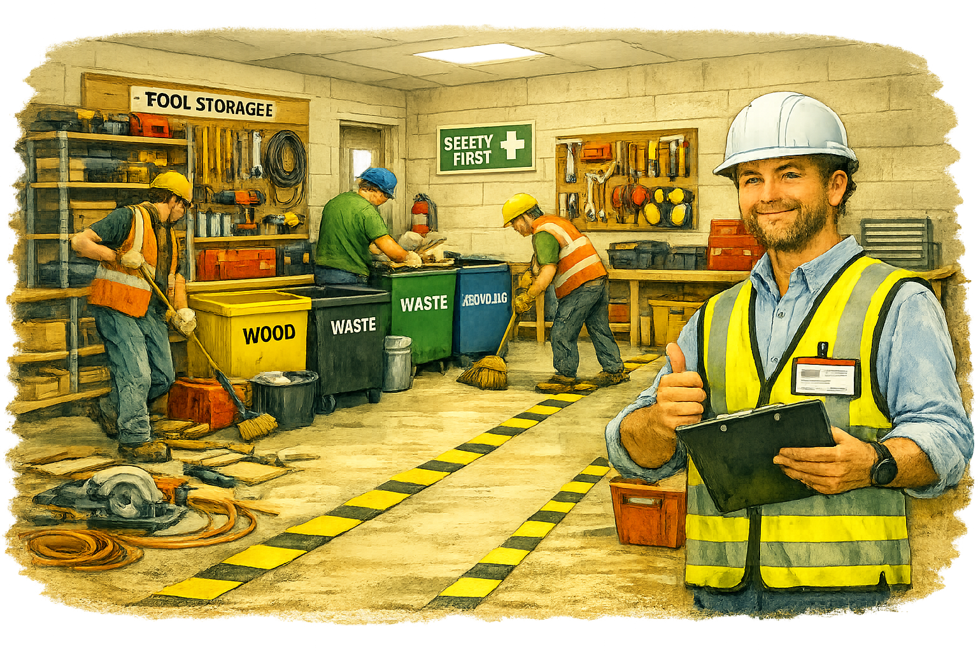
What the HSE Did
The inspector issued an Improvement Notice requiring the site manager to:
Clear all walkways and keep them free from obstruction.
Provide designated waste bins and tidy areas for tools.
Introduce a daily site clean‑up routine.
Train workers on good housekeeping practices.
Work continued, but only after the site was reorganised and made safe.
Why the HSE Took Action
The HSE acted because:
Poor housekeeping is a common cause of slips, trips, and falls.
Blocked routes can delay evacuation in an emergency.
Good organisation helps prevent accidents and improve efficiency.
What We Learn
Keep walkways clear and tidy at all times.
Store tools and materials in designated areas.
Dispose of waste regularly and safely.
Good housekeeping shows professionalism and care for safety.

Slide 16
Practice Test.
Q1: What is the main role of the Health and Safety Executive (HSE)?
To punish workers who break rules
To protect people by enforcing safety laws and promoting good practice
To manage building projects for local councils
To provide insurance for construction companies
Q2: Which type of notice stops work immediately when there is a serious risk to life?
Improvement Notice
Inspection Report
Prohibition Notice
Safety Certificate
Q3: In Case Study 2, what was the main issue the HSE inspector found?
Unsafe scaffolding
Poor housekeeping
PPE not being worn correctly
Electrical faults

Slide 17
Glossary of Terms.
Health and Safety Executive (HSE)
The national organisation that enforces health and safety law in the UK and helps prevent work‑related injury and illness.
Inspector
A trained HSE officer who visits workplaces to check safety standards and investigate accidents or complaints.
Enforcement
The process of making sure health and safety laws are followed. Inspectors can issue notices or take legal action if rules are broken.
Improvement Notice
A legal document requiring an employer to fix safety problems within a set time. Work can continue while improvements are made.
Prohibition Notice
A legal order that stops work immediately when there is a serious risk of injury or death.
Investigation
An official inquiry carried out by the HSE after an accident, complaint, or report of unsafe conditions.
Compliance
Following health and safety laws, regulations, and guidance correctly.
Duty Holder
The person or organisation responsible for making sure work is carried out safely — often the employer or site manager.
Risk Assessment
A process used to identify hazards, decide who might be harmed, and put control measures in place.
Control Measures
Actions or equipment used to reduce risk, such as PPE, barriers, or safe systems of work.
Prosecution
Legal action taken by the HSE against individuals or companies who break health and safety law.

Slide 18
Workplace Inspection
A formal visit by an HSE inspector to check that safety standards are being met.
Legislation
The laws and regulations that set out how health and safety must be managed at work.
Safe System of Work
A planned and organised method of carrying out a task safely, based on risk assessment findings.
Compliance Officer
A person within a company who helps ensure that health and safety rules are followed.

Slide 19



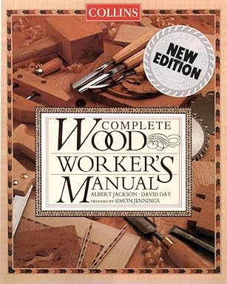
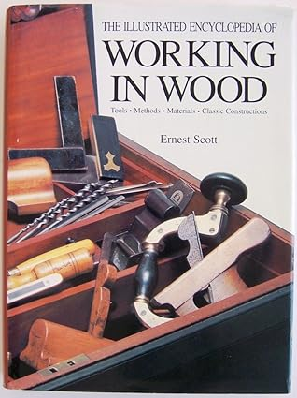




Resources.
101.1.
https://www.hse.gov.uk/construction/new-health-safety.html
https://www.hse.gov.uk/construction/resources/index.html
Collins Complete Woodworkers Manual.
ISBN-10: 9780004140056
ISBN-13: 978-0004140056
The Illustrated Encyclopedia of Working in Wood.
ISBN-10: 051712078X
ISBN-13: 978-0517120781
Working in Wood, An Introduction
ISBN-10: 1857325648
ISBN-13: 978-1857325645
https://www.youtube.com/watch?v=QbK8p1tKxYI
https://www.combepaffordschool.co.uk/_site/data/files/curriculum/work-related-learning/construction/learning-organisers/2024/DC67115973FDAA2AA324548070B4765C.pdf?utm_source=copilot.com
https://www.hse.gov.uk/construction/resources/law.docx
https://www.youtube.com/watch?v=3vZzvKZtZ2A
https://www.hse.gov.uk/construction/resources/toolboxtalks.docx
https://qualifications.pearson.com/content/dam/pdf/BTEC-Specialist-Qualifications/Health-and-Safety-in-a-Construction-Environment/Specification-Issue-2.pdf
https://www.youtube.com/watch?v=5zjzvZzvKzA

Slide 20
Index.
A
Accidents, HSE investigations of – 6, 7
Advisory guidance (HSE) – 5, 7
Activities (Safety Squad) – 8–12
Assessment criteria (HSE roles) – 4
C
Case Studies – 9–11
• Case Study 1: Unsafe Scaffolding – 9
• Case Study 2: PPE Failure – 10
• Case Study 3: Poor Housekeeping – 11
Compliance – 6, 13
Construction safety checks – 5–7
Control measures (HSE advice) – 5
D
Data (HSE statistics) – 6
Duty holder – 13
E
Enforcement – 6–7
Enforcement Notices – 6
Employer duties (HSE context) – 5
Evidence gathering – 6
Exit routes (blocked) – 11
G
Guidance (HSE) – 5, 7
Glossary of Terms – 13–14
H
Hazards (HSE inspections) – 5
Health & Safety Executive (HSE) – 4–7
Housekeeping (poor) – 11
I
Improvement Notice – 6, 10, 11
Index – 15 Inspection (workplace) – 5–7
Inspector (HSE) – 4–7
Investigation – 6
L
Learning Outcome Overview – 4
Legal duties – 4–7
Legislation (HSE enforcement) – 6, 13
N
Notices (HSE) – 6–7
• Improvement Notice – 6, 10, 11
• Prohibition Notice – 6, 9

Slide 21
P
PPE (HSE checks) – 5, 10
Practice Test – 12
Prohibition Notice – 6, 9
Prosecutions – 6–7
R
Records (training, inspections) – 6
Risk assessment (HSE checks) – 5
Roles of the HSE – 4–7
S
Safety advice – 5
Safety behaviour – 10
Scaffolding (unsafe) – 9
Site inspections – 5–7
Statistics (HSE) – 6
T
Training (HSE requirements) – 5, 10
Trip hazards – 11
W
Walkways (blocked) – 11
What the HSE does – 5–7
Workplace inspection – 5–7

Slide 22











Other Books in the series.
This series of books accompanies the learning materials developed for the unit 101: Introduction to Health and Safety in Construction. They include:
101.1.1: The Importance of Health and Safety in Construction
101.1.2: The role of the Health and Safety Executive (HSE)
101.1.3: Main Regulations
101.1.4: Roles and Responsibilities
101.2.1: Common Causes of Accidents in Construction
101.2.2: Risk
101.2.3: Hazard
101.2.4: Risk Assessments
101.3.1: Safety Sign Categories
101.3.2: Safety Signs
101.3.3: COSHH Safety Signs
101.4.1: Personal Protective Equipment (PPE)
Educon.
Education in Construction.

