Slide 1




Lecturer: James Rix

Slide 2

Contents.
Title Page……………………………………………………………………01
Contents...........................................................................02
Intro………………………………………………………………………….03
Aim…………………………………………………………………………..04
Objectives…………………………………………………………………04
Activity Overview………………………………………………………..05
Why this activity helps learning…………………………………….06
Student Instructions…………………………………………………..07
Lecturer Instructions……………………………………………..…..08
Scaffolding Options………………………………………………..….09
Differentiation Strategies…………………………………………….10
Assessment Opportunities………………………………………….11
Printables………………………………………………………………...12
Spinner Label...……………………………………………………13
Regulation Flash Cards.………………………………………..14
Reference Sheets.………………………………………….…….16
Bonus Content……………………………………………….……22
Challenge token……………………………………………….....30
Regulation Scenario Cards…………………………………….31
Activity Worksheet……………………………………………….35
Thank You………………………………………………………………….40
James Rix

Slide 3
Intro.
The Regulation Spinner Challenge is an interactive learning activity designed to make Health & Safety regulations more engaging, memorable, and accessible for construction learners. Using a 3D‑printed spinner board, students land on one of six key UK regulations and complete a challenge linked to real‑world site practice. This transforms a traditionally theory‑heavy topic into a hands‑on, discussion‑driven experience that builds confidence and supports deeper understanding.
Learners explore what each regulation means, why it exists, and how it applies to everyday construction tasks. Through short prompts, scenario‑based questions, and group discussion, they develop the knowledge and communication skills needed for safe working practice. The activity supports a wide range of abilities, including SEND learners, through simple language, visual prompts, and structured challenge types.
James Rix

Slide 4
Aim:
The aim of this activity is to help learners build a confident understanding of key UK construction regulations by exploring them through a hands‑on, chance‑based spinner challenge. Learners will develop their ability to recall, explain, and apply Health & Safety regulations to real site situations, improving both their knowledge and their readiness for safe working practice.
Learning Objectives:
By the end of this activity, learners will be able to:
Identify six key UK Health & Safety regulations used in construction.
Explain what each regulation covers in simple terms.
Give examples of how each regulation applies on site.
Describe consequences of not following the regulation.
Apply regulation knowledge to short site‑based scenarios.
Communicate their understanding verbally or in writing.
James Rix

Slide 5
Activity Overview.
Learners use a 3D‑printed spinner board divided into six sections, each representing a different Health & Safety regulation. After spinning, they draw a challenge token that tells them what type of response they must give (e.g., explain it, give an example, identify a risk, apply to a scenario). Learners use the provided Regulation Reference Sheets to support their answers.
The activity can be run individually, in pairs, or in small groups. It works as a warm‑up, revision task, or standalone learning activity.
James Rix

Slide 6
Why this activity helps!
This activity:
Turns abstract regulations into practical, memorable tasks.
Builds confidence through repetition and varied challenge types.
Supports SEND learners with visual prompts and simple definitions.
Encourages verbal communication and peer discussion.
Reinforces exam‑style skills such as explanation, application, and scenario reasoning.
Provides a low‑pressure, game‑based environment that increases engagement.
James Rix

Slide 7
Student Instructions.
Spin the wheel to select a regulation.
Pick a Challenge Token to see what type of answer you need to give.
Use the Regulation Reference Sheet to help you understand the rule.
Complete the challenge by writing or saying your answer.
Share your response with your group or tutor.
Listen to feedback and improve your answer if needed.
James Rix

Slide 8
Lecturer Instructions.
Set up the spinner board and place regulation sheets around it.
Explain the six regulations briefly before starting.
Demonstrate one example round so learners understand the process.
Encourage learners to use the reference sheets rather than guessing.
Circulate, question, and stretch learners as they work.
Use challenge tokens to differentiate and vary difficulty.
End with a plenary to reinforce key learning points.
James Rix

Slide 9
Scaffolding Options.
Provide sentence starters (e.g., “This regulation is about…”, “An example is…”).
Allow learners to answer verbally instead of writing.
Use picture‑based prompts for SEND learners.
Offer simplified definitions for lower‑ability groups.
Pair higher‑ability learners with those needing support.
Allow learners to re‑spin if they land on a regulation they cannot yet explain.
James Rix

Slide 10
Differentiation Strategies.
For Lower Ability / SEND:
Use high‑contrast, simplified regulation sheets.
Reduce writing load (tick boxes, short answers).
Provide worked examples.
Allow collaborative answers.
For Higher Ability / Level 2:
Add scenario‑based extension questions.
Ask learners to link two regulations together.
Require full explanations with consequences and controls.
Introduce “challenge rounds” where learners must teach the regulation to the group.
James Rix

Slide 11
Assessment Opportunities.
Quality of verbal responses during the challenge.
Completion of worksheets or whiteboard tasks.
Ability to apply regulations to scenarios.
Peer discussion and reasoning.
Tutor questioning and observation.
Exit tickets or plenary tasks.
James Rix

Slide 12
Printables.
Spinner Label
Regulation Flash Cards
Reference Sheets
Bonus Content
Challenge Tokens
Reg Scenario Cards
Activity Worksheet
James Rix

Slide 13
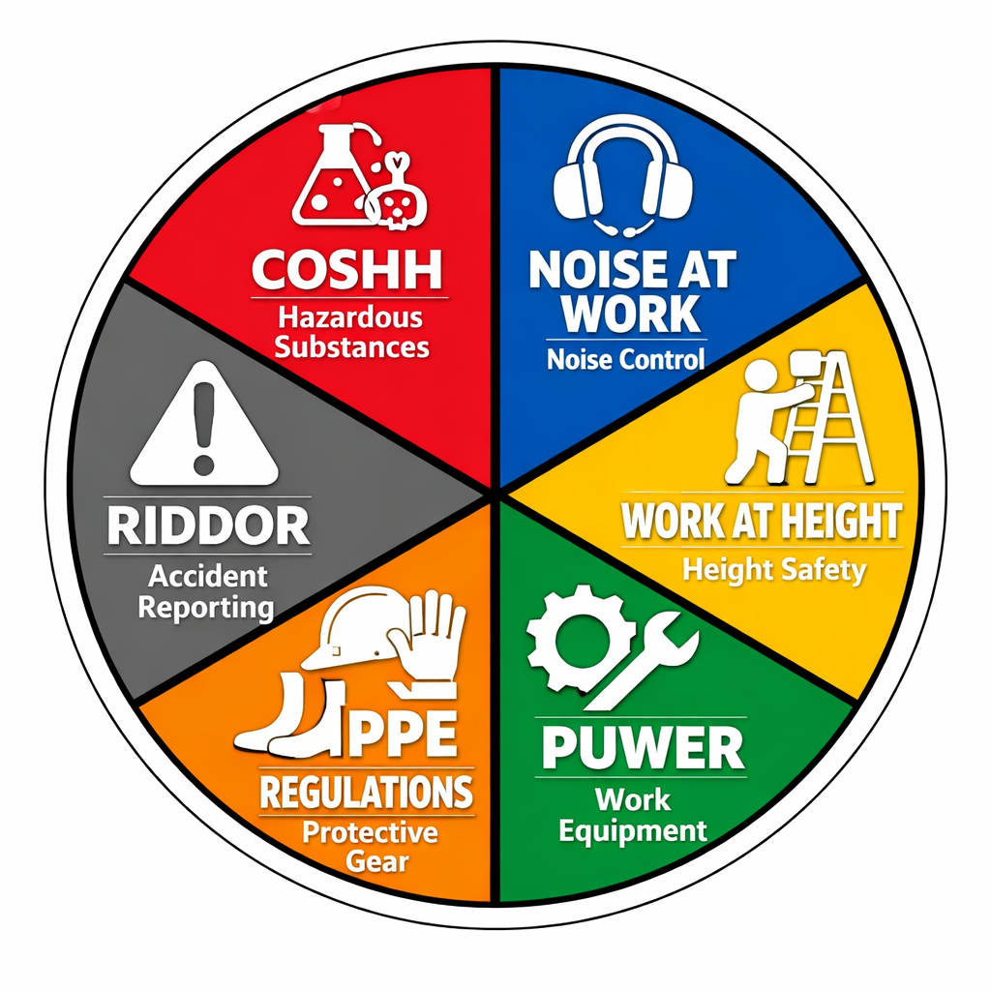

Slide 14





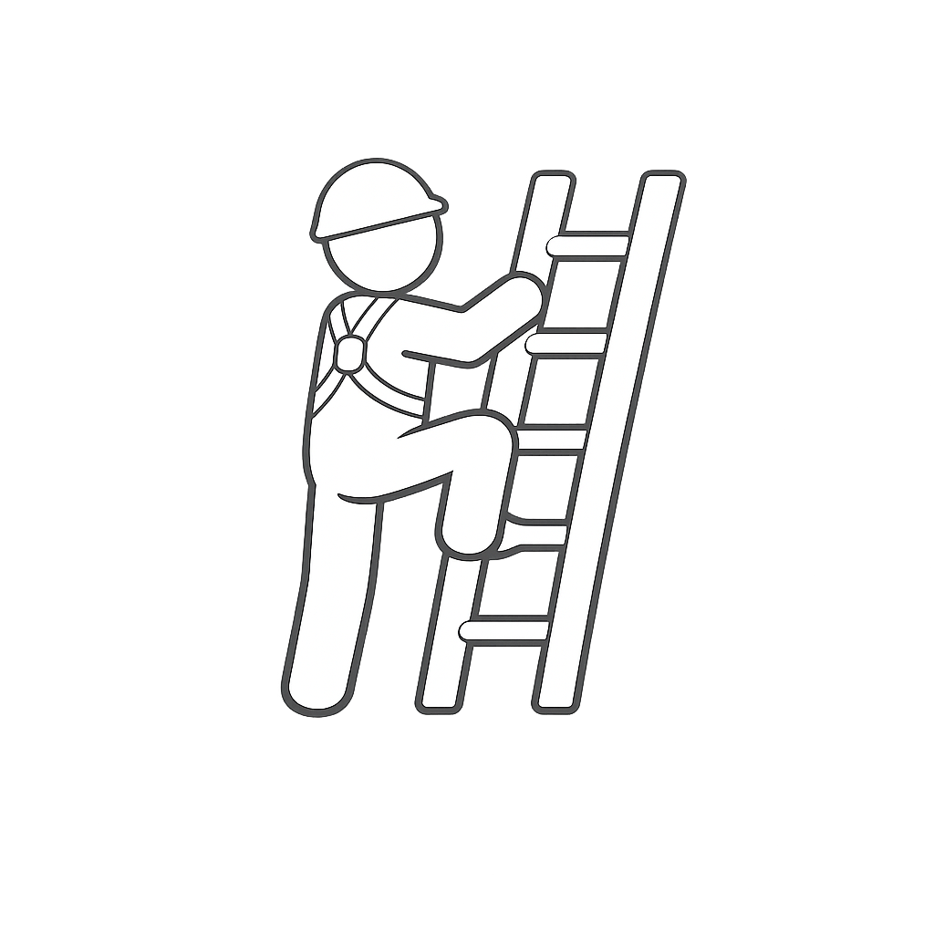

COSHH
101.1: Know the importance of Health & Safety in the Construction Industry
Activity
Abbr: COSHH
Year: 1989
Title: Control of Substances Hazardous to Health
Description:
COSHH requires employers to control hazardous substances to protect workers’ health. It focuses on assessing risks and putting controls like safe handling, ventilation, and PPE in place.
101.1c – Spin the Regs
Regulation Flash Card
James Rix
Noise
At Work
101.1: Know the importance of Health & Safety in the Construction Industry
Activity
Abbr: NAW
Year: 2005
Title: Noise at Work
Description:
The Noise at Work Regulations protect workers from hearing damage by requiring employers to assess noise levels, reduce exposure, and provide hearing protection where needed.
101.1c – Spin the Regs
Regulation Flash Card
of ill‑health cases were back/joint/muscle problems
James Rix
Working
At Height
101.1: Know the importance of Health & Safety in the Construction Industry
Activity
Abbr: WAHR
Year: 2005
Title: Work at Height Regulations Description:
The Work at Height Regulations require employers to prevent falls by planning work properly, using safe equipment, and ensuring workers are trained and competent when working at any height where a fall could cause injury.
101.1c – Spin the Regs
Regulation Flash Card
James Rix
PUWER
101.1: Know the importance of Health & Safety in the Construction Industry
Activity
Abbr: PUWER
Year: 1998
Title: Provision and Use of Work Equipment Regulations
Description: PUWER requires employers to ensure that all work equipment is suitable, safe to use, properly maintained, and operated only by trained and competent people to prevent accidents and injuries.
101.1c – Spin the Regs
Regulation Flash Card
James Rix
Half of all fatal injuries

Slide 15


PPE
101.1: Know the importance of Health & Safety in the Construction Industry
Activity
Abbr: PPE
Year: 1992
Title: Personal Protective Equipment at Work Regulations
Description: The PPE Regulations require employers to provide suitable personal protective equipment, ensure it fits properly, and train workers to use it correctly when risks cannot be controlled by other means.
101.1c – Spin the Regs
Regulation Flash Card
James Rix
RIDDOR
101.1: Know the importance of Health & Safety in the Construction Industry
Activity
Abbr: RIDDOR
Year: 2013 (current version)
Title: Reporting of Injuries, Diseases and Dangerous Occurrences Regulations
Description: RIDDOR requires employers to report certain workplace accidents, injuries, diseases, and dangerous occurrences to the HSE so that serious risks can be monitored, investigated, and prevented in the future.
101.1c – Spin the Regs
Regulation Flash Card
James Rix
of ill‑health cases were back/joint/muscle problems

Slide 16
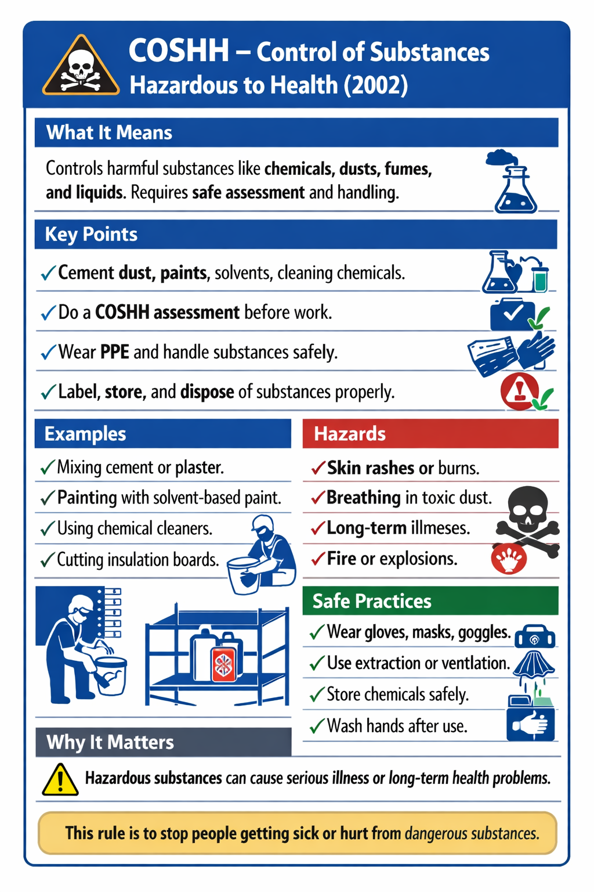

Slide 17
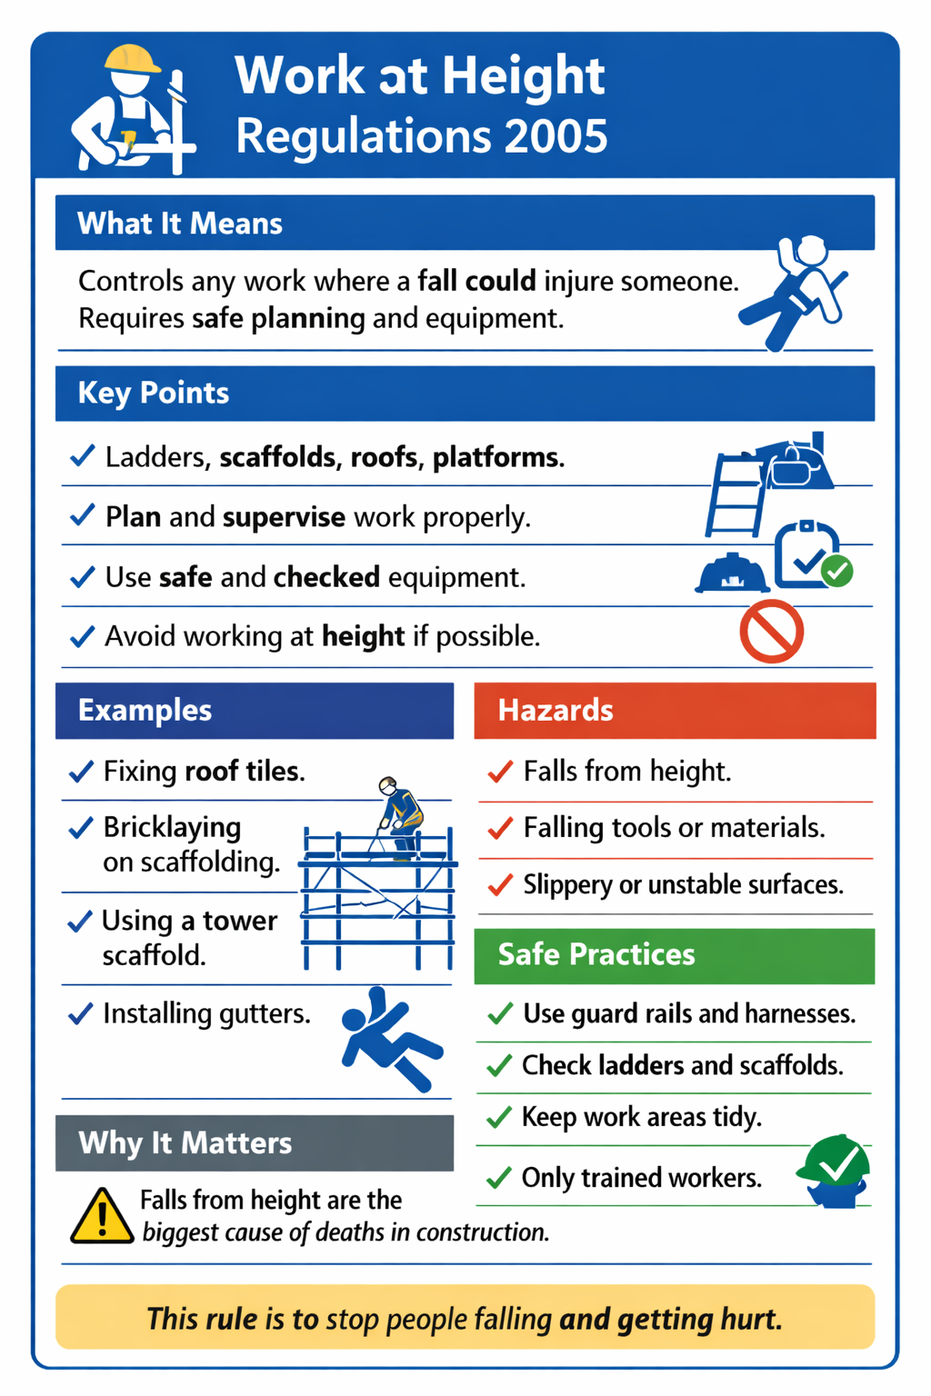

Slide 18
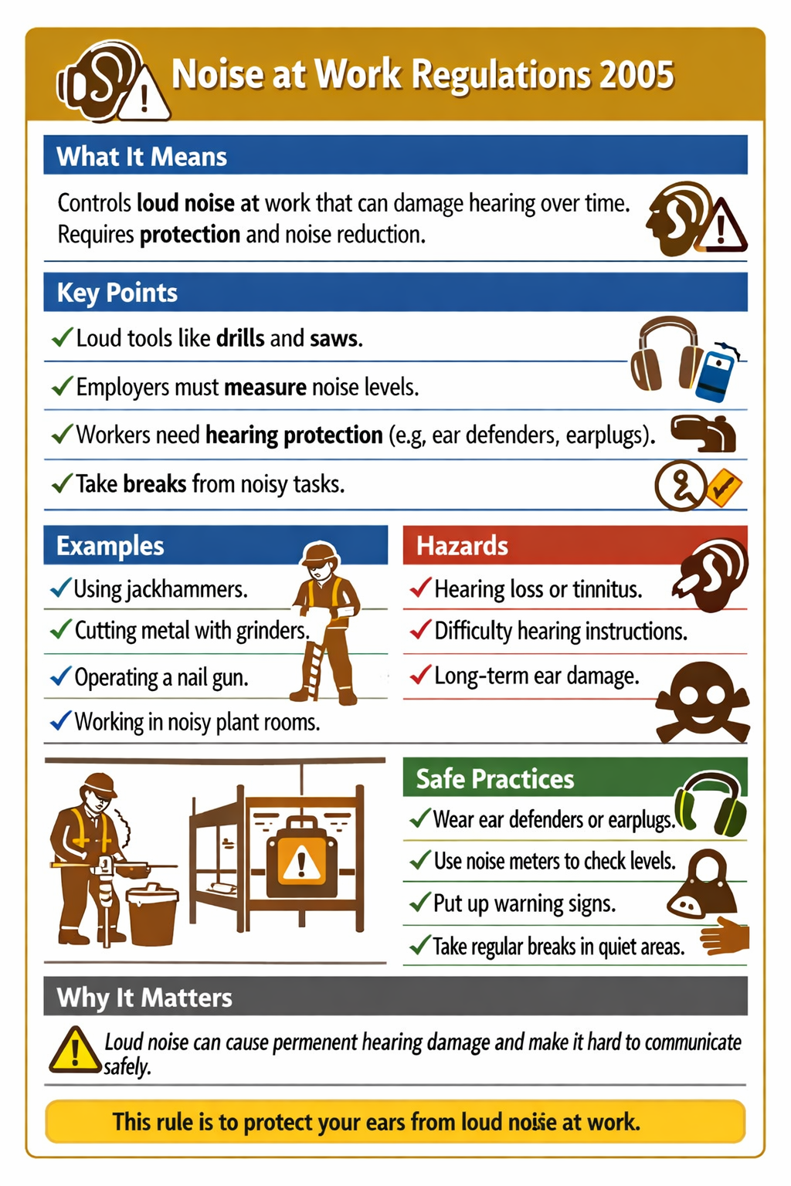

Slide 19
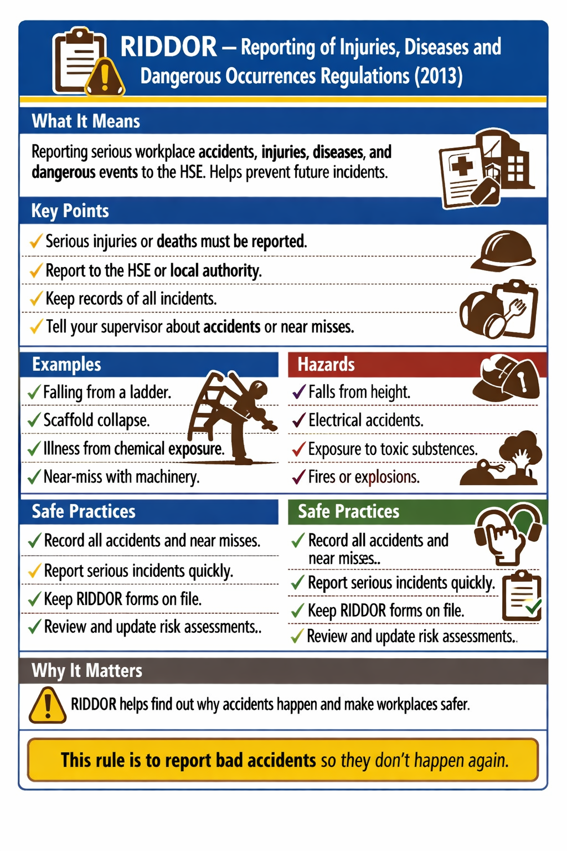

Slide 20
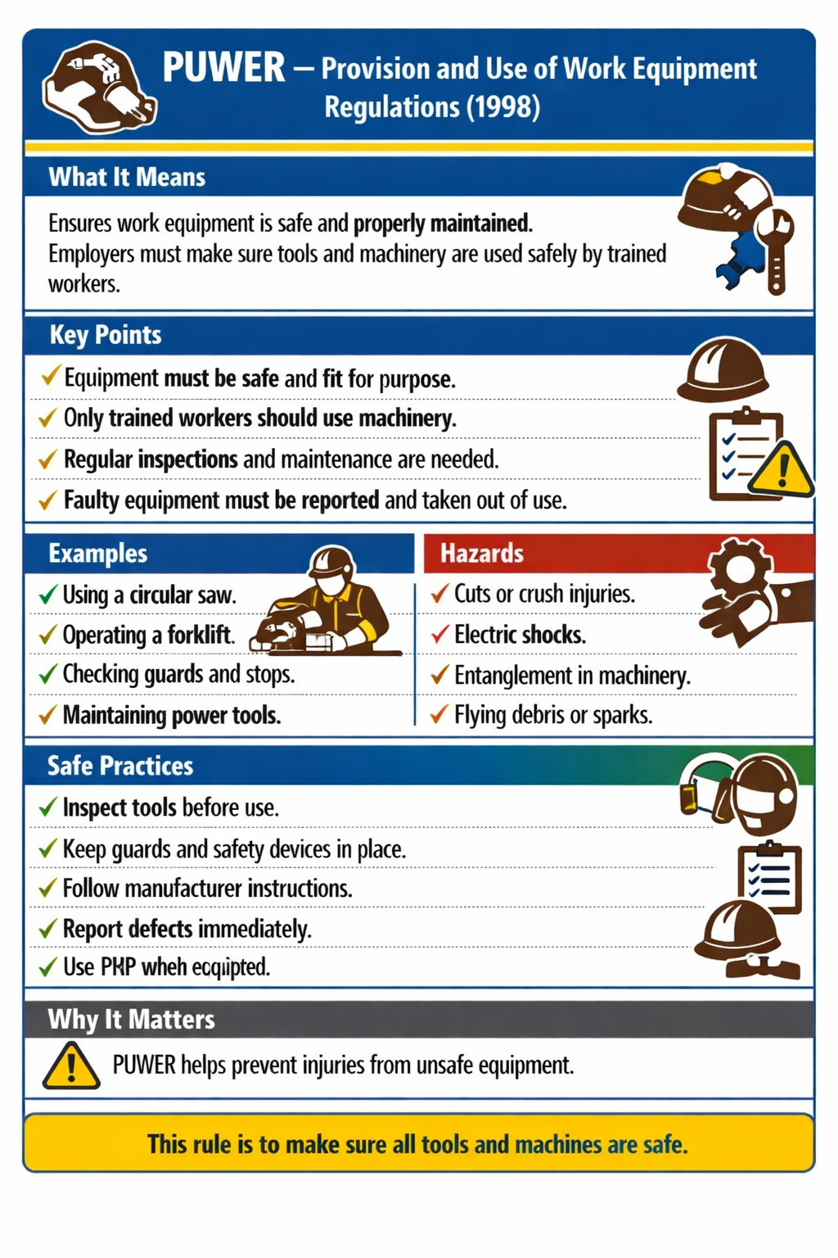

Slide 21
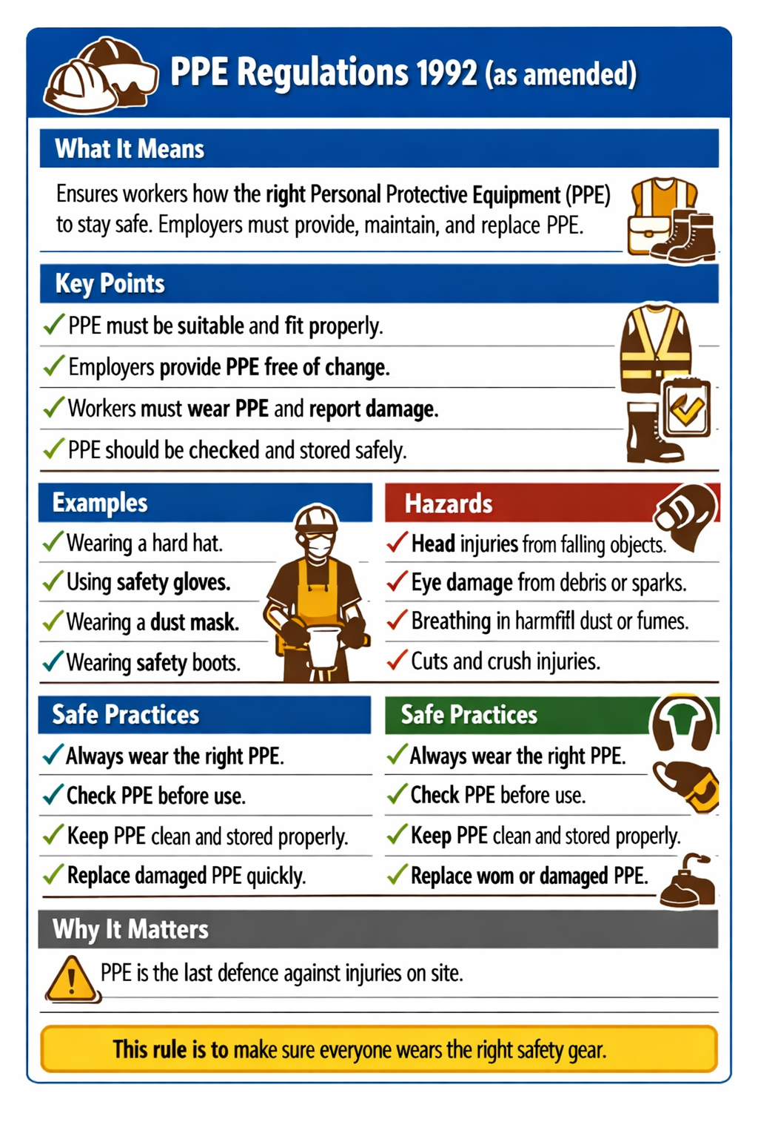

Slide 22
101.1: Know the importance of Health & Safety in the Construction Industry
1974
Activity
101.1c – Spin the Regs
Regulation Match-Up Card
James Rix
101.1: Know the importance of Health & Safety in the Construction Industry
2013
Activity
101.1c – Spin the Regs
Regulation Match-Up Card
James Rix
of ill‑health cases were back/joint/muscle problems
101.1: Know the importance of Health & Safety in the Construction Industry
2002
Activity
101.1c – Spin the Regs
Regulation Match-Up Card
James Rix
101.1: Know the importance of Health & Safety in the Construction Industry
2005
Activity
101.1c – Spin the Regs
Regulation Match-Up Card
James Rix
Half of all fatal injuries

Slide 23
101.1: Know the importance of Health & Safety in the Construction Industry
1998
Activity
101.1c – Spin the Regs
Regulation Match-Up Card
James Rix
101.1: Know the importance of Health & Safety in the Construction Industry
2005
Activity
101.1c – Spin the Regs
Regulation Match-Up Card
James Rix
of ill‑health cases were back/joint/muscle problems
101.1: Know the importance of Health & Safety in the Construction Industry
2002
Activity
101.1c – Spin the Regs
Regulation Match-Up Card
James Rix

Slide 24
101.1: Know the importance of Health & Safety in the Construction Industry
The Health and Safety at Work Act
Activity
101.1c – Spin the Regs
Regulation Match-Up Card
James Rix
101.1: Know the importance of Health & Safety in the Construction Industry
Reporting of Injuries, Diseases and Dangerous Occurrences
Activity
101.1c – Spin the Regs
Regulation Match-Up Card
James Rix
101.1: Know the importance of Health & Safety in the Construction Industry
Control of Substances Hazardous to Health
Activity
101.1c – Spin the Regs
Regulation Match-Up Card
James Rix
101.1: Know the importance of Health & Safety in the Construction Industry
Provision and Use of Work Equipment
Activity
101.1c – Spin the Regs
Regulation Match-Up Card
James Rix
Half of all fatal injuries

Slide 25
101.1: Know the importance of Health & Safety in the Construction Industry
Noise at Work
Activity
101.1c – Spin the Regs
Regulation Match-Up Card
James Rix
101.1: Know the importance of Health & Safety in the Construction Industry
Working at Height
Activity
101.1c – Spin the Regs
Regulation Match-Up Card
James Rix
of ill‑health cases were back/joint/muscle problems
101.1: Know the importance of Health & Safety in the Construction Industry
Personal Protective Equipment
Activity
101.1c – Spin the Regs
Regulation Match-Up Card
James Rix

Slide 26
101.1: Know the importance of Health & Safety in the Construction Industry
HASAWA
Activity
101.1c – Spin the Regs
Regulation Match-Up Card
James Rix
101.1: Know the importance of Health & Safety in the Construction Industry
RIDDOR
Activity
101.1c – Spin the Regs
Regulation Match-Up Card
James Rix
101.1: Know the importance of Health & Safety in the Construction Industry
COSHH
Activity
101.1c – Spin the Regs
Regulation Match-Up Card
James Rix
101.1: Know the importance of Health & Safety in the Construction Industry
PUWER
Activity
101.1c – Spin the Regs
Regulation Match-Up Card
James Rix
Half of all fatal injuries

Slide 27
101.1: Know the importance of Health & Safety in the Construction Industry
NAW
Activity
101.1c – Spin the Regs
Regulation Match-Up Card
James Rix
101.1: Know the importance of Health & Safety in the Construction Industry
WAH
Activity
101.1c – Spin the Regs
Regulation Match-Up Card
James Rix
of ill‑health cases were back/joint/muscle problems
101.1: Know the importance of Health & Safety in the Construction Industry
PPE
Activity
101.1c – Spin the Regs
Regulation Match-Up Card
James Rix

Slide 28
101.1: Know the importance of Health & Safety in the Construction Industry
applies to all types and places of work and to employers, employees, self-employed people, subcontractors and even suppliers. The Act is there to protect not only the people at work but also the general public, who may be affected in some way by the work that has been or will be carried out.
Activity
101.1c – Spin the Regs
Regulation Match-Up Card
James Rix
101.1: Know the importance of Health & Safety in the Construction Industry
employers have a duty to report accidents, diseases or dangerous occurrences. The HSE use this information to identify where and how risk arises and to investigate serious accidents
Activity
101.1c – Spin the Regs
Regulation Match-Up Card
James Rix
101.1: Know the importance of Health & Safety in the Construction Industry
state how employees and employers should work with, handle, move and safely dispose of potentially dangerous substances. A substance hazardous to health is anything that might negatively affect your health.
Activity
101.1c – Spin the Regs
Regulation Match-Up Card
James Rix
101.1: Know the importance of Health & Safety in the Construction Industry
These regulations cover all new or existing work equipment leased, hired or second-hand. They apply in most working environments where the HASAW applies, including all industrial, offshore and service operations.
.
Activity
101.1c – Spin the Regs
Regulation Match-Up Card
James Rix
Half of all fatal injuries

Slide 29
101.1: Know the importance of Health & Safety in the Construction Industry
These regulations help protect you against the consequences of being exposed to high levels of noise.High levels of noise can lead to permanent hearing loss.
Activity
101.1c – Spin the Regs
Regulation Match-Up Card
James Rix
101.1: Know the importance of Health & Safety in the Construction Industry
cover any activity where a person could fall and be injured, regardless of the height involved. They set out clear duties for employers, the self‑employed, and anyone who controls work at height (such as building owners or site managers).
Activity
101.1c – Spin the Regs
Regulation Match-Up Card
James Rix
of ill‑health cases were back/joint/muscle problems
101.1: Know the importance of Health & Safety in the Construction Industry
These regulations cover all types of personal protection equipment (PPE), from gloves to breathing apparatus.
Activity
101.1c – Spin the Regs
Regulation Match-Up Card
James Rix

Slide 30


Slide 31
1️⃣ COSHH – Hazardous Substances
Scenario: A decorator is sanding old paint that contains lead. Dust is spreading around the room and no extraction or masks are being used.
Learner Task: Which regulation applies, and why?

Slide 32
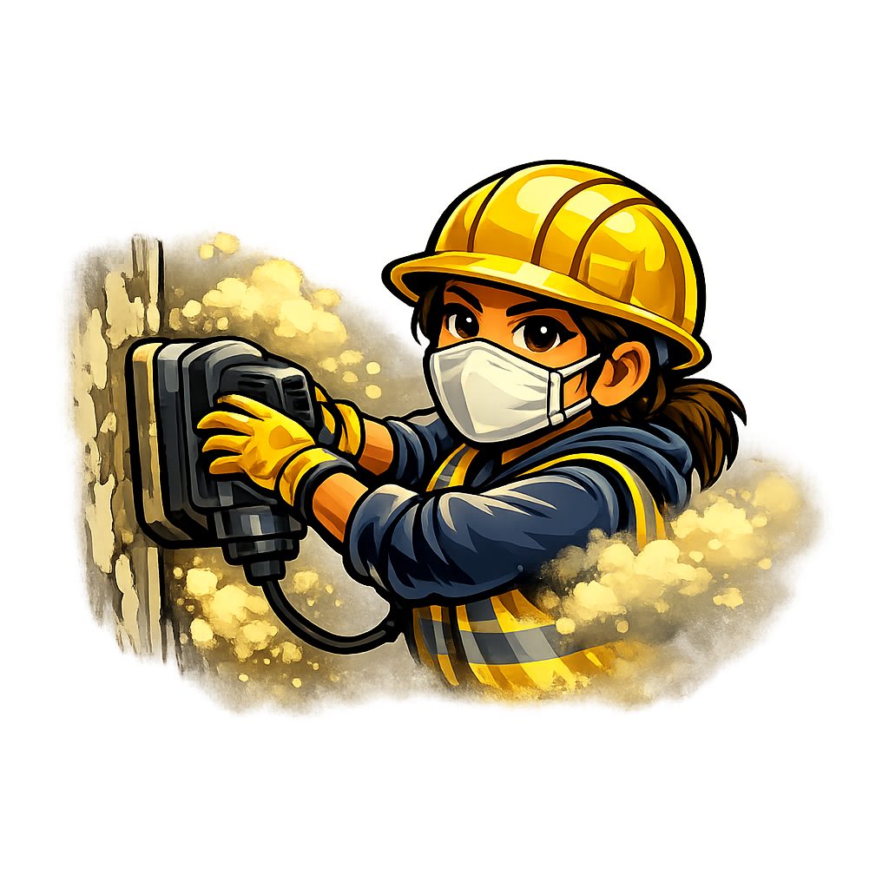
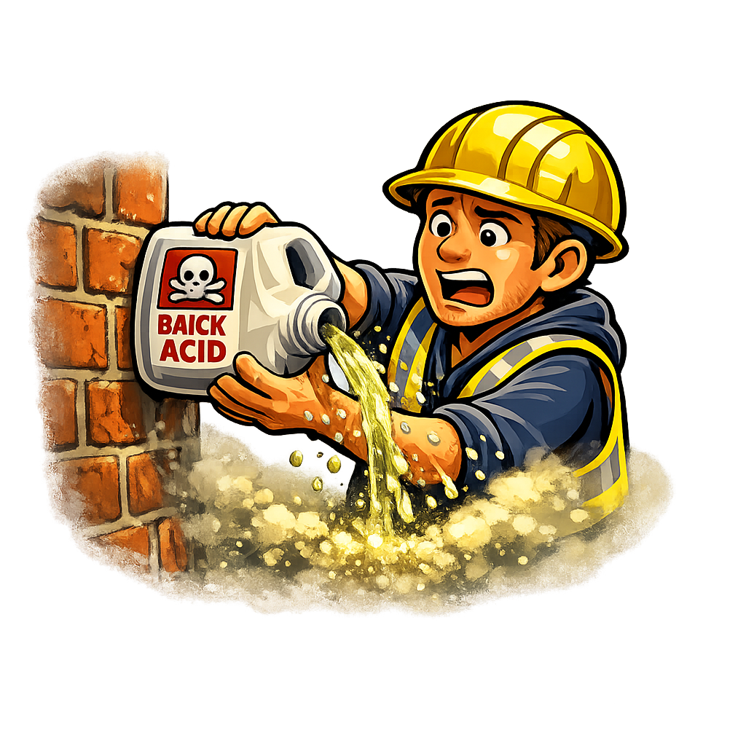


101.1: Know the importance of Health & Safety in the Construction Industry
Reg Scenario
Activity
1️⃣
Scenario: A decorator is sanding old paint that contains lead. Dust is spreading around the room and no extraction or masks are being used.
Learner Task: Which regulation applies, and why?
101.1c – Spin the Regs
Regulation Scenario Card
James Rix
101.1: Know the importance of Health & Safety in the Construction Industry
Reg Scenario
Activity
2️⃣
Scenario: A cleaner is using a strong brick‑acid solution without gloves. The liquid splashes onto their skin and causes burning.
Learner Task: Which regulation applies, and why?
101.1c – Spin the Regs
Regulation Scenario Card
James Rix
of ill‑health cases were back/joint/muscle problems
101.1: Know the importance of Health & Safety in the Construction Industry
Reg Scenario
Activity
3️⃣
Scenario: A groundworker uses a pneumatic breaker for several hours. No hearing protection is provided, and he complains of ringing in his ears.
Learner Task: Which regulation applies, and why?
101.1c – Spin the Regs
Regulation Scenario Card
James Rix
101.1: Know the importance of Health & Safety in the Construction Industry
Reg Scenario
Activity
4️⃣
Scenario: A painter stands on the top step of a stepladder to reach a high corner. The ladder wobbles because it is on uneven ground.
Learner Task: Which regulation applies, and why?
101.1c – Spin the Regs
Regulation Scenario Card
James Rix
Half of all fatal injuries

Slide 33
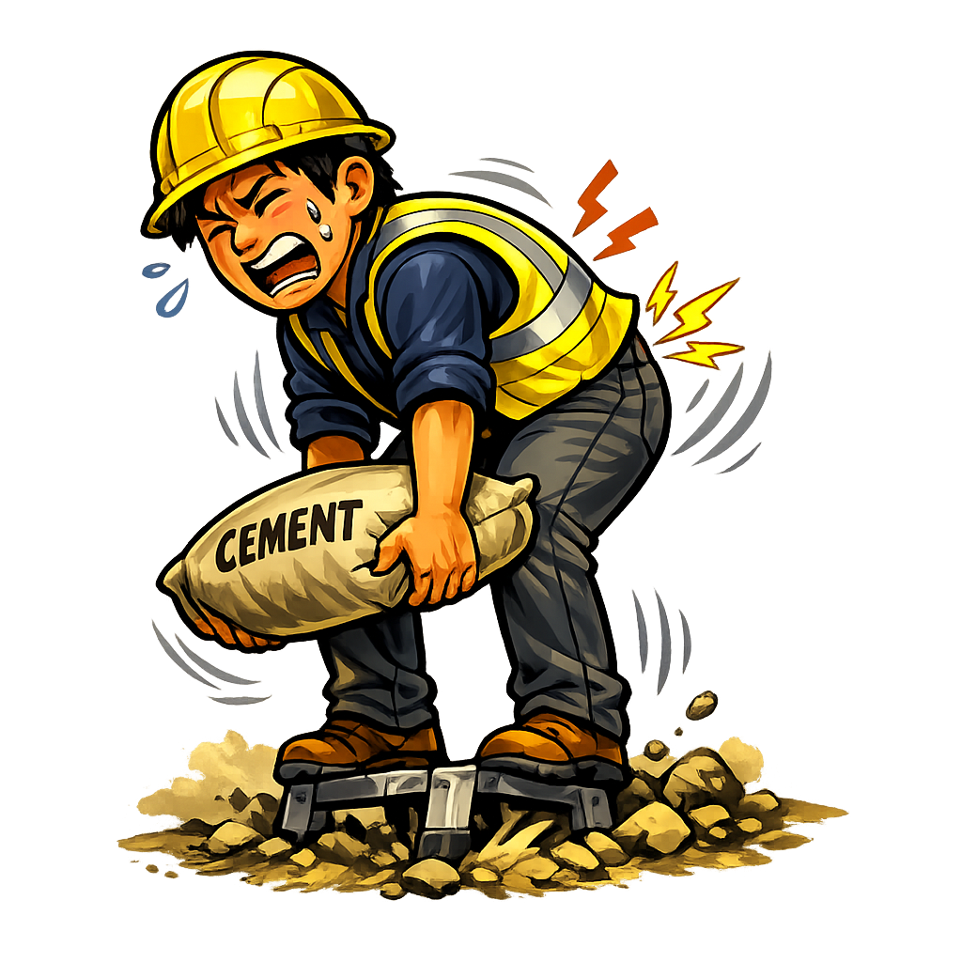


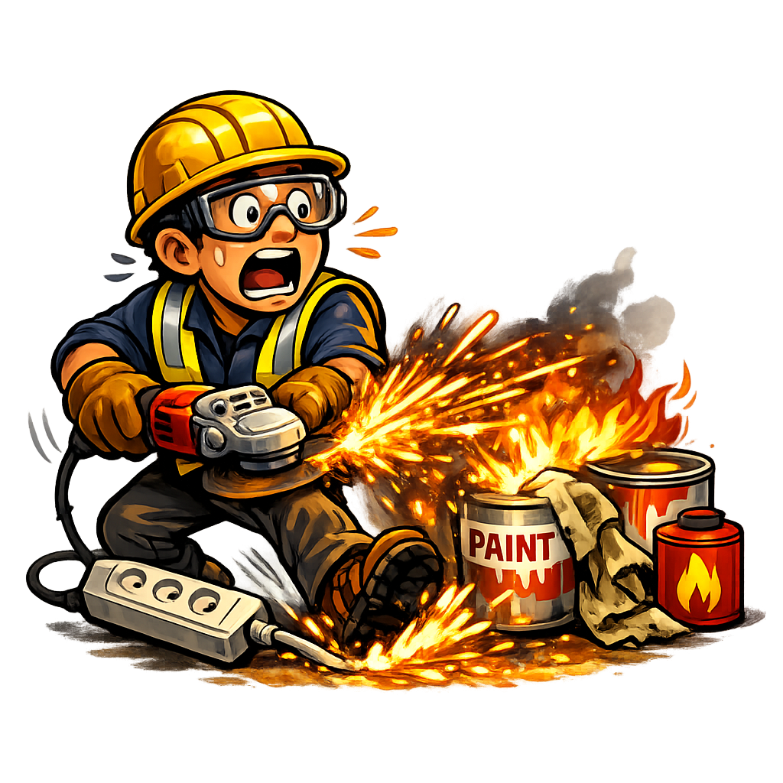
101.1: Know the importance of Health & Safety in the Construction Industry
Reg Scenario
Activity
5️⃣
Scenario: A labourer drops a heavy block on his foot and fractures a toe. The site manager tells him “we don’t need to report that”.
Learner Task: Which regulation applies, and why?
101.1c – Spin the Regs
Regulation Scenario Card
James Rix
101.1: Know the importance of Health & Safety in the Construction Industry
Reg Scenario
Activity
6️⃣
Scenario: A worker is cutting metal with an angle grinder. Sparks fly into his eyes because he was not given safety goggles.
Learner Task: Which regulation applies, and why?
101.1c – Spin the Regs
Regulation Scenario Card
James Rix
of ill‑health cases were back/joint/muscle problems
101.1: Know the importance of Health & Safety in the Construction Industry
Reg Scenario
Activity
7️⃣
Scenario: A cement mixer is being used even though the plug is cracked and the cable is exposed. The supervisor says “it still works, just be careful”.
Learner Task: Which regulation applies, and why?
101.1c – Spin the Regs
Regulation Scenario Card
James Rix
101.1: Know the importance of Health & Safety in the Construction Industry
Reg Scenario
Activity
8️⃣
Scenario: A new apprentice is told to use a nail gun without any training or supervision. He is unsure how to load or fire it safely.
Learner Task: Which regulation applies, and why?
101.1c – Spin the Regs
Regulation Scenario Card
James Rix
Half of all fatal injuries

Slide 34
Answer Sheet – Regulation Scenario Cards
1️⃣ COSHH – Hazardous Substances
Answer: COSHH Why: The worker is creating harmful dust from old paint and needs protection and control measures.
2️⃣ COSHH – Hazardous Substances
Answer: COSHH Why: The cleaner is using a strong chemical that can burn skin, so COSHH rules apply.
3️⃣ Noise at Work Regulations
Answer: Noise at Work Regulations Why: The worker is exposed to loud noise from a breaker and has no hearing protection.
4️⃣ Work at Height Regulations
Answer: Work at Height Regulations Why: The painter is using a ladder unsafely on uneven ground, creating a fall risk.
5️⃣ RIDDOR
Answer: RIDDOR Why: A broken toe is a reportable injury, and the manager must record and report it.
6️⃣ PPE Regulations
Answer: PPE Regulations Why: The worker needed goggles to protect their eyes from sparks while cutting metal.
7️⃣ PUWER – Work Equipment
Answer: PUWER Why: The cement mixer is damaged and unsafe, so it should not be used under PUWER rules.
8️⃣ PUWER – Work Equipment
Answer: PUWER Why: The apprentice is using a nail gun without training or supervision, which breaks PUWER requirements.

Slide 35
101.1.1c: Regulations
Participant Info.
Team: Individual:
____________________________ ________________________
____________________________
____________________________
____________________________
____________________________
____________________________
____________________________
Lecturer: James Rix

Slide 36


101.1.1b: HSE Role
Before you start!
Before You Start
Before you begin this activity, take a moment to get ready. You’ll be exploring the main Health and Safety regulations that protect people working in construction. Each regulation has a different purpose — some deal with chemicals, others with noise, equipment, or accidents.
You’ll use the spinner to land on a regulation, read what it means, and match it to real‑life situations that could happen on site. This activity helps you recognise which rules apply to different hazards and why they matter.
Make sure you have your spinner, regulation cards, and a pen or pencil ready. Work carefully, think about each scenario, and discuss your ideas with your group before writing your answers.

Slide 37
Regulation Table.
Complete this table.
Year | Abbreviation | Title | Description
1974
 |  | Reporting of injuries, Diseases and Dangerous Occurrences
2002 |  |  | how employees and employers should work with, handle, move and safely dispose of potentially dangerous substances.
2005 | NAW |  | Duty to reduce exposure to high levels of noise which can damage your hearing.
 |  | Provision and Use of Work Equipment
2005 | WAH
2 | PPE

Slide 38
Q: Why is the Health and Safety at Work Act 1974 known as the Umbrella Regulation for construction safety?
___________________________________________________________________________________________________________________________________________________________________________________________________
Q: Spin the spinner and explain how it helps keep workers safe.
___________________________________________________________________________________________________________________________________________________________________________________________________

Slide 39
Regulation Table - Complete.
Year | Abbreviation | Title | Description
1974 | HASAWA | The Health & Safety at Work Act | The main umbrella regulation to all others here
2013 | RIDDOR | Reporting of injuries, Diseases and Dangerous Occurrences | duty to report accidents, diseases or dangerous occurrences.
2002 | COSHH | The Control of Substances Hazardous to Health | how employees and employers should work with, handle, move and safely dispose of potentially dangerous substances.
2005 | NAW | The Control of Noise at Work | Duty to reduce exposure to high levels of noise which can damage your hearing.
1998 | PUWER | Provision and Use of Work Equipment | cover all new or existing work equipment leased, hired or second-hand.
2005 | WAH | Working at Height | Covers workers working from height.
2002 | PPE | Personal Protective Equipment | cover all types of personal protection equipment (PPE),
Lecturer Only

Slide 40

Thank You.
We would like to take this opportunity to thank you for using this learning resource, we hope you found it useful.
If you have any questions regarding this or any of our learning resources, please contact us on:
educon.rix@gmail.com
Lecturer:
James Rix
James Rix

