Slide 1




101.1 – Homework Pack
PRACTICE
Importance of Health and Safety in Construction
Lecturer: James Rix

Slide 2
Contents.
Cover
Contents
Purpose
Brief
Resource List
Assessment
Skills
Keywords
Matching activity (terms → definitions)
Fill‑in‑the‑blank worksheet
Activity Sheets
H5P
Evidence Form
Thank You

Slide 3
Purpose.
To help learners practise and reinforce the key knowledge required for Assessment Criteria 1.1–1.4, including:
Why health and safety matters
What the HSE does
Key regulations under the Health and Safety at Work Act 1974
Responsibilities of employers and employees
This pack builds confidence with essential vocabulary and concepts before moving on to 101.2.

Slide 4
Brief.
Complete all activities in this pack. Use your class notes, the worksheets provided, and the keywords list to help you. Work independently and answer in full sentences where required. This pack is designed to help you practise the core knowledge for Unit 101.1.

Slide 5
Resources.
Your class notes from the 101.1 session
Unit 101 handout (provided in class)
Access to the following reference materials:
  Basic Construction Skills – Health & Safety (City & Guilds)
  HSE website: www.hse.gov.uk
Pen, paper, highlighters
Optional: PPE examples from your workplace or classroom (boots, gloves, hi‑vis)

Slide 6
Assessment.
Your tutor will assess this homework through:
Completion of all worksheets
Accuracy of definitions and keyword use
Correct identification of responsibilities and regulations
Ability to apply knowledge to simple scenarios
Self‑assessment check at the end
This pack contributes to your formative assessment for Unit 101.

Slide 7
Skills.
Learners will develop:
Construction vocabulary (HSE, COSHH, PUWER, PPE, etc.)
Reading comprehension
Written communication
Health & safety awareness
Independent learning
Basic problem‑solving (scenario tasks)
Attention to detail

Slide 8

101.1.
Keywords.
Keyword Reference Sheet.
1. Accident
An unplanned event that results in injury, damage, or loss.
2. Fatality
A death caused by unsafe working conditions or serious incidents on site.
3. Hazard
Anything with the potential to cause harm (materials, equipment, environment, behaviour).
4. Risk
The likelihood and severity of harm occurring from a hazard.
5. Control Measure
An action or system put in place to reduce or eliminate risk.
6. Legislation
Laws that govern workplace safety (e.g. HASAWA 1974, CDM 2015).
7. Responsibility
Legal and moral duties of employers and employees to maintain safety.
8. Insurance
Financial protection affected by accident rates and safety performance.
9. Productivity
Output and efficiency impacted by safe or unsafe working practices.
10. Cost
The financial impact of accidents, including lost output, fines, claims, and downtime.

Slide 9
Matching Task 1.
Student Name:
Student Number:
Date:
Draw a line between the term and the correct definition.
Term | Definition
1. Health and Safety Executive (HSE) | A. Rules that control dangerous substances
2. COSHH | B. Organisation that enforces health and safety laws
3. PUWER | C. Rules for using work equipment safely
4. PPE | D. Equipment used to protect workers from harm
5. RIDDOR | E. System for reporting injuries, diseases and dangerous occurrences

Slide 10
Matching Task 2.
Student Name:
Student Number:
Date:
Responsibility | Employer or Employee?
1. Provide a safe workplace | A. Employer
2. Use PPE correctly | B. Employee
3. Complete risk assessments | A. Employer
4. Not put others at risk | B. Employee
5. Maintain safe machines and equipment | A. Employer
Matching Task 3.
Regulation | Covers
1. Noise at Work Regulations | A. Protecting workers from loud environments
2. Work at Height Regulations | B. Preventing falls from ladders, scaffolds and roofs
3. PPE Regulations | C. Ensuring workers have correct protective equipment
4. COSHH | D. Controlling hazardous substances
5. PUWER | E. Safe use of tools, machinery and equipment

Slide 11
Matching Task 4.
Student Name:
Student Number:
Date:
Importance | Outcome
1. Reduce accidents | Work continues without disruption
2. Minimise insurance costs | Fewer injuries and safer workers
3. Minimise lost output | Lower financial risk for employers

Slide 12
Fill in the Blanks
Student Name:
Student Number:
Date:
Task 3 – Regulations Under the Health & Safety at Work Act 1974
Fill in the blanks with the correct regulation.
________ controls hazardous substances.
________ covers safe use of tools and machinery.
________ covers noise levels in the workplace.
________ covers working safely at height.
________ covers reporting injuries and dangerous occurrences.
Word bank: COSHH, PUWER, Noise at Work, Work at Height, RIDDOR
Task 4 – Responsibilities of Employers and Employees
Choose the correct word to complete each sentence.
Employers must provide a ________ workplace.
Employers must carry out ________ assessments.
Employees must not put ________ at risk.
Employees must use ________ provided by the employer.
Employers must maintain safe ________ and equipment.
Word bank: risk, machines, PPE, safe, risk

Slide 13

101.1a – Wordsearch.
Wordsearch
Activity Sheet.
Student Name:

Slide 14

101.1b – Crossword.
Crossword
Activity Sheet.
Student Name:

Slide 15

101.1c – Word Scramble.
Word Scramble
Activity Sheet.
Student Name:

Slide 16

101.1d– Word Match.
Word Match
Activity Sheet.
Student Name:

Slide 17


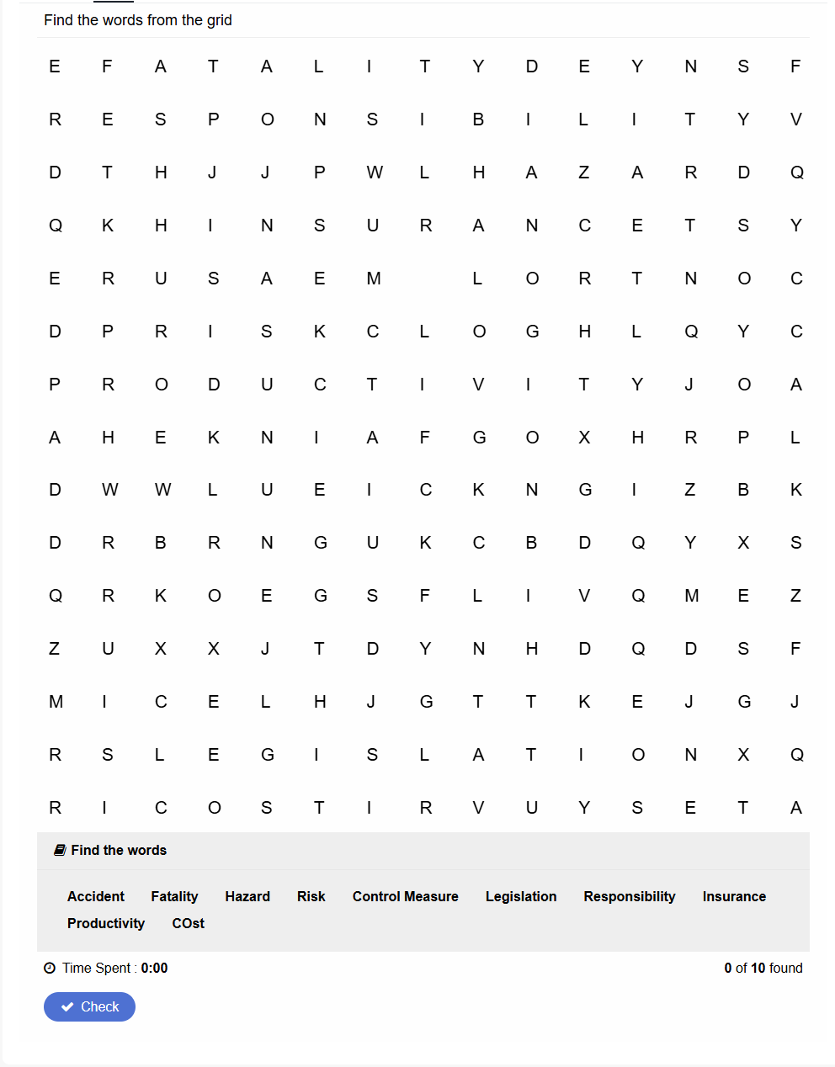
H5P - Wordsearch.
101.1 – Wordsearch.
Lecturer: James Rix

Slide 18

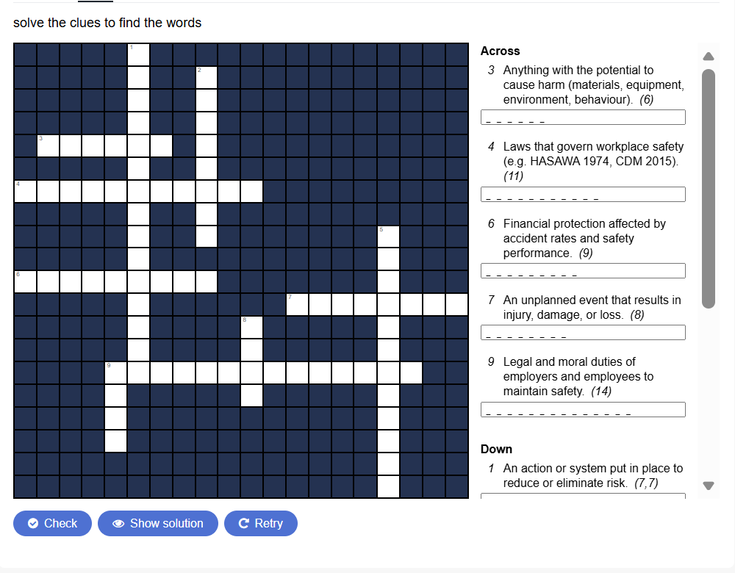
H5P - Crossword.
101.1 – Crossword.
Lecturer: James Rix

Slide 19

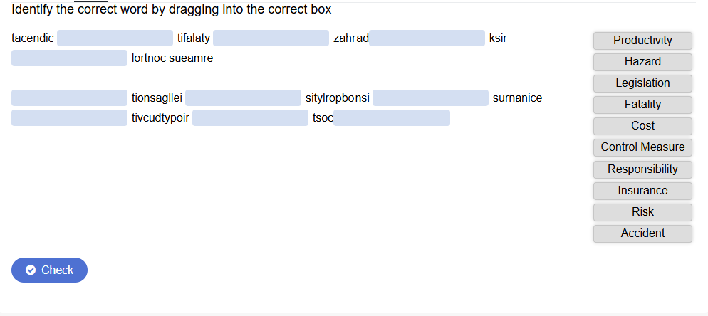
H5P – Word Scramble.
101.1 – Word Scramble.
Lecturer: James Rix

Slide 20

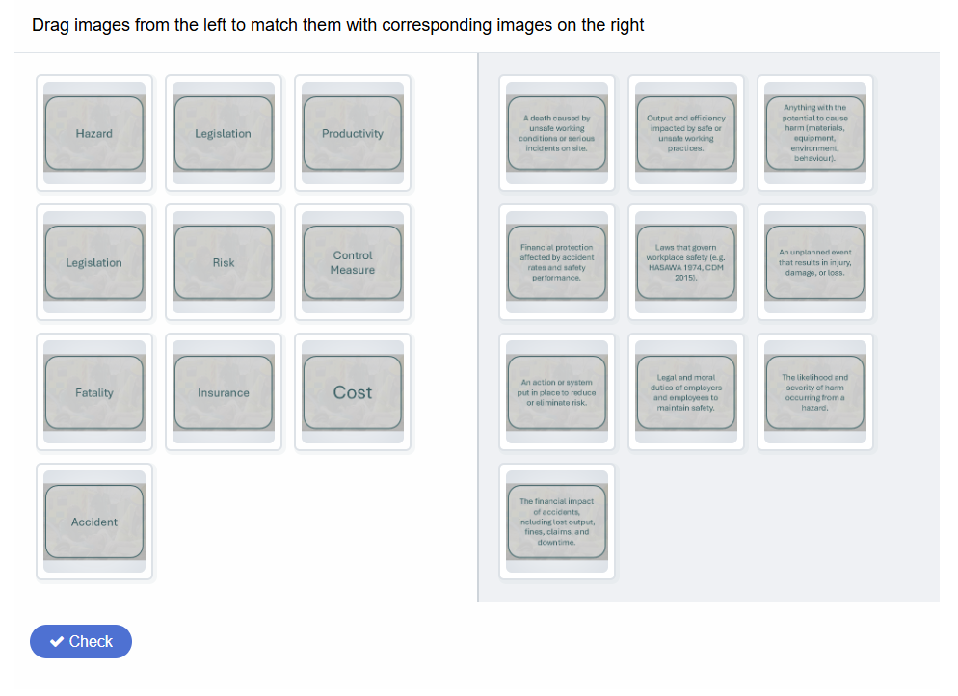
H5P – Word Match.
101.1 – Word Match.
Lecturer: James Rix

Slide 21
Evidence.
Student Name:
Student Number:
Date:
Place Evidence Here
Description

Slide 22
Evidence.
Student Name:
Student Number:
Date:

Slide 23

Thank You.
We would like to say thank you for using this learning material, we hope you found it useful.
If you have any questions regarding this or any other learning material, or have any suggestions about improvements or ideas please email James Rix at:
educon@gmail.com
Lecturer: James Rix

